Slide 1
Capacity Remuneration Mechanism
Detailed Info Session 28/02/2025

Slide 2
Disclaimer
This document constitutes a commercial presentation for the Belgian Capacity Remuneration Mechanism (CRM) and is to be considered as an educational document facilitating understanding of all other CRM documents that together form the official legal and operational framework. As an introduction to the CRM, the commercial presentation sets out the wide range of principles governing the mechanism as a whole, focusing on the outlook for the operational rollout for the CRM 2025 and further, based on the current regulatory framework and purposely simplifying some items to facilitate understanding. Elia refers any readers wishing to gain a complete understanding to all relevant legal and explanatory references:
The Law and its implementing Royal Decrees https://economie.fgov.be/nl/themas/energie/bevoorradingszekerheid/capaciteitsremuneratiemechanis | The Functioning Rules, as approved by the CREG on 13/09 2024 https://www.elia.be/-/media/project/elia/elia-site/users-group/ug/wg-adequacy/2024/ 20240913/20240913_crm_functioningrules_en_amended.pdf | The Capacity Contract, as approved by the CREG on 21/08/2024 https://www.elia.be/-/media/project/elia/elia-site/public-consultations/2024/20240402_crm-capacity-contrac-for-public-consultation_version_clean_en.pdf
This commercial presentation is based on the current understanding and state of play, which may evolve as certain regulatory (Functioning Rules, Capacity Contract) and legal (Royal Decree, Law) documents still need to be formally approved and/or adopted or might evolve over time. This document has no legal value and if it is in any way inconsistent with existing legal or regulatory documents, then the latter shall prevail. The main objective of this document is to highlight the customer’s obligations and opportunities within the Capacity Remuneration Mechanism.
All illustrative cases are fictive and are meant as relatable examples. Any similarities with real market parties are coincidental and unintended.

Slide 3
Disclaimer
Disclaimer: This presentation is built upon the proposal for the CRM FR V5 that was submitted by Elia to the CREG on February 1st. In meantime the CREG has published its decision on the CRM FR V5 including a set of material changes from Elia’s proposal. These changes are not yet incorporated in this presentation.
This presentation represents the current design of the Belgian Capacity Remuneration Mechanism. At this time, the State Aid Decision of the EC (SA114003) is being transposed into the Belgian regulatory framework (Electricity Law, Royal Decrees governing the CRM). At the time of this presentation these changes have not entered into force, but are expected to do so in the coming months.
This presentation is built upon the proposal for the CRM FR submitted by Elia to the CREG on February 1st. In meantime the CREG has launched a public consultation on a set of changes. Where relevant Elia will highlight these during the presentation.
This presentation has been prepared targeting Belgian Market Actors and does not dive into the specificities for the Cross-Border participation to the Belgian CRM. A dedicated session is planned for foreign Market Actors to elaborate on the Cross-Border specificities.

Slide 4
Where can I find more information?
Elia has a dedicated webpage containing relevant information for CRM participation: Capacity Remuneration Mechanism
CRM Product sheet
CRM Design notes
CRM Functioning Rules

Slide 5
The ‘simplified’ CRM lingo
TERM |  | EXPLANATION
CMU |  | Capacity Market Unit, A Capacity (« Individual CMU ») or several associated Capacities (« Aggregated CMU»).
Payback Obligation |  | The obligation to pay back an amount to Elia is the reference price exceeds the strike price (i.e. the reliability option).
Availability Monitoring |  | The process under which Elia confirms the contracted capacity is delivering its obligation.
NRP |  | The maximal nominal power that a capacity can provide to the system at any given moment, as declared by the CRM Candidate or as determined by ELIA or by the DSO the Prequalification Process.
Remaining Maximum Capacity |  | The part of the NRP of a CMU that remains after taking into account the declaration of Unavailable Capacity from the Capacity Provider
Daily Schedule CMU |  | A CMU that is also a Scheduling Agent. Its scheduling data is used for the Availability Monitoring process. >< Non-daily Schedule CMU.
Energy Constrained CMU |  | A CMU that can only delivery energy (or reduce its consumption) for a limited period of time per day, as per its prequalification. >< Non-energy Constrained CMU.
Secondary Market |  | The possibility for Capacity Providers to trade CRM Obligations.

Slide 6
Today’s Detailed Session
Purpose of Today’s session
Right to remuneration Availability Obligation
Availability monitoring
Availability Testing
Unavailability Penalties
Payback Obligation
Secondary Market Final notes

Slide 7
Purpose of Today’s session
Right to remuneration Availability Obligation
Availability monitoring
Availability Testing
Unavailability Penalties
Payback Obligation
Secondary Market Final notes

Slide 8
The purpose of Today’s session is to provide energy market players with the knowledge required to prepare their participation to the CRM
Today’s session is
In-depth, the session is focused on more complex subject matter and will go into all details and minutiae needed to prepare your participation.
Non-exhaustive, not all intricacies of the CRM will be covered, as the session will only focus on rights, obligations and risk management for CRM participants
Applied, the session will not only cover theory, but will provide example cases.

Slide 9
In-depth: This session aims at giving a complete understanding of the rights and obligations
This session is structured as follows:
Right to remuneration – glance on the settlement process
Availability Obligation – how does Elia determine your availability?
Payback Obligation – when and to who does the payback obligation apply?
Secondary Market – what volume can be traded and how?
Rights
Obligations
Remuneration
Availability Obligation
2
1
Payback Obligation
3
Secondary Market
4

Slide 10
Rights
Right to remuneration

Slide 11
Rights – Right to remuneration
Signing a CRM contract gives the Capacity Provider the right to a remuneration
Rights
Obligations
Remuneration
Availability Obligation
Payback Obligation
Secondary Market

Slide 12
The remuneration is determined in the Auction Process
The Auction applies a Pay-As-Bid principle: selected CMUs are rewarded their own bid price
The Bid Price determines the right to remuneration
The total remuneration is then determined as:
$$Remuneration \left[y\right]=Bid Price \left[Eur/MW/y\right]∗Contracted Capacity \left[MW\right]$$
(!) The remuneration is not indexed between the Auction and the Delivery Period

Slide 13
Blocks for the settlement process during the delivery period
Settlement procedure during the delivery period covers 3 main parameters with each a separate process flow:
Monthly Remuneration (in function of Capacity Remuneration as set out in the Capacity Contract) :
At transaction level
Availability Monitoring
Settlement of Unavailability Penalties (covering availability monitoring & availability tests), subject to penalty limit (in line with Functioning Rules).
At CMU level
Payback Obligation
Settlement of the Payback Obligation, subject to Stop-Loss limit (in line with Functioning Rules).
At Transaction level

Slide 14
Overview of main blocks for the settlement process during the delivery period
Month M-1
Month M
Month M+1
Month M+2
M-5WD
M-2WD
Capacity Provider provides an ex-ante invoice to Elia:
Ex-ante invoice only includes transactions with a validation date no later than 5 Working Days prior to the first day of month M.
Elia issues a Delivery Report at the latest the 15/M+2, it contains:
Unavailability Penalties and the associated monthly penalty cap (if applicable).
Amount of the Payback Obligation.
Associated Stop-Loss amount.
The capacity provider will be asked to provide an invoice or credit note.
Contestation procedure applies to the penalty calculation and the Payback Obligation in the Delivery Report
Payment by Elia of the Capacity Remuneration at the latest the last day of Month M+1

Slide 15
Purpose of Today’s session
Right to remuneration
Availability Obligation
Availability monitoring
Availability Testing
Unavailability Penalties
Payback Obligation
Secondary Market Final notes

Slide 16
Obligations

Slide 17
Obligations – Availability Obligation
Signing a CRM contract also comes with two obligations:
The Availability Obligation
The Payback Obligation
Rights
Obligations
Remuneration
Availability Obligation
Payback Obligation
Secondary Market

Slide 18
Availability Obligation

Slide 19
Availability Obligation – structure
The availability obligation consists of two main elements
Availability Monitoring – To monitor whether the CMU is present in the market
Availability testing – To ensure that CMUs that were not observed can deliver too
Availability Obligation
Availability Monitoring
Availability Testing
1
AMT Moments
Selection for a Test
2
Available capacity
Available capacity
3
Obligated capacity
Obligated capacity
Missing capacity

Slide 20
AMT Moments
1

Slide 21
The price on the Belgian day-ahead market serves as the Availability Monitoring Trigger
Availability Monitoring
1. AMT Moments
To identify potential adequacy relevant situations, the CRM relies on the Belgian day-ahead market:
When the price on the day-ahead market exceeds the AMT Price, this leads to an Availability Monitoring Trigger
The Availability Monitoring Trigger Price (AMT Price) is determined ex-ante
An MTU during which the day-ahead price exceeds the AMT-Price is called an “AMT MTU”
A set of consecutive AMT MTUs is called an “AMT Moment”
Elia communicates on the occurrence of AMT Moments one day in advance on its website
Elia calculates the AMT-price for the Delivery Period by May 15th of the year where the Delivery Period starts.
Elia publishes the resulting AMT-price on its website

Slide 22
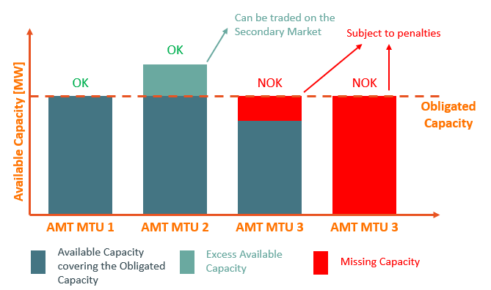
During AMT Moments Elia can monitor availability
Availability Monitoring
1. AMT Moments
It is during AMT Moments that Elia can (but does not have to!) monitor all Capacity Providers
Elia can monitor up to 30 AMT Moments per year
On average, Elia expects to monitor 15 AMT Moments per year
Whenever Elia performs Availability monitoring:
all CMUs are monitored
Available, Obligated and Missing Capacity are calculated for each individual AMT MTU
A Missing Capacity Penalty is applied if needed
Elia will report back to the Capacity Provider on the performance of their CMUs by means of the Monthly Delivery Activity Report (MDAR) in M+2

Slide 23
Available Capacity
2

Slide 24
During Availability Monitoring Available Capacity is calculated
Availability Monitoring
2. Available Capacity
The Belgian CRM remunerates availability of the CMU.
The CMUs of Capacity Providers are expected to be Available during AMT Moments
Available Capacity is capacity that participates in the energy market & that could activate in case its activation price is exceeded
In the CRM, a further distinction is made between:
Proven availability: Available Capacity that was observed to be present on the energy market(s)
Unproven availability: Available Capacity that was not observed to be present on the energy market(s)
Lastly, Capacity providers are obliged to notify Elia of any unavailability of their CMU
Again, a further distinction is made between:
Announced Unavailable Capacity
Unannounced Unavailable Capacity

Slide 25
Available Capacity – overview
Availability Monitoring
2. Available Capacity
The figure below gives an overview of the most important concepts regarding Availability:
Unavailable
Capacity
A
Announced
The notification and determination of:
Unavailable Capacity
Available Capacity
Proven Availability
Depends on whether the CMU is Daily Schedule or not
Unannounced
Proven
C
Unproven
Nominal
Reference
Power
Available
Capacity
B

Slide 26
Notifying Elia of Unavailable Capacity
A

Slide 27
Notifying Unavailable Capacity – concepts
Availability Monitoring
2. Available Capacity
Whenever Capacity Providers are aware of any limitation of their capacity with respect to their NRP, they are obliged to notify Elia
Capacity Providers notify the “Remaining Maximum Capacity” (RMC) of their CMU
Elia calculates the Unavailable Capacity as follows:
$$P_{Unavailable}\left(CMU,t\right)=NRP\left(CMU,t\right)−P_{Max,Remaining}\left(CMU,t\right)$$
In its notification the capacity provider indicates whether the Unavailable Capacity is to be considered as either Announced or Unannounced:
“Announced” only possible until 11:00 D-1 before the start of the notification period
Limit of 75 calendar days, of which only 25 during winter, applies to Announced Unavailable Capacity
Announced/Unannounced Unavailable Capacity impacts a (potential) unavailability penalty (see later)

Slide 28
Notifying Unavailable Capacity – in practice
Availability Monitoring
2. Available Capacity
CMU with Daily Schedule
CMU without Daily Schedule
No manual notification
Automatic notification based on Availability Plan
Information mapped to RMC notification
Capacity Provider indicates in the CRM IT Interface whether automatically created notification is Announced/Unannounced
No Automatic notification
Manual notification in the CRM IT Interface
Notification contains:
Remaining Maximum Capacity
Start / end of limitation
Announced / Unannounced
Reason for unavailability
(!) CMUs without Daily Schedule that have signed an OPA-contract are allowed to use the process for CMUs with Daily Schedule if Elia is notified in time

Slide 29
Scheduled Maintenance
Availability Monitoring
2. Available Capacity
On top of notifying Elia of any Unavailable Capacity using an RMC notification, Capacity Providers have the option to also notify Elia of any “Scheduled Maintenance”
Scheduled Maintenance are unavailability that are known significantly ahead of time
No / very limited penalties applied during moments of scheduled maintenance
Limit: 20 calendar days, of which 0 during the winter period
CMU with Daily Schedule
CMU without Daily Schedule
Days with scheduled maintenance based on the Availability Plan
Manually select eligible days in CRM IT Interface
Deadline: notify days in calendar year Y before 31/12 Y-1
Manual notification of days with Scheduled maintenance
Manually select eligible days in CRM IT Interface
Deadline: 90 calendar days before start of scheduled maintenance

Slide 30
Available Capacity – CMUs with Daily schedule
B
C

Slide 31
Available Capacity – CMUs with Daily Schedule
Availability Monitoring
2. Available Capacity
For CMUs with a Daily Schedule the determination of the Available Capacity is straightforward:
Available Capacity is equal to Maximum Available Capacity contained in the Availability Plan of the CMU
In turn, the share of the Available Capacity which is considered as Proven Availability is calculated as:
$$P_{Available, proven}\left(CMU,t\right)=MIN\left(P_{Available}\left(CMU,t\right); P_{Schedule}\left(CMU,t\right)+V_{correction}\left(CMU,t\right)\right)$$
Topic part of CREG PC
Unproven Availability
Capacity which was not observed to present in the market.
Consistently high amounts of Unproven Availability is one of the potential triggers for an Availability Test (see later)
Correction Ancillary
Services (AS)
Available
Capacity
(Availability Plan)
Proven Availability
Schedule

Slide 32
Available Capacity – CMUs without Daily schedule
B
B
C

Slide 33
Available Capacity – CMUs without Daily Schedule
Availability Monitoring
2. Available Capacity
For CMUs without a Daily Schedule, no existing source is readily available to retrieve information regarding their availability.
Instead, Elia relies on a combination of different sources to determine the Available Capacity:
Information gathered
Calculation of building blocks
Determination of available capacity
Data sources
RMC notification
Declared Price
Measured Power
Building blocks
Required Volume
Active Volume
Result
Available Capacity
Proven Availability
1
2

Slide 34
Declared prices & Required Volume
Availability Monitoring
2. Available Capacity
1
CMUs without Daily Schedule can submit Declared Prices and Associated Volumes to Elia.
The Declared Price is the activation price of the unit in a specific market
The volume associated to the Declared Price is the volume which should be activated in case the declared price is exceeded
Capacity Providers can declare a Day-ahead, Intra-day and Imbalance activation price
The Declared Prices can vary throughout time, to reflect fluctuating activation costs
Capacity providers are expected to react according to their declared prices, consistent deviations can trigger a test
CMUs must at least declare a single declared price and associated volume for the Day-ahead market before the start of the Delivery Period.
€/MWh
Declared Price | Associated Volume
70 | 5
100 | 10
140 | 15
140
100
70
5
10
15
MW

Slide 35
Declared prices & Required Volume
Availability Monitoring
2. Available Capacity
1
Based on the declared prices, Elia determines the Required volume.
The Required Volume is the total volume expected to be delivered in the market when (one of) the Declared Prices is exceeded in the market.
This is evaluated for all markets for which Declared Prices have been submitted
The maximum volume retained in any of these markets is the Required Volume
For example, consider the following declared prices for the day-ahead market:
€/MWh
partial Declared Price | Associated Volume
70 | 5
100 | 10
140 | 15
140
120
100
70
5
10
15
MW
Required Volume

Slide 36
Example – Required Volume in case of multiple price references
DSM
NRP: 5MW
The highest Associated Volumes for which the Declared Price was surpassed on the different markets:
For the same MTU, the maximum is taken between the three references
Each maximum is the Required Volume for that MTU
 | BAL | INT | DA
…
14:00 | 2 | 3 | 3
14:15 | 4 | 3 | 5
14:30 | 1 | 2 | 0
14:45 | 2 | 1 | 3
…
 | BAL | INT | DA
…
14:00 | 2 | 3 | 3
14:15 | 4 | 3 | 5
14:30 | 1 | 2 | 0
14:45 | 2 | 1 | 3
…
 | BAL | INT | DA | Required Volume
…
14:00 | 2 | 3 | 3 | 3
14:15 | 4 | 3 | 5 | 5
14:30 | 1 | 2 | 0 | 2
14:45 | 2 | 1 | 3 | 3
…

Slide 37
Measured Power & Active Volume
Availability Monitoring
2. Available Capacity
1
In parallel to the volume that is expected to be active in the market (i.e., the Required Volume), Elia also calculates the volume of the CMU that was observed as active in the market: the Active Volume
The active Volume consists of two elements: the initial Active Volume, and the Correction Volume
A correction for the participation to Ancillary Services is applied (see later)
Correction AS
Active Volume
Initial Active Volume
For Demand Side Management (DSM):
$V_{Act,initial}=P_{Baseline}−P_{Measured}$
For all other technologies:
$$V_{Act,initial}=P_{Measured}$$

Slide 38
Available Capacity – CMUs without Daily Schedule
Availability Monitoring
2. Available Capacity
Based on the Required Volume and the Active Volume, the Available volume of CMUs without Daily Schedule is calculated as follows:
$$P_{Available}\left(CMU,t\right)=MIN\left({NRP\left(CMU,t\right)−V_{req}\left(CMU,t\right)+V}_{act}\left(CMU,t\right);P_{max,remaining}(CMU,t)\right)$$
Topic part of CREG PC
The Proven Availability is calculated as the Active Volume of the CMU:
$$P_{Available, proven}\left(CMU,t\right)=MIN\left(P_{max,remaining}\left(CMU,t\right); V_{Act}\left(CMU,t\right)\right)$$
Both the Available Capacity and the Proven Availability are capped by the Remaining Maximum Capacity, as these values can naturally not exceed this.
Required
Volume
Active Volume
=
Proven
Availability
Nominal
Reference
Power
Available
Capacity

Slide 39
Note – AS corrections

Slide 40
Corrections for the participation to Ancillary Services
Availability Monitoring
2. Available Capacity
Elia foresees a correction for the participation to both Balancing and Redispatching products:
aFRR/mFRR
Redispatching
$$V_{Correction }=Max\left\{0; V_{Reservation,UP}−V_{activation,UP} \right\}+ V_{Activation,DOWN}$$
$$V_{Correction }= V_{RD,DOWN}$$
Contracted but not activated
= correction volume
Only Redispatching activations in the downward direction are accounted for, as these lower the measured power of the CMU
Reserved +
not activated
FCR
Reserved +
activated
Measured power
=
Initial activated volume
$$V_{Correction }= V_{FCR}$$
Not reserved +
activated
Given that FCR is a symmetrical product, the CRM assumes a worst-case full downward activation, and therefore corrects for the entire contracted FCR volume

Slide 41
Note – Baseline methodology

Slide 42
Baseline methodology
Availability Monitoring
2. Available Capacity
Demand Side Management (DSM) Delivery Points, require the calculation of a baseline to determine the active volume.
There are currently two baseline methodologies foreseen in the CRM:
High X of Y Baseline
Baseline method based on historical consumption
Baseline value at MTU t is equal to average consumption on MTU t over previous similar days
Baseline declaration
The Capacity Provider himself submits a baseline value for his Delivery Points
If the baseline is accurate with respect to actual consumption (outside of activations) it is applied

Slide 43
Obligated Capacity
3

Slide 44
During AMT Moments Obligated Capacity is calculated
Availability Monitoring
3. Obligated Capacity
As mentioned before: the CRM remunerates Availability.
The amount of Available Capacity that needs to be delivered is called the Obligated Capacity:
Obligated Capacity is the minimum amount of Available Capacity a CMU must deliver to ensure its contracted obligations
In case the CMU is not able to provide available capacity equal to or greater than its obligation this can lead to Missing Capacity.
The calculation of Obligated Capacity depends on the type of CMU:
Non-energy constrained CMUs – based on derated capacity
Energy Constrained CMUs – based on non-derated capacity

Slide 45
Obligated Capacity for Non-energy Constrained CMUs
A

Slide 46
Obligated Capacity for Non-energy Constrained CMUs
Availability Monitoring
3. Obligated Capacity
The calculation of the Obligated Capacity for Non-energy Constrained CMUs is straightforward:
Obligated Capacity is equal to the Total Contracted Capacity of the CMU:
$$P_{Obligated}\left(CMU,t\right)=Total Contracted Capacity\left(CMU,t\right)$$
(!) On MTUs where the Capacity Provider declared Scheduled Maintenance, the Obligated Capacity is further reduced with the amount of Unavailable Capacity
Enables to the CMU to avoid penalties at times when the unit is under maintenance.
This leads to the following complete formula:
$$P_{Obligated}\left(CMU,t\right)=Total Contracted Capacity\left(CMU,t\right)−P_{Announced,Unavailable, Maintenance}\left(CMU,t\right)∙Derating Factor(CMU, t)$$

Slide 47
Obligated Capacity for Energy Constrained CMUs
B

Slide 48
Obligated Capacity for Energy Constrained CMUs – ex-ante transactions
Availability Monitoring
3. Obligated Capacity
For Energy Constrained CMUs, the Obligated Capacity following ex-ante transactions is determined as follows:
Obligated Capacity is equal to the non-derated ex-ante Total Contracted Capacity of the CMU:
$$P_{Obligated}\left(CMU,t\right)=\frac{Total Contracted {Capacity}_{ex−ante}\left(CMU,t\right)}{Derating Factor(CMU,t)}$$
Several attention points are important for the determination of the obligated capacity:
The Obligated Capacity is only imposed during a limited set of MTUs.

Slide 49
The Obligated Capacity related to ex-ante transactions is only imposed on a limited set of MTUs
Availability Monitoring
3. Obligated Capacity
Energy Constrained CMUs are only required to deliver their Obligated Capacity on a limited set of MTUs
The amount of MTUs depends on the SLA-level chosen for the CMU
The MTUs during which the Obligated Capacity is required are called SLA-MTUs
Outside of SLA MTUs the Obligated Capacity is equal to zero
Example: Obligated Capacity for an Energy Constrained CMU with an SLA-level of 3
Obligated Capacity to be delivered during SLA MTUs: Contracted Capacity/Derating Factor
Obligated Capacity zero outside of SLA MTUs
AMT Moment
MTU 1
MTU 2
MTU 3
MTU 4
MTU 5
SLA MTUs
(!) Note – Energy Constrained CMUs are only expected to activate once per day, even if there would be more than one AMT moment occurring on the same day

Slide 50
Note - Selection of SLA MTUs
Availability Monitoring
3. Obligated Capacity
Determination of activation depends on type of CMU:
Daily Schedule CMU: Daily Schedule
Non-daily Schedule CMU: Required Volume
In case no activation took place, all AMT MTUs are retained
Set of AMT MTUs with highest measured power
All AMT MTUs occurring on a day
AMT MTUs where the unit actually activated

Slide 51
Obligated Capacity for Energy Constrained CMUs – ex-post transactions
Availability Monitoring
3. Obligated Capacity
For obligations acquired on the Secondary Market in an ex-post transaction, the obligated capacity related to this contract is simply the contracted capacity (not divided by the derating factor):
Obligated Capacity is equal to the ex-post Total Contracted Capacity of the CMU:
$P_{Obligated}\left(CMU,t\right)=$ $Total Contracted {Capacity}_{ex−post}\left(CMU,t\right)$
Example: Obligated Capacity for an Energy Constrained CMU with an SLA-level of 3
Obligated Capacity based on ex-post transactions
Obligated Capacity to be delivered during SLA MTUs
Obligated Capacity zero outside of SLA MTUs
AMT Moment
MTU 1
MTU 2
MTU 3
MTU 4
MTU 5
SLA MTUs

Slide 52
Obligated Capacity for Energy Constrained CMUs – combined formula
Availability Monitoring
3. Obligated Capacity
Combining the formulas for both ex-ante and ex-post transactions yields the following resulting Obligated Capacity formula for Energy Constrained CMUs:
$$P_{Obligated}\left(CMU,t\right)=\frac{Total Contracted {Capacity}_{ex−ante}\left(CMU,t\right)}{Derating Factor(CMU,t)}+Total Contracted {Capacity}_{ex−post}\left(CMU,t\right)−P_{Announced,Unavailable, Maintenance}\left(CMU,t\right)∙Derating Factor(CMU, t)$$
(!) Simillar to non-energy constrained CMUs, on MTUs where the Capacity Provider declared Scheduled Maintenance, the Obligated Capacity is further reduced with the amount of Unavailable Capacity

Slide 53
Availability Obligation – structure
The availability obligation consists of two main elements
Availability Monitoring – To monitor whether the CMU contributes to adequacy
Availability testing – To ensure that CMUs that were not observed can deliver too
Availability Obligation
Availability Monitoring
Availability Testing
AMT Moments
Test Moments
1
Available capacity
Available capacity
2
Obligated capacity
Obligated capacity
3
Missing capacity

Slide 54
Test Moments
1

Slide 55
Availability Monitoring alone is not enough
Availability Testing
1. Test Moments
The distinction between Proven and Unproven Availability allows CMUs to be considered as available when their variable costs are not covered
Hypothetically, a Non-daily Schedule CMU could consistently declare very high prices
This results in a Required Volume = 0
The CMU then always has an Available Capacity equal to its NRP, but all of this is Unproven Availability
The Capacity Provider would then receive remuneration without ever proving that he is really available
Need for a complimentary mechanism

Slide 56
Availability Testing is used when Availability cannot be directly monitored
Availability Testing
1. Test Moments
Objective of Availability Tests:
Complementary to Availability Monitoring
For “Unproven” capacity
Capability to react to surprise signal in day-ahead
Principles for selection:
Low Proven Availability in monitoring
Previously failed Availability Tests
Missing Capacity in monitoring
Poor correlation between (Partial) Declared Prices and measured output in the delivery Point
Avoid days with particularly low risk on adequacy
From Availability Obligation introduction:
“Section 9.5 describes the Availability Tests, as a complementary tool to the Availability Monitoring to verify whether the Capacity Provider has committed to the obligation.”
Availability testing is not meant to be “on top of” monitoring, but rather as a last resort.
The final selection procedure for testing moments is designed to accurately measure availability, but is not disclosed publically to ensure market parties cannot specifically prepare for them

Slide 57
Available Capacity Obligated Capacity
2
3

Slide 58
Principles of Availability Testing
Availability Testing
2. Obligated Capacity
3. Available Capacity
A Capacity Provider is notified on day D-1 between 09:00 and 09:30 that he will be tested
The notification includes the start and end time of the Availability Test
The duration of the Testis either one quarter hour, or the full SLA in case a previous Test failed
On day D, the Capacity Provider must provide Available Capacity equal to at least its Obligated Capacity during the Test moment
The Available Capacity is based on the Measured Power
Not based on nominations or Unproven Availability: Elia wants solid proof
Is still adapted for Ancillary Services and Redispatching
The Obligated Capacity is equal to
$$MIN(NRP\left(CMU,t\right)−P_{Unavailable,Announced}\left(CMU,t\right);\frac{Total Contracted Capacity(CMU,t)}{Derating Factor(CMU,t)}$$
Topic part of CREG PC

Slide 59
Missing Capacity

Slide 60
Availability Obligation – structure
The availability obligation consists of two main elements
Availability Monitoring – To monitor whether the CMU contributes to adequacy
Availability testing – To ensure that CMUs that were not observed can deliver too
Availability Obligation
Availability Monitoring
Availability Testing
AMT Moments
Test Moments
Available capacity
Available capacity
Obligated capacity
Obligated capacity
Missing capacity

Slide 61
When a CMU fails to cover its Obligated Capacity, Missing Capacity is detected
Availability Testing
Missing Capacity
Missing Capacity can be determined in two ways:
Not enough Available Capacity to cover the Obligated Capacity: $Max(P_{obligated}−P_{Available};0)$
Not enough Proven Availability to cover the ex-post Contracted Capacity: $Max({Contracted Capacity}_{ex−post}−P_{Proven};0)$
This is combined in the general formula for Missing Capacity:
$$Missing Capacity=Max(P_{Obligated}−P_{Available};{Contracted Capacity}_{ex−post}−P_{proven};0)$$
1
2
1
2

Slide 62
Missing Capacity practical examples
Availability Testing
Missing Capacity
1
Obligated Capacity
Available Capacity
Obligated Capacity is not covered by Available Capacity; Ex-post Contracted Capacity is covered by Proven Availability
The difference between $P_{Obligated}$ and $P_{Available}$ sets the Missing Capacity
Ex-post Contracted Capacity
Proven Availability
Ex-post Contracted Capacity
Proven Availability
Obligated Capacity is covered by Available Capacity; Ex-post Contracted Capacity is not covered by Proven Availability
The difference between ${CC}_{ex−post}$ and $P_{Proven}$ sets the Missing Capacity
2
Obligated Capacity
Available Capacity
Ex-post Contracted Capacity
Proven Availability
Both the Obligated Capacity and the Ex-post Contracted Capacity are not covered by either Available Capacity or Proven Availability
The maximum between the two sets the Missing Capacity
3
Obligated Capacity
Available Capacity
Both the Obligated Capacity and the Ex-post Contracted Capacity are covered
No Missing Capacity ☺
4
Obligated Capacity
Available Capacity
Ex-post Contracted Capacity
Proven Availability

Slide 63
Elements of the Unavailability Penalty
Availability Testing
Missing Capacity
Unannounced Missing Capacity & Announced Missing Capacity
Penalty Factor $X$
Weighted contract value

Slide 64
The Missing Capacity can either be Announced or Unannounced
Availability Testing
Missing Capacity
UMC & AMC
The classification takes place based on the notifications of Announced Unavailabilities
Announced Missing Capacity is penalized less severely; as such Capacity Providers have an incentive to accurately notify this
Announced Missing Capacity is the amount of Missing Capacity covered by the Announced Unavailabilities
$$AMC=Min\left(P_{Unavailable,Announced};MC\right)$$
Unannounced Missing Capacity is the remaining proportion of the Missing Capacity
$$UMC=max⁡(MC−AMC)$$
Missing Capacity during Scheduled Maintenance is always considered as Unannounced

Slide 65
The Penalty Factor reflects the severity of the Missing Capacity
Availability Testing
Missing Capacity
Penalty Factor $X$
 | Winter Period 01/11/20xx – 31/03/20xx | Summer Period 01/04/20xx – 31/10/20xx
Announced Missing Capacity | 0,9 | 0
Unannounced Missing Capacity | 1,4 | 0,5

Slide 66
A CMU’s Unavailability Penalty varies in function of its remuneration
Availability Testing
Missing Capacity
Weighted Contract Value
A CMU’s penalty depends on its remuneration. But what happens when a CMU has multiple contracts with different remunerations?
We calculate the volume-weighted average of all contracts:
$$\frac{\sum_{N}{({Capacity Remuneration}_{i}∗{Contracted Capacity}_{i})}}{\sum_{N}{{Contracted Capacity}_{i}}}$$
Where:
$N$ is the number of transactions (Primary or Secondary) with a Transaction Period covering the moment for which the penalty is calculated
${Capacity Remuneration}_{i}$ is the Capacity Remuneration from the Contract for Transaction $i$
${Contracted Capacity}_{i}$ is the Contracted Capacity from the Contract for Transaction $i$

Slide 67
Availability Testing
Missing Capacity
Weighted Contract Value
Weighted contract value
Practical example
A CMU has 2 contracts that cover an MTU $t$ for which a penalty is calculated
Transaction 1: 100 MW @ 30 000 €/MW/y
Transaction 2: 10 MW @ 10 000 €/MW/y
Weighted contract value is calculated as
$$\frac{\left(100 ∗30 000\right)+(10∗10 000)}{(100+10)}=28 180$$

Slide 68
The Unavailability Penalty formula
Availability Testing
Missing Capacity
Topic part of CREG PC
3
$$\frac{1}{Q∗UP}[\sum_{t∈T}{\left(1+X\right)∗{weighted contract value}_{t}∗{UMC}_{t}+\sum_{t=1}^{T}{\left(1+X\right)∗{weighted contract value}_{t}}∗{AMC}_{t}}]$$
$Q$ is the amount of MTUs of the AMT Moment for which a penalty is calculated
$UP$ is a fixed value, always equal to 15
$T$ is the set of MTUs of the AMT Moment for which a penalty is calculated
1
2
1
2
3

Slide 69
Availability Testing
Missing Capacity
Example – Unavailability Penalty
Practical example 1
Weighted contract value = 28 180 €/MW
AMT Moment took place during winter
AMT Moment spanning 2 MTUs with the following Missing Capacities:
Unavailability Penalty is calculated as
$$\frac{1}{2∗15}\left[\left(1+0,9\right)∗28 180∗20+\left(1+0,9\right)∗28 180∗30+0+0\right]$$
$$=74 037 €$$
 | MTU 1 | MTU 2
AMC | 20 | 30
UMC | 0 | 0

Slide 70
Availability Testing
Missing Capacity
Example – Unavailability Penalty
Practical example 2
Weighted contract value = 28 180 €/MW
AMT Moment took place during summer
AMT Moment spanning 3 MTUs with the following Missing Capacities:
Unavailability Penalty is calculated as
$$\frac{1}{3∗15}\left[\left(1+0\right)∗28 180∗20+0+0+0+0+\left(1+0,5\right)∗28 180∗50\right]$$
$$=46 157 €$$
 | MTU 1 | MTU 2 | MTU 3
AMC | 20 | 0 | 0
UMC | 0 | 0 | 50

Slide 71
Penalty Cap
Availability Testing
Missing Capacity
Yearly cap:
The total amount of applied Unavailability Penalties over one Delivery Year cannot exceed the total amount of Capacity remuneration received by the CMU over the entire Delivery Year
Monthly cap:
The total amount of applied Unavailability Penalties over one month cannot exceed 20% of the total amount of Capacity Remuneration received by the CMU over the entire Delivery Year
This only applies to Transactions on the Primary Market, or a Secondary Market Transaction covering the entire Delivery Period
The caps are calculated for each CMU at the start of the Delivery Period

Slide 72
Notification of the Unavailability Penalties
Availability Testing
Missing Capacity
The Capacity Provider receives a monthly activity report that includes information on the CMU’s performance during AMT Moments and Availability Tests
AMT Moments and/or Availability Tests take place during a certain month $M$
The measuring data is validated, which can take until the end of month $M+1$
The Activity report is sent on the 15th of month $M+2$

Slide 73
Escalation procedure
Availability Testing
Missing Capacity
In case of repeated determinations of Missing Capacity, the CMU will incur a downwards revision of its Monthly Remuneration
This happens when Missing Capacity has been determined on three separate occasions throughout the same Delivery Period
The Missing Capacity must exceed 20% of the Obligated Capacity
For practical reasons, the CMU will continue receiving its original remuneration at the end of the month. The Downwards Revision is added as an extra penalty in the monthly report
Despite its lower remuneration, the CMU is still subject to the same Availability Obligation (i.e. Obligated Capacity does not change)
The downwards revision is equal to the maximum ratio of the three concerned Missing Capacities and the Obligated Capacities
The Capacity Provider can reinstate the original Monthly Remuneration by successfully providing its Obligated Capacity on 3 consecutive occasions

Slide 74
Payback Obligation

Slide 75
Obligations – Payback Obligation
Signing a CRM contract also comes with two obligations:
The Availability Obligation
The Payback Obligation ← next
Rights
Obligations
Remuneration
Availability Obligation
Payback Obligation
Secondary Market

Slide 76
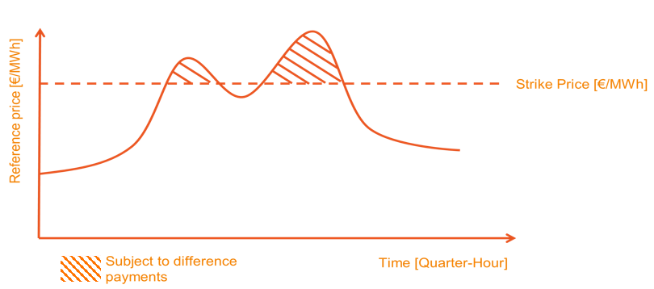
Payback Obligation
In a mechanism with a reliability option, the capacity provider receives a capacity remuneration but is obliged to payback money to society whenever the reference energy spot price (e.g. day-ahead price) exceeds a pre-defined strike price.
Such approach has two advantages for society:
Avoiding windfall profits: as the capacity provider already receives a capacity remuneration on top of its ‘normal’ energy market revenues (which should cover all its fixed costs), extreme energy prices would provide him with an extra, double remuneration. This would constitute a windfall profit.
Strengthening incentive to deliver on SoS-obligations: as capacity providers are obliged to payback when the energy price exceeds the strike price and those moments are strongly correlated with moment of (near-)scarcity, there is an extra incentive for capacity providers to be available for the system at such moments.

Slide 77
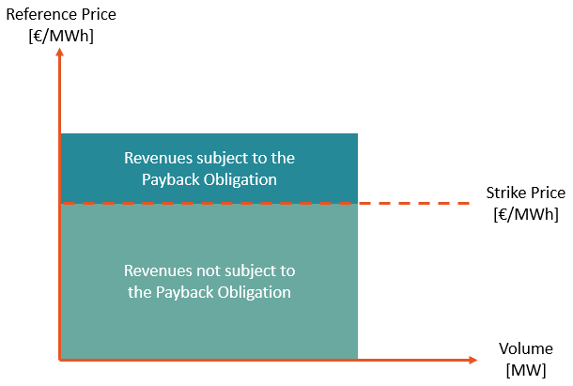
Elements of the Payback Obligation
In a simplified view, the total Payback is equal to
$$\max\left(\left(Reference Price −Strike Price\right);0\right)×Volume subject to Payback Obligation$$
1
We’ll have a look at each element of this formula:
The Reference Price
The Strike Price
The volume that is subject to the Payback Obligation
1
2
3
2
3

Slide 78
Reference Price
1

Slide 79
An accurate metric is needed that reflects a unit’s revenues
Payback Obligation
1. Reference Price
The Day-Ahead price is used for this purpose:
Relevant signal related to adequacy
Liquid and transparent market
Technology neutral
The Day-Ahead price faced by a unit depends on its choice of NEMO. In the CRM IT Interface, the Capacity Provider can select the NEMO he wishes to use

Slide 80
Strike Price
2

Slide 81
Characteristics of the Strike Price
Payback Obligation
2. Strike Price
The Strike Price represents the price threshold [€/MWh] above which revenues are deemed excessive
Based on historical Day-Ahead prices
Crucial Auction parameter: Capacity Providers need to know its value to be able to submit accurate bids
Long lead time between (e.g. Y-4) Auction and Delivery Period: prices might structurally change between calibration and delivery
The Strike Price is set by the Minister as an Auction parameter
An actualization process takes place, resulting in the Actualized Strike Price during the Delivery Period

Slide 82
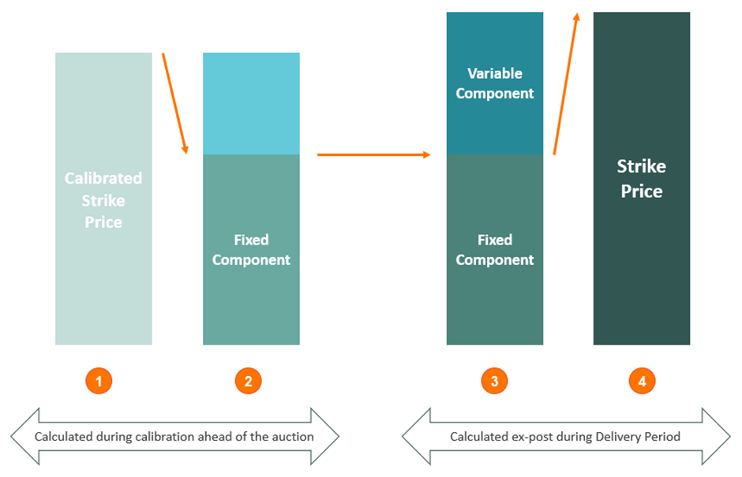
Actualization of the Strike Price
Payback Obligation
2. Strike Price
A monthly ex-post actualization of the strike price based on monthly DA prices (i.e. strike price of September is set by DA prices of September).
This actualization would apply from the first delivery year and to single & pluriannual contracts.
At the time of the auction
$$Fixed component=calibrated strike price − average DA prices for the calibration period$$
During delivery
$$Variable component=average DA prices for month m$$

Slide 83
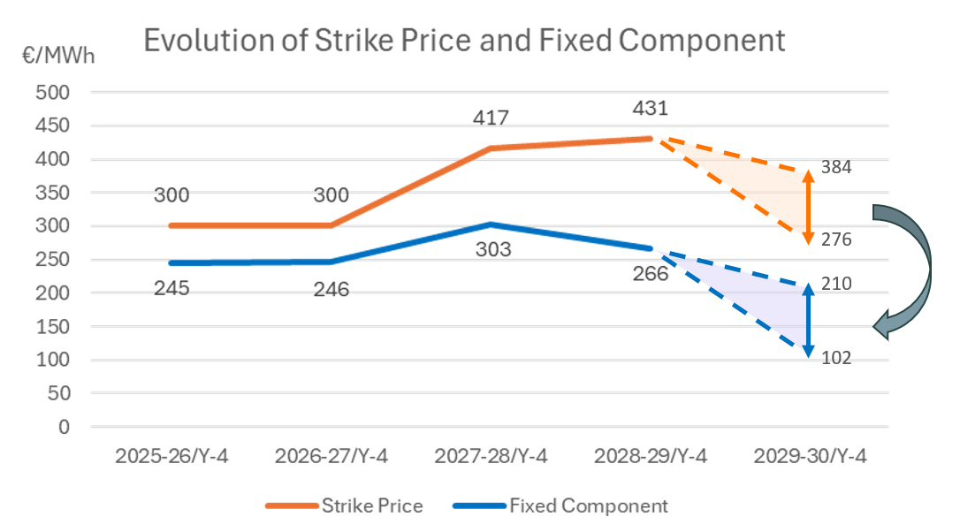
Evolution of Strike Price and fixed component
Payback Obligation
2. Strike Price
The fixed component should remain relatively stable throughout time
For the upcoming auctions it will be set by MD on 31/03 (within the range shown on slide)

Slide 84
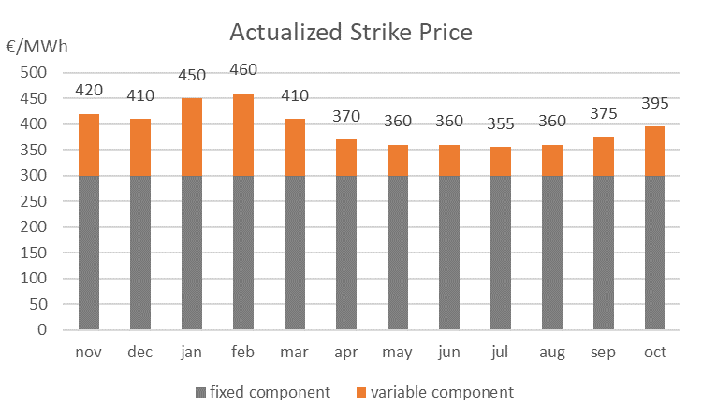
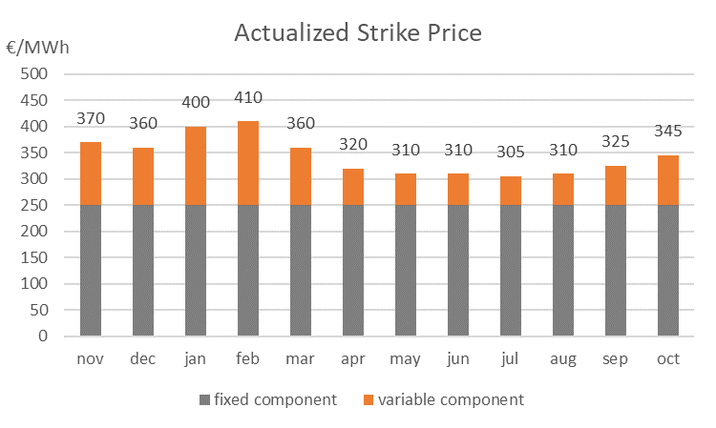
Example – Actualization of the Strike Price
Payback Obligation
2. Strike Price
A CMU has a Transaction with Strike Price 400 €/MWh
The resulting fixed component is equal to 300 €/MWh
The variable component varies throughout the year
The resulting Actualized Strike Price is as follows
The same CMU obtains a second Transaction, this time with a Strike Price of 390 €/MWh
The resulting fixed component is equal to 250 €/MWh
The variable component varies throughout the year
The resulting Actualized Strike Price is as follows

Slide 85
Practical considerations for the Strike Price
Payback Obligation
2. Strike Price
The variable component, and as such the Actualized Strike Price, is only know ex-post
In the monthly delivery activity report, the final value for that month’s Actualized Strike Price is included
For each Transaction separately, when its Actualized Strike Price is exceeded the Payback Obligation is applied based on the Contracted Capacity of that Transaction

Slide 86
Volume
3

Slide 87
The volume subject to the Payback Obligation depends on the Contracted Capacity
Payback Obligation
3. Volume
Similar to the (Actualized) Strike Price, it is evaluated for each Transaction separately
Both Transactions from the Primary and the Secondary Market are taken into account
In some cases, not all Contracted Capacity subject to the Payback Obligation:
Unavailable Capacity is taken into account via the Availability Ratio
Exemptions apply for DSM and storage capacity
Elia makes the distinction between
Non-energy Constrained CMUs
Energy Constrained CMUs: ex-ante Transactions
Energy Constrained CMUs: ex-post Transactions

Slide 88
Payback Exemption
Payback Obligation
3. Volume
The Volume subject to the PBO depends on the Primary Market transaction Date and the technology of the CMU
Primary Market Transaction year
Payback exemption
2021
Not Applicable
2022
Not Applicable
2023
Not Applicable
2024
DSM only
2025
Storage* & DSM
*Payback exemption for storage subject to update of legal framework-

Slide 89
The volume depends on the type of CMU
Payback Obligation
3. Volume
A. Non-Energy Constrained
For Non-energy Constrained CMUs, the Payback Obligation is based on the (derated) Contracted Capacity
This includes Contracted Capacity
Primary Transactions
Secondary Transactions, both ex-ante and ex-post
This is simply equal to the Contracted Capacity included in the Capacity Contract
$Volume subject to the Payback Obligation=Contracted Capacity$

Slide 90
Volume for an ex-ante Transaction of an Energy Constrained CMU
Payback Obligation
3. Volume
A. Energy Constrained ex-ante
Ex-ante Transactions include
Primary Transactions
Ex-ante Secondary Market Transactions
Remember from the Availability Obligation:
Energy Constrained CMUs are limited in the duration of their delivery by their Service Level Agreement (SLA)
This results in the SLA MTUs: a subset of MTUs that respects their constraints and demands only one activation per day
The SLA MTUs also come into play for the Payback Obligation
Considering their technological constraints, the Payback Obligation for ex-ante Transactions is only applied during the SLA MTUs
During these SLA MTUs, the volume subject to the Payback Obligation is the non-derated Contracted Capacity
$$Volume subject to the Payback Obligation=\frac{Contracted Capacity}{Derating Factor}$$
The Derating Factor used is the one included in the Capacity Contract for that Transaction

Slide 91
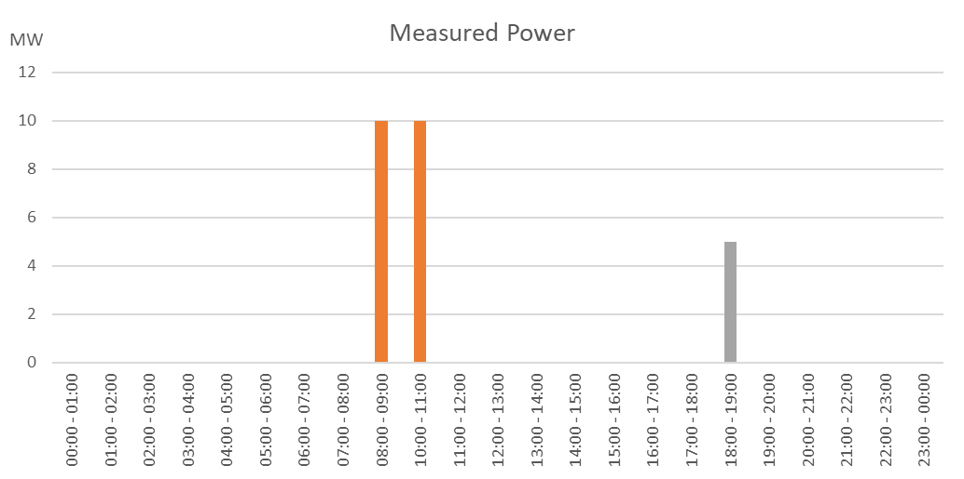
Example for an Energy Constrained ex-ante Transaction
Payback Obligation
3. Volume
A. Energy Constrained ex-ante
SLA MTUs
Non-SLA MTUs
Energy Constrained, SLA 2
NRP = 10 MW
One ex-ante Transaction with a Contracted Capacity = 3 MW
Derating Factor = 30%
Volume subject to the Payback Obligation during SLA MTUs = 10MW
Volume subject to the Payback Obligation outside SLA MTUs = 0 MW
During the SLA MTUs, the volume subject to the Payback Obligation is equal to 10 MW
Outside the SLA MTUs, the volume subject to the Payback Obligation is equal to 0 MW

Slide 92
Volume for an ex-post Transaction of an Energy Constrained CMU
Payback Obligation
3. Volume
A. Energy Constrained ex-post
Energy Constrained CMUs can engage in ex-post Secondary Market Transactions
These Obligations can occur on top of ex-ante Transactions
Not limited to SLA MTUs: for ex-post Secondary Market Transactions, the Payback Obligation is always applied
The Payback Obligation for ex-post Transactions is based on the (derated) Contracted Capacity:
$$Volume subject to the Payback Obligation=Contracted Capacity$$

Slide 93
Example for an Energy Constrained ex-post Transaction
Payback Obligation
3. Volume
A. Energy Constrained ex-post
SLA MTUs
Non-SLA MTUs
Energy Constrained, SLA 2
NRP = 10 MW
One ex-ante Transaction with a Contracted Capacity = 3 MW
Derating Factor = 30%
Ex-post Transaction between 18:00 and 19:00 with Contracted Capacity = 5 MW
For the Transaction Period of this Transaction, the Contracted Capacity is also subject to the Payback Obligation, regardless of SLA MTUs
During the SLA MTUs, the volume subject to the Payback Obligation is equal to 10 MW
Even though it’s not an SLA MTU, the Contracted Capacity is subject to the Payback: 5 MW

Slide 94
The Volume for the Payback Obligation is influenced by other factors
Payback Obligation
3. Volume
Not all capacity identified previously is always subject to the Payback Obligation
Elia identifies two adaptations:
Unavailable Capacity (e.g. forced outage) via the Availability Ratio
Payback exemption for DSM and storage

Slide 95
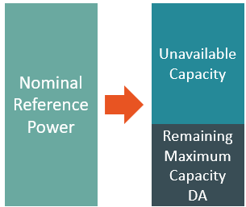
Availability Ratio
Payback Obligation
3. Volume
The Availability Ratio takes into account the amount of capacity that was not present due to e.g. forced outages or maintenance
This capacity was not capable to capture excessive profits in the first place, hence it is logical to remove them from the Payback Obligation
The identification of Unavailable Capacity is based on the Capacity Provider’s declaration of Remaining Maximum Capacity
To prevent gaming after the publication of the Day-Ahead prices, only notifications until 11:00 D-1 are taken into account
This results in the Remaining Maximum Capacity DA
Both Announced Unavailable Capacity and Unannounced Unavailable Capacity is taken into account

Slide 96
Availability Ratio
Payback Obligation
3. Volume
Based on the Remaining Maximum Capacity DA, a ratio can be established for every MTU $t$ that represents the fraction of capacity that was present:
$$\frac{Min\left(total volume subject to Payback Obligation;Remaining Maximum Capacity DA\right) }{total volume subject to Payback Obligation}$$
The total volume subject to the Payback Obligation is the sum over all the Transactions that the CMU has that cover the MTU $t$

Slide 97
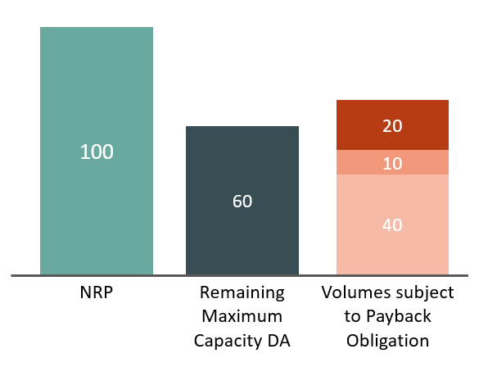
Example on the Availability Ratio
Payback Obligation
3. Volume
NRP = 100 MW
Unavailable Capacity = 40 MW
Remaining Maximum Capacity DA = 60 MW
3 Transactions covering the same MTU t, each with their own volume subject to the Payback Obligation
40 MW
10 MW
20 MW
Availability Ratio =
$$\frac{Min(70;60)}{70}=86\%$$

Slide 98
DSM and storage
Payback Obligation
3. Volume
DSM and storage capacities are no longer subject to the Payback Obligation
When a CMU consists solely of DSM and/or storage, the Payback Obligation is simply always equal to 0
An aggregated CMU can consist of some DSM and/or storage Delivery Points, and some thermal Delivery Points
In that case, the Payback Obligation is calculated pro-rata the DSM and/or storage capacity in the total NRP:
$$\frac{NRP\left(CMU,Transaction\right)−\sum_{i}{{DSM or storage NRP}_{i}(CMU,Transaction)}}{NRP(CMU,Transaction)}$$
$i$ represent the Delivery Points part of the CMU
For each Transaction, the NRP and DSM/storage volumes that were relevant at the time of contract signature are used. This prevents gaming by adding more DSM/storage Delivery Points after conclusion of the Transaction

Slide 99
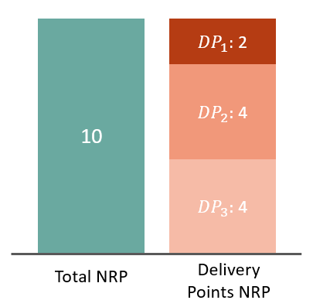
Example on DSM and storage
Payback Obligation
3. Volume
NRP = 10 MW
3 Delivery Points:
DP1 (battery): 2 MW
DP2 (DSM): 4 MW
DP3 (thermal):4 MW
Proportion of NRP that is not DSM or storage =
$$\frac{10−6}{10}=40\%$$

Slide 100
Complete Payback Obligation formula
Payback Obligation
Having identified all elements of the Payback Obligation, the complete formula can be established
$$Payback Obligation\left(CMU,Transaction,t\right)=$$
$$\left(Reference Price\left(CMU,t\right)−Actualized Strike Price\left(CMU,Transaction,t\right)\right)$$
$$×$$
$$Volume subject to the Payback Obligation\left(CMU,Transaction,t\right)$$
$$×$$
$$Availability Ratio\left(CMU,t\right)$$
$$×$$
$$\frac{NRP\left(CMU,Transaction\right)−\sum_{i}{{DSM or storage NRP}_{i}(CMU,Transaction)}}{NRP(CMU,Transaction)}$$
$$/4$$

Slide 101
The Payback Obligation is calculated for each Transaction separately
Payback Obligation
Transactions are characterized by their own parameters:
Contracted Capacity
Actualized Strike Price
DSM and storage NRP
Some other parameters are still calculated for the CMU as a whole
Reference Price
Availability Ratio

Slide 102
Stop-Loss
Payback Obligation
Hypothetically, in case of structural high prices that even the Actualization mechanism can’t cope with, a Capacity Provider could be faced with excessive amounts of Payback
The risk of excessive Payback could discourage Capacity Providers from participation in the Auction
The Stop-Loss mechanism establishes a cap equal to the total yearly Capacity Remuneration
From the moment this cap is reached, no more Payback Obligation is applied
The Stop-Loss is applied for every Transaction individually
This only applies to Transactions on the Primary Market, or a Secondary Market Transaction covering the entire Delivery Period

Slide 103
Payback Obligation and retro-activity
Payback Obligation
The Payback Obligation has undergone a couple of changes since the first CRM Auction in 2021
Some of these changes could have impacted the bid price of participants, and are as such not applicable retro-actively
Payback Exemption
Activation Ratio
Declared Market Price
Topic part of CREG PC

Slide 104
Retro-activity: Payback Exemption
Payback Obligation
The Payback Exemption applies differently for different technologies
DSM: contracts signed in 2024 or later
Storage: contracts signed in 2025 or later
For Aggregated CMUs that partly consist of DSM/storage:
The ratio only takes into account DSM for contracts signed in 2024
The ratio takes into account both DSM and storage from 2025 onwards

Slide 105
Retro-activity: Activation Ratio
Payback Obligation
Topic part of CREG PC
Remember from the Availability obligation for Non-daily Schedule CMUs: based on the Declared Prices, we establish a Required Volume that is expected to react based on the price signal
During Payback Events, this Required Volume might not be able to react with its full NRP
The Volume subject to the Payback Obligation is based on the full Contracted Capacity. But if not all this Contracted Capacity was in-the-money, this is taken into account via the Activation Ratio:
$$\frac{MIN\left(volume subject to the Payback Obligation;Required Volume\right)}{volume subject to the Payback Obligation}$$
Only applicable to contracts signed in the 2024 Auction

Slide 106
Retro-activity: Declared Market Price (DMP)
Payback Obligation
Topic part of CREG PC
The Declared Market Price allowed the participation of Non-daily Schedule CMUs in the CRM who had a variable cost that exceeds the Actualized Strike Price
This was particularly relevant for DSM units. Seeing as they are now exempted from the Payback Obligation, it has been removed
From the Auction of 2025 onwards, the DMP no longer applies

Slide 107
Retro-activity and Secondary Market Transactions
Payback Obligation
When selling/buying obligations on the Secondary Market, it is important to know which rules apply
The modalities that apply are determined by the Auction year of the original Transaction
Examples
When a Transaction originally concluded in 2024 is sold, the Payback Exemption applies if the Buyer is DSM
When a Transaction originally concluded in 2025 is sold, the Payback Exemption applies if the Buyer is DSM or storage
When a Transaction originally concluded in 2023 is sold, the Payback Exemption never applies

Slide 108
Retro-activity: overview
Payback Obligation
Topic part of CREG PC
Auction Year | Payback Exemption | Activation Ratio | Declared Market Price
2021 | No | No | Yes
2022 | No | No | Yes
2023 | No | No | Yes
2024 | DSM | Yes | Yes
2025 and onwards | DSM and storage | No | No

Slide 109
Purpose of Today’s session
Right to remuneration
Financial Security Obligation
Availability Obligation
Availability monitoring
Availability Testing
Unavailability Penalties
Payback Obligation
Secondary Market Final notes

Slide 110
Obligations – Payback Obligation
Signing a CRM contract also comes with two obligations:
The Availability Obligation
The Payback Obligation
Rights
Obligations
Remuneration
Availability Obligation
Payback Obligation
Secondary Market

Slide 111
Secondary market – content
In this detailed info session, the following four questions related to the secondary market will be answered:
What is the secondary market?
What volume is available on the secondary market?
How is a secondary market transaction processed?
What are the rights and obligations following a secondary market transaction?

Slide 112
What is the secondary market?

Slide 113
DELIVERY PERIOD
What is the Secondary Market & why does it exist?
Capacity Providers can trade capacity obligations on the Secondary Market. This allows CMUs to sell their excess capacity or to cover their capacity shortages.
The purpose of a Secondary Market is:
To allow Capacity Providers to be able to transfer their CMU Contracted Capacities and related obligations to another CMU in order to allow them to manage their risks better.
To contribute to enhance competition in the Primary Market (Auction) of all participating technologies ensuring SoS within the CRM.
To decrease the risk of the Auction bidders, and therefore decrease the overall CRM cost.
Contractual rights
The payment of the Capacity Remuneration
Obligations
Availability Obligation
Pre-delivery Control
Payback Obligation
Seller of an Obligation
Buyer of an Obligation

Slide 114
Secondary Market transactions – key parameters
A Secondary Market transaction has the following key parameters (non-exhaustive):
CMU of the seller
CMU of the buyer
Secondary Market Capacity
Transaction period start
Transaction period end
Type (see later):
Ex-ante when transaction date < period start
Ex-post when transaction date > period start
SM Transaction period
Time
Transaction notification
(ex-ante)
Transaction period start
Transaction notification
(ex-post)
Transaction
Period end

Slide 115
What volume is available on the secondary market?
As a seller / as a buyer

Slide 116
Volume available on the secondary market – sellers
The volume that can be sold (or bought) on the secondary market is called the “Secondary Market Capacity”
For the seller of a transaction, its calculation is straightforward:
A CMU cannot sell more than its contracted capacity:
$$Secondary market capacity ≤Contracted Capacity$$

Slide 117
Volume available on the secondary market – buyers
Topic part of CREG PC
The Secondary Market Capacity available to buyers on the secondary market is limited by the “Secondary Market Remaining Eligible Volume” or SMREV:
$$Secondary Market Capacity ≤SMREV$$
The following key-principle applies when calculating the SMREV:
Volumes which have already been considered towards adequacy cannot be used anymore on the Secondary Market
The following volumes are already considered towards adequacy:
Any contracted volume
Any Opt-out volume that is classified as IN
For energy-constrained CMUs the volume also depends on whether the transaction is ex-ante or ex-post
See following slides

Slide 118
Volume available on the secondary market – buyers
Topic part of CREG PC
Example: Non-energy constrained CMU for both ex-ante & ex-post transactions
Opt-Out (IN)
$Derating Factor$*
Secondary Market Remaining Eligible Volume (SMREV)
Derated Opt-Out (IN)
Not considered yet towards SoS
$$Derating Factor$$
Derated Opt-Out (IN)
Already considered towards SoS
Contracted Capacity
NRP
Reference power
(NRP – OptOut)
Bid Volume
* $The last pubilshed Derating Factor$

Slide 119
Volume available on the secondary market – buyers
Example: Energy constrained CMU for an ex-ante transaction
Opt-Out (IN)
Secondary Market Remaining Eligible Volume (SMREV)
$Derating Factor$*
Not considered yet towards SoS
Derated Opt-Out (IN)
Derated Opt-Out (IN)
$$Derating Factor$$
Contracted Capacity
Already considered towards SoS
Derating Factor
NRP
Reference power
(NRP – OptOut)
Bid Volume
* $The last pubilshed Derating Factor$

Slide 120
Volume available on the secondary market – buyers
Example: Energy constrained CMU for an ex-post transaction
Opt-Out (IN)
$Derating Factor$*
Derated Opt-Out (IN)
Not considered yet towards SoS
$$Derating Factor$$
Already considered towards SoS
Reference power
(NRP – OptOut)
During
SLA MTUs
=
Ex-ante
Outside
SLA MTUs
NRP
Bid Volume
* $The last pubilshed Derating Factor$

Slide 121
How is a secondary market transaction processed?

Slide 122
SM transaction process* – overview
The current process generally consists of two phases:
Approval
Signature
To process transactions in parallel, a batch is introduced between the approval and signature processes
Bilateral agreement between two parties
Process triggered by operator within 15 WD
Transaction notified by Party 1
Contains all approved transactions
Approval process
Signature process
1 WD (0 WD in practice)
5 WD
5 WD
Transaction Date logged
Potential market abuse reported
CREG reaction on potential market abuse
BATCH
5 WD
10 WD (no report)
Contract signature ELIA
Done
3 WD
2 WD
3 WD
Transaction confirmed by Counterparty
Transaction Approved/Rejected
Modify / create contracts (Annex A)
Contract signature both parties
*The process is subject to the final version of the Functioning Rules v5 published by the CREG on 15/05/2025

Slide 123
A Secondary Market Transaction is a bilateral agreement between market parties
1
Elia does not provide a platform to match potential buyers to potential sellers.
Another party can take up the role of exchange (none have done so yet)
Instead, market parties are expected to enter into a bilateral agreement themselves
To this end, Elia publishes a list of all prequalified CRM actors and their contact details on its website
Once a bilateral agreement is found, one of the parties notifies Elia of the transaction, starting the secondary market process
Bilateral agreement between two parties
Transaction notified by Party 1
Approval process

Slide 124
After notifying the secondary market transaction, the approval process starts
2
After receiving the notification, Elia will log the Transaction Date
The Transaction Date determines the ex-ante / ex-post status of the transaction
Elia has 1 WD to log the Transaction Date
Following the logging of the transaction date:
Elia has 3 Working Days to either approve or reject the transaction
The transaction counterparty has 3 Working Days to confirm the transaction
If no confirmation is received, the transaction is rejected by Elia
(!) In case Elia receives multiple transactions relating to the same CMU, the approval process of these transactions will happen sequentially and in order of the notification date.
Transaction notified by Party 1
Approval process
1 WD (0 WD in practice)
Transaction Date logged
3 WD
Transaction confirmed by Counterparty
Transaction Approved/Rejected

Slide 125
Before starting the contractual implementation, Elia gathers all approved transactions*
3
To avoid repeating the contractual implementation (creating / signing contracts) several times in a row for different transactions related to the same CMU, Elia first gathers all approved transaction in a “batch” when relevant.
Once all transactions related to the same CMU have been approved, Elia will launch the signature process for multiple transactions at the same time.
This enables the creation and signature of a single contract (including annexes)
Approval process
BATCH
Signature process
*The introduction of the batch process is subject to the inclusion of this proposal in the final version of the Functioning Rules v5 published by the CREG on 15/05/2025

Slide 126
Finally, the secondary market transaction is implemented in the contract
4
Once the signature process is initiated by Elia, Elia has two Working Days to create all contracts / annexes.
After the creation of the contract, both parties have 3 Working Days to sign.
Elia has the option to notify the CREG of any potential market abuse when relevant.
The CREG can reject the transaction if they conclude it constitutes anti-competitive or market abuse behavior.
Signature process
5 WD
5 WD
Potential market abuse reported
CREG reaction on potential market abuse
5 WD
10 WD (no report)
Contract signature ELIA
Done
2 WD
3 WD
Modify / create contracts (Annex A)
Contract signature both parties

Slide 127
What are the rights and obligations following a secondary market transaction?

Slide 128
Note – CRM contract structure
Contract: describes relation between ELIA and Capacity Provider: a framework agreement
One contract is signed per CMU per delivery period
Annex A: section of the contract where the information for each transaction is stored
Annex A.x (Transaction): describes the contract parameters relevant to each transaction (period, volume, strike price, etc.)
Contract
CMU-ABC123
Contract modalities apply to all transactions for the CMU for a delivery period
Annex A
Transaction 1
Period
Volume
Derating
Transaction 2
Period
Volume
Derating
…
Each transaction is a contract in itself, signed under a specific version of the functioning rules (based on original transaction date)

Slide 129
Secondary Market – contractual impact
When a secondary market transaction is signed, a new contract (when needed) and a new Annex A.x are signed:
Seller of the obligation
Buyer of the obligation
Contract
Contract
If needed a new contract between the buyer and Elia is created
CMU-ABC123
CMU-DEF456
Annex A
Annex A
Transaction 1
Period
Volume
Derating
Transaction 1
Period
Volume
Derating
Annex A.x of the relevant transaction is created
The Annex A.x of the relevant transaction is modified and signed

Slide 130
(Some of) The parameters of the transaction are modified during a secondary market transaction
The parameters related to the rights (remuneration) and payback obligation (strike price,..) are not adapted
The parameters related to the availability obligation are adapted, as these are specific to the CMU that delivers the obligation
Seller of the obligation
Transaction
Buyer of the obligation
Transaction
Remuneration
Strike Price
Primary Market Transaction
Transaction period
Derating Factor
Technology
CMU ID
Volume
Transaction
Remuneration
Strike Price
Primary Market Transaction
Transaction period
Derating Factor
Technology
CMU ID
Volume

Slide 131
Note – version of the functioning rules applicable to a transaction
The Functioning Rules are updated every year on May 15, these rules exhaustively stipulate the rights and obligations of capacity providers
important to know what version is applicable when acquiring an obligation on the secondary market
The following principles apply:
The latest version of the functioning rules apply to all transactions (primary & secondary market) except for the provisions included in Annex 18.8 (H)
For the rules that are not applied retro-actively (contained in Annex 18.8 (H)), the date of signature of the original Primary Market transaction is used to determine the applicable version of the FR.

Slide 132
Purpose of Today’s session
Right to remuneration
Financial Security Obligation
Availability Obligation
Availability monitoring
Availability Testing
Payback Obligation Final notes

Slide 133
High level view on the CRM process
FINAL NOTES
Preparation
Prequalification
Auction
Q1
Q2
Q3
Q4
PQ procedure & Auction
PQ File Submission
PQ results notification
Bidding
Auction Clearing
15/05
15/06
15/09
30/09
31/10
XB participation
Application Form
Application File Submission
02/04
12/04
Pre-Auction clearing
Result notification
Multi-year contracts / New capacities
Deadline production license request FOD 15/04
Submission deadline Investment File CREG 15/06
Technical Agreement Elia 25/08
IPC Derogation
Submission deadline IPC derogation CREG 30/04
Result notification

Slide 134
FINAL NOTES
Your participation in the Y-1 / Y-4 Auction
Now to Q2 2025
‘Preparation’
Flex revenue estimation with Elia on demand / in the ‘Road Shows’
By 15 June 2025
‘Submission’
Prequalification File to Elia
Multi year contract possible via CREG
Sept 2025
‘Bidding’
Elia feedback on MW
Your offers for the Auction by 30/09
As of Oct 2025
Results & Contracts
Your Elia KAM guides you through your flexibility valorization supported by:
CRM dedicated support (customer.crm@elia.be)
Balancing products dedicated support (contracting_AS@elia.be)
You can also find here the list of “Balancing Services Providers”

