Slide 1
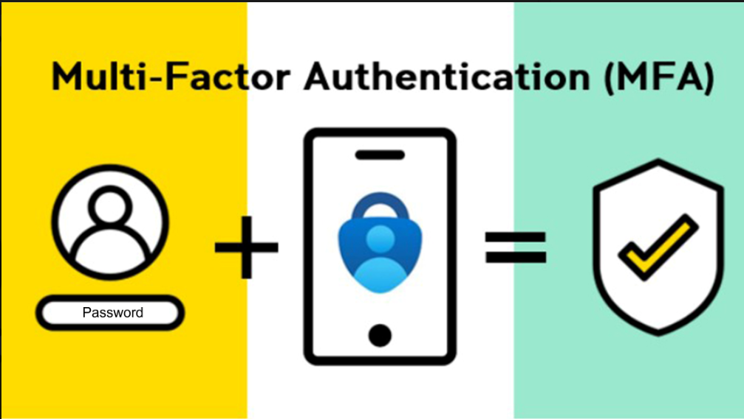
QRC 004 – EXACT – Multi-Factor Authentification
What is the Multi-Factor Authentication ?
The Multi-factor Authentication (MFA) is an authentication method that requires the user to provide two or more verification factors to gain access to the Elia systems.
To decrease the likelihood of a cyber attack, following factors are used:
The username (email address) + password;
The passcode generated by the Authenticator* (link to the user and his/her personal smartphone)
The MFA is required for every test (worker & work leader) and for every login by a V-SPOC.
*app used to confirm a user’s identity to perform digital authentication.
We recommend to use the Microsoft Authenticator

Slide 2
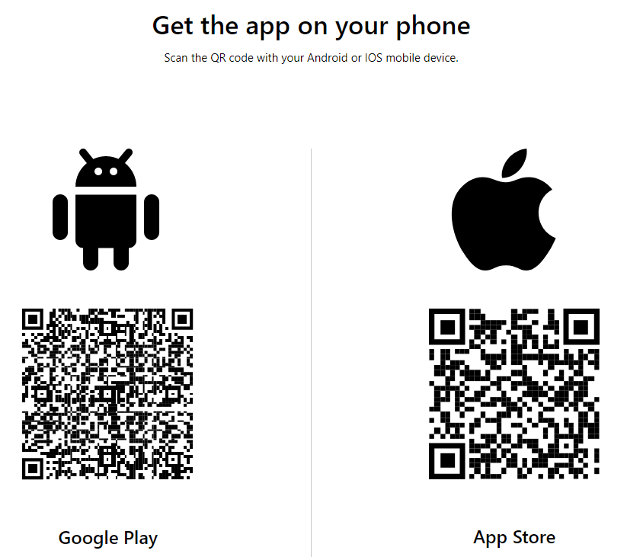
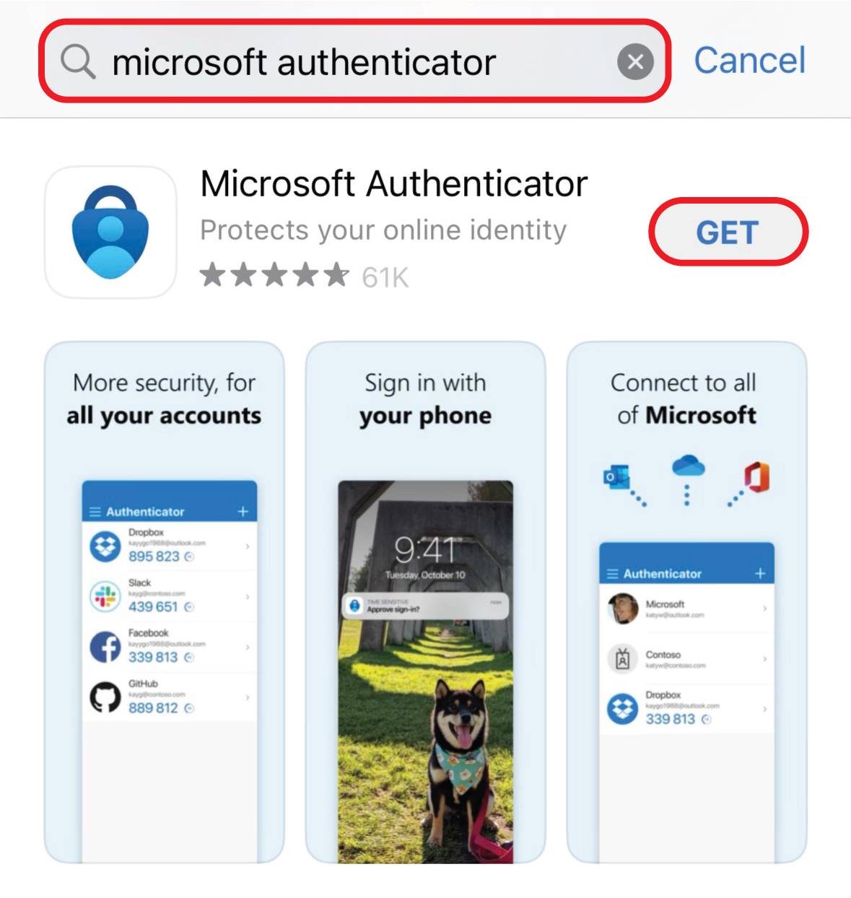
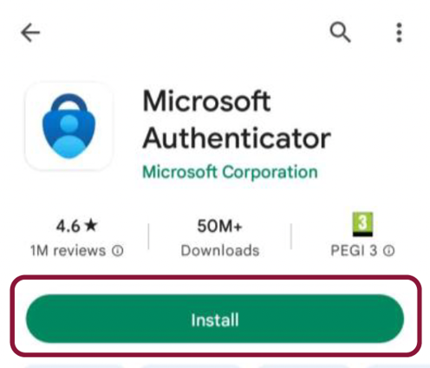
QRC 004 – EXACT – Multi-Factor Authentification
How to download Microsoft Authenticator?

Slide 3
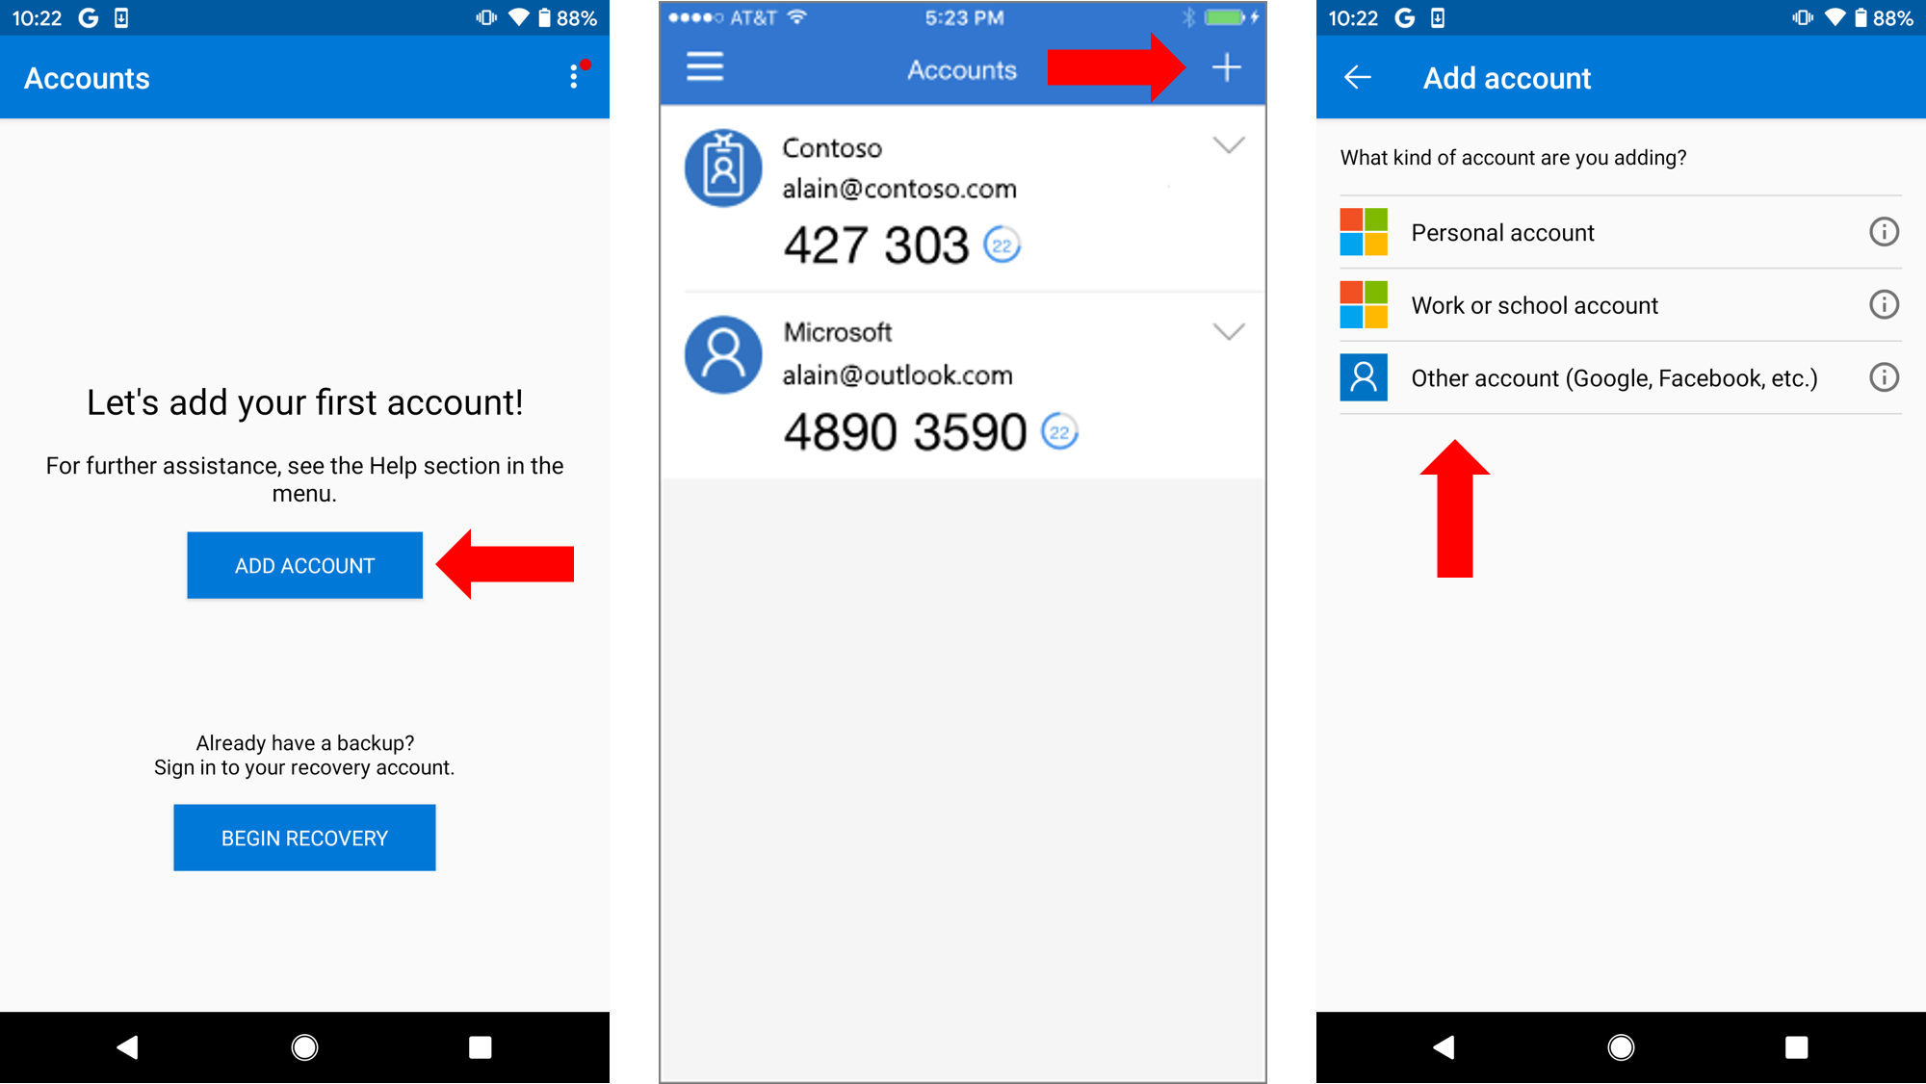
QRC 004 – EXACT – Multi-Factor Authentification
How to add an account to Microsoft Authenticator?

