Slide 1
Creation and follow-up of Requests for invoice and Workorders (WO’s) in REFIN
V5 01/08/2023

Slide 2
Content
Login suppliers
Flows & process in REFIN
Creation of Requests and Workorders (WO’s) in REFIN
Follow-up Requests and WO’s
Requests and WO’s rejected

Slide 3
1. Login suppliers
Via Elia Portal : https://srm.elia.be
Username : VENxxxxxx@eliaext.be
where xxxxxx is your supplier number
Password is case sensitive ! With upper and lower cases + numbers.
This login is unique per supplier : several persons at the supplier can share this login and every ‘REFIN-contact’ can also manage his own purchase orders (see slides 26 & 37).

Slide 4
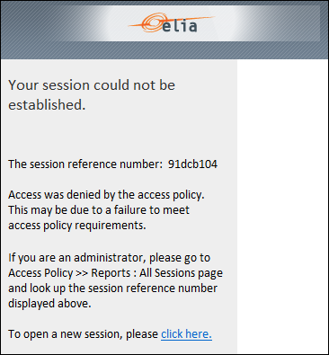
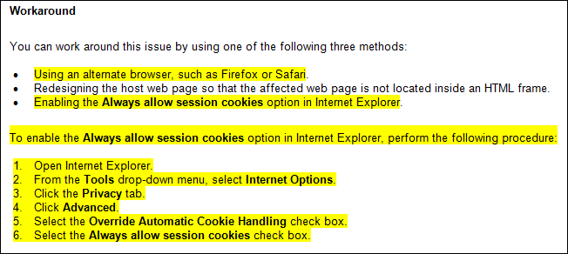
1. Login suppliers
In case of problem due to cookies, click on the link ‘click here’ to open a new session, or follow instructions hereunder.

Slide 5
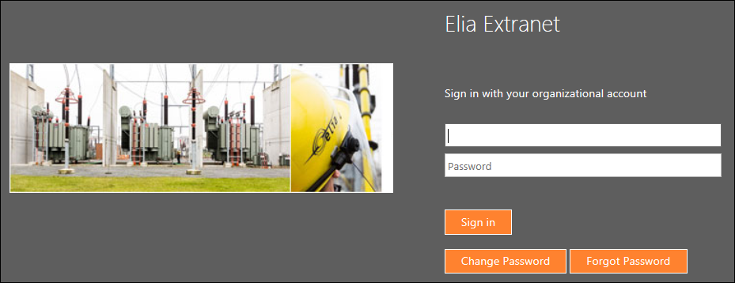
1. Login suppliers
The password remains valid during 4 months.
Before expiry of the password, you’ll be notified by an automatic e-mail from Elia.
Before expiry date : click ‘Change password’ to modify the password and extend you access with 4 more months.
After expiry date : click ‘Forgot password’ to reset the password.

Slide 6
1. Login suppliers
Portal is also available on the Elia website, page “Suppliers / Information and tools for suppliers” :
http://www.elia.be/en/suppliers/information-and-tools-for-suppliers
The supplier’s manual is also available on the same page.

Slide 7
1. Login suppliers
Internet options
Internet Explorer > 6.0 (Compatibility view)
Deactivate the pop-up blocker in the Internet options.
For a full compatibility add the site “elia.be” en “srm.elia.be” in the “authorized websites” in ‘Compatibility View settings’.

Slide 8
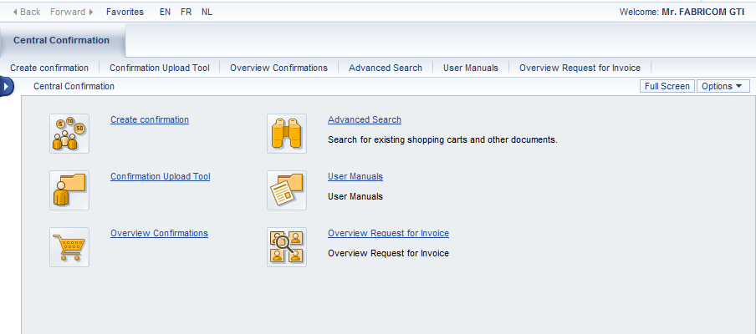
1. Login suppliers
Create confirmation to create Requests for invoice / Workorders.
Overview Request for Invoice to search Requests for invoice / Workorders.
User Manuals for the suppliers.
Log off
Changing the language

Slide 9
2. Flows & process in REFIN

Slide 10
2. REFIN tool : for which PO’s ?
REFIN tool is exclusively used for the ‘Requests for invoice’ and supplements (Workorders – WO’s) related to purchase orders for Elia ‘investment-projects’.
For these PO’s the project number TR-xxxxx is mentioned.
Other PO’s not related to Elia investment-projects
are managed in another tool (SUS – through the same Portal), for some suppliers who already work with this tool.
are not managed in a webtool. Requests for invoice are therefore sent by email to the Elia-responsible of the PO.

Slide 11
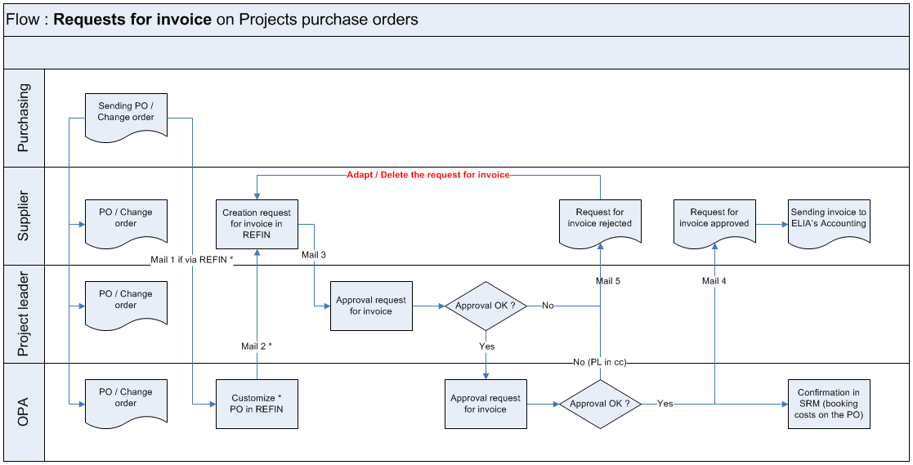
2. Flow in REFIN for the Requests for invoice
OPA : Operational Project Assistant.

Slide 12
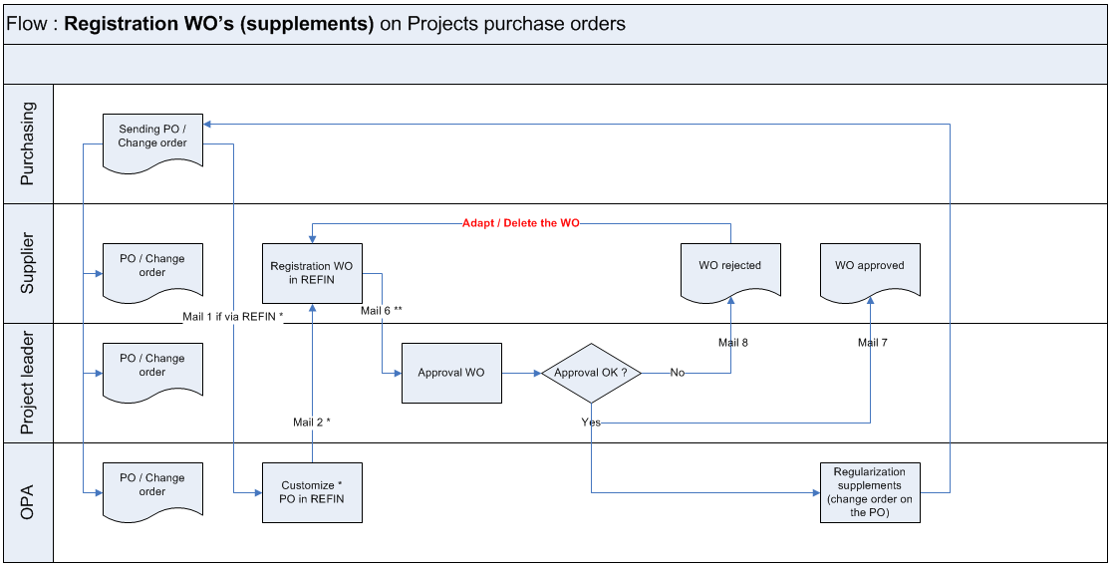
2. Flow in REFIN for the workorders (WO’s)

Slide 13
2. Process in REFIN
As soon as a purchase order is approved, the supplier receives an email with the PDF of this PO (or of the change order) and its attachments.
The default REFIN-contact person for the supplier receives another email when the PO is ready in REFIN for submitting the Requests for invoice or the Workorders (WO’s).
This person can be different from the one who received the PO.
The PO is then available in REFIN.
NB : If the supplier is active in Ariba, he will receive the PO in Ariba.
In this case it is no longer possible to submit the Requests for invoice in REFIN. This process in REFIN is replaced by the SES (Service Entry Sheets) in Ariba.
However, REFIN still applies to the WO’s, whether or not PO's are sent to Ariba. (see slide 23)

Slide 14
2. Process in REFIN
After carrying out works, the supplier may
submit “Requests for invoice” on the base of the invoice modalities specified in the PO or in the Framework agreement.
(If the supplier is active in Ariba, il will submit SES in Ariba for the invoicing process)
submit “WO’s” for extra works not yet covered by the PO, on request of the project leader.

Slide 15
2. Process in REFIN
After approval or reject of a ‘Request for invoice’ or a Workorder (WO), the supplier receives an e-mail from Elia with the decision that has been taken :
approval of a ‘Request for invoice’ : the e-mail = signal allowing to invoice (mailbox Accounting collection_ap@elia.be).
approval of a WO : the amount of the extra works is approved and will be regularized later in an official change order to the PO, in order to add these supplements in the PO.
After receipt of the change order, the supplier may submit a ‘Request for invoice’ in order to invoice these approved supplements.
reject of a Request / WO : the supplier must adapt or delete the Request / WO. The supplier can access the Request / WO from the link in the rejection e-mail, or at any moment from the list “Overview Requests for Invoice” (see point 5 hereafter).

Slide 16
2. Process in REFIN
Important remarks :
The approval date of a ‘Request for invoice’ may in no way whatsoever be taken into consideration for the payment time-limit of the final invoice.
REFIN is a tool that makes the approval of the requests for invoice easier and grants a faster payment of the invoices due to this prior approval, but payment of invoices is always linked to the invoicing date itself.
A Request or a WO is not to be staying in the ‘Overview’ list with the status « Rejected ». This status must be temporary.
The supplier must therefore :
either modify the rejected Request / WO and send it back for approval to the project leader, after saving the modifications.
or delete the rejected Request / WO if it’s not justified (incorrect PO, works not allowed…).
(see flows : slides 11-12)

Slide 17
2. Process in REFIN
Contractual price revisions and storage costs don’t have to be submitted as WO’s in REFIN. These costs are to be sent per separate e-mail to the Elia’s Project leader and will be regularized as a change order on the PO.

Slide 18
3. Creation of Requests and Workorders (WO’s) in REFIN

Slide 19
3. Creation of Requests and WO’s
Click on the 1st menu “Create confirmation”.

Slide 20
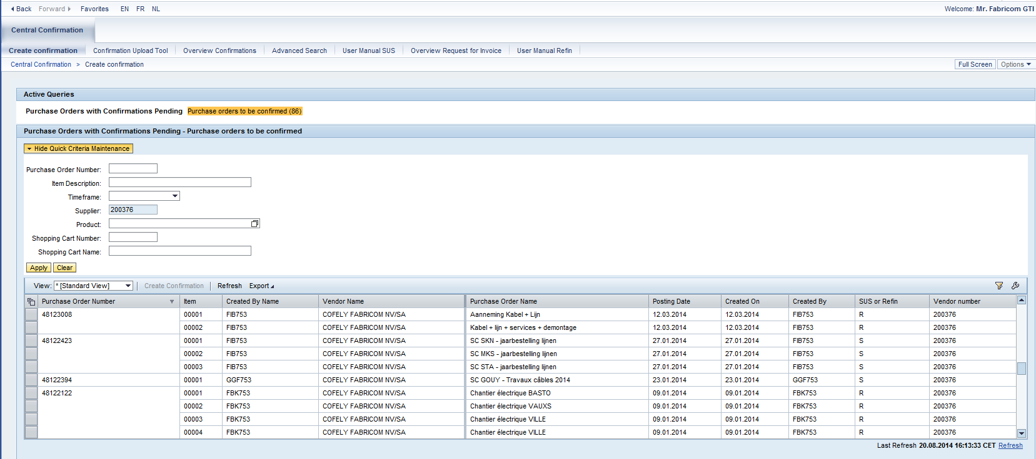
3. Selection of the purchase order
Enter a PO-number to search for a specific PO.
Without criteria, especially without timeframe, you’ll receive all the open PO’s in REFIN (R) and in SUS (S).
REFIN-process doesn't take into account the item level of a PO. As a result you may choose any PO-item.
SUS-process take well into account the item level of a PO ! The pro forma invoice (confirmation) will be linked with this PO-item.

Slide 21
3. Selection of the purchase order
The list gives you only the purchase orders still open, in other words PO’s where there is a balance to be invoiced.
In Ariba you see for the PO the status ‘Invoiced’ instead of ‘Partially invoiced’.
In REFIN, the open amount of the PO = 0.
Tip :
If you enter a PO-number, you’re better not to enter other selection criteria that couldn't be compatible with this PO-number.
In this case you should also erase the default timeframe set on the last 12 months.

Slide 22
3. Selection of the purchase order
If you don’t find the PO, there are 3 possible reasons :
The PO wasn’t customized for the REFIN-process.
→ Take then contact with the OPA or Purchasing Support.
The PO is in approval due to a change order for the regularization of approved supplements in REFIN (WO’s process).
→ Wait until de change order is approved .
The PO is closed.
→ If you have to submit a WO on a closed PO (which was not sent to Ariba), use then the menu ‘Overview Request for invoice’.

Slide 23
3. Selection of the purchase order
How do you submit a WO on an Ariba-PO ?
You can submit a 1st WO in REFIN on a PO in ARIBA via the menu ‘Create confirmation’ as long as the PO is still ‘open’, i.e. with a balance to invoice.
Once a 1st WO has been submitted in REFIN, and even if the PO is closed afterwards, the next WO’s can still be submitted in REFIN via the menu ‘Overview Requests for invoice’, since a history (1st WO) is then available.
If no WO’s have been submitted in REFIN and the PO is closed in Ariba, then in this case and only in this case, the statement of work must be sent by email to the PL (Project Leader), as in this case the PO is no longer available in REFIN.

Slide 24
3. Selection of the purchase order
Select the appropriate PO by clicking before the number (line becomes orange), and click on “Create Confirmation”

Slide 25
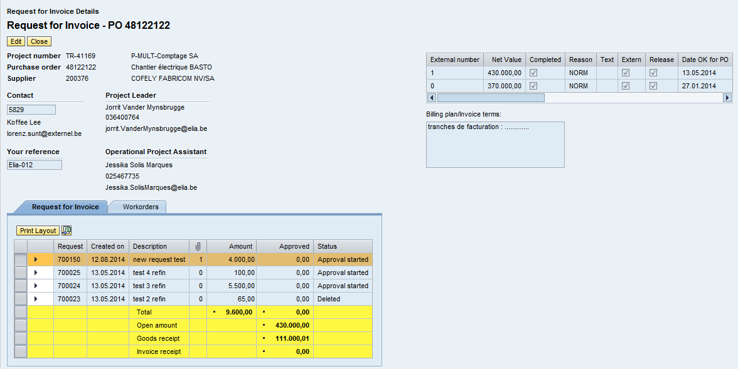
3. Detail screen in REFIN
Click first on “Edit”
2 tabs : the 1st one for the Requests for Invoice and the 2^{d} for the Workorders (WO’s).
Total = total submitted/approved (excl. status Deleted / Rejected).
Open amount = balance available for invoicing.
Goods receipt = costs booked on the PO.
Invoice receipt = invoices booked on the PO.

Slide 26
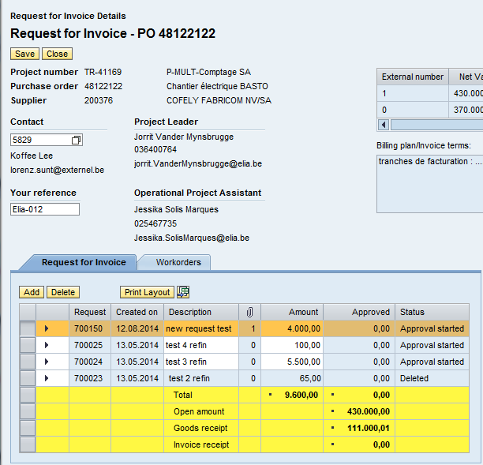
3.1. Creation of a Request for invoice
Default contact person for the Elia PO. If necessary to be replaced by your personal details.
Fill your own reference for the Elia PO.
Click on “Add” in the tab “Request for Invoice” to create a Request.

Slide 27
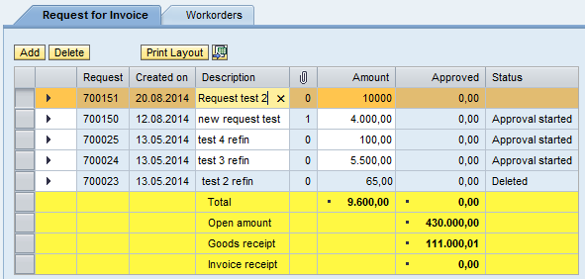
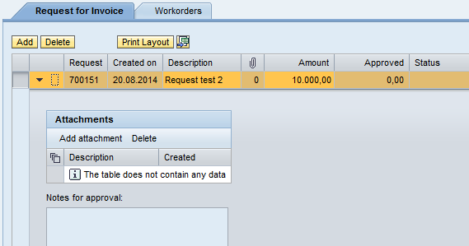
3.1. Attachments
Fill a clear description and the value for you request for invoice.
Add all the needed attachments and proofs (statements of executed works in conformance with the PO,…).

Slide 28
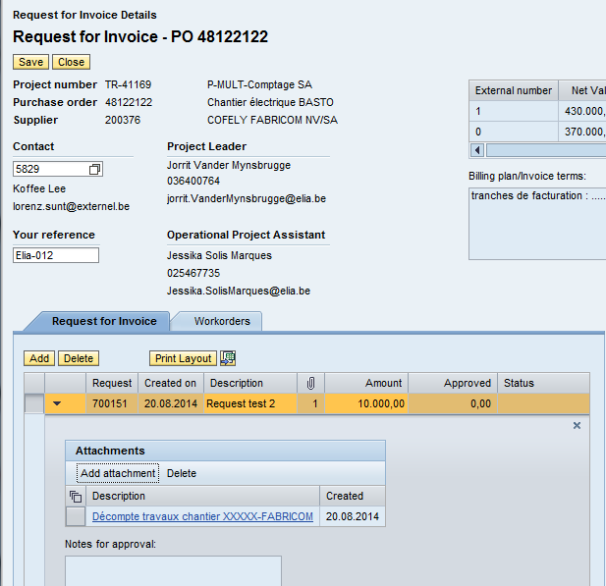
3.1. Save a Request for invoice
Click on “Save”.
If you submit a Request exceeding the open amount of the PO, you‘ll receive following error :
Contact then the Project Leader.
Otherwise the Request is booked :
and the status becomes ‘Approval started’ : the Request is sent for approval to the Project Leader.

Slide 29
3.2. Creation of a Workorder (WO)
Click first on “Edit”
Click on “Add” in the tab “Workorders” to create a WO.
Remark: a WO can be created separately or at the same time as a Request.

Slide 30
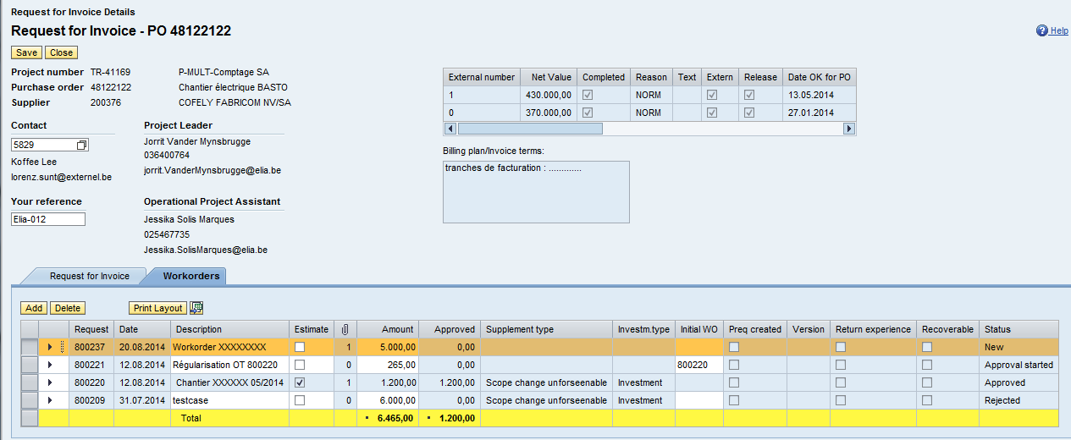
3.2. Creation of a Workorder (WO)
Fill a clear description and the value of the WO.
Attachments to a WO are added on the same way as for a Request, by opening the arrow on the left side.

Slide 31
3.2. Creation of an estimated Workorder (WO)
For a WO with an estimated value, tick also the box “Estimate”.

Slide 32
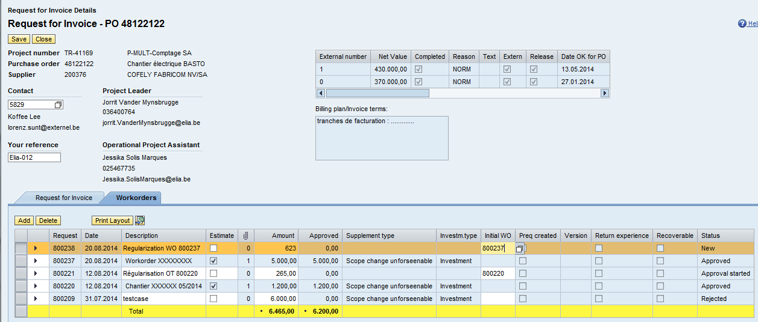
3.2. Creation of a WO to regularize an estimated WO
As soon as the works are carried out and the final value is known (e.g. 5.623 eur), you create a new WO to regularize the 1st estimated WO (No. 800237 for 5.000 eur) for the price difference (623 eur). Fill also the number of the 1st estimated WO in column ‘Initial WO’.

Slide 33
3.2. Save a Workorder (WO)
Click on “Save”.

Slide 34
4. Follow-up of Requests and Workorders (WO’s)

Slide 35
4. Follow-up of Requests and WO’s
Click on the menu “Overview Request for Invoice”.

Slide 36
4. Follow-up of Requests and WO’s
Reminder : the menu ‘Overview Requests for invoice’ is not used to search for a PO, but to display the list of ‘Requests for invoice’ or WO’s that have been submitted on a PO.
If there have been no ‘Request for invoice’ or WO, the system will not ‘find’ the PO, as there is no list (history of ‘Requests for invoice’ and WO’s) to display.

Slide 37
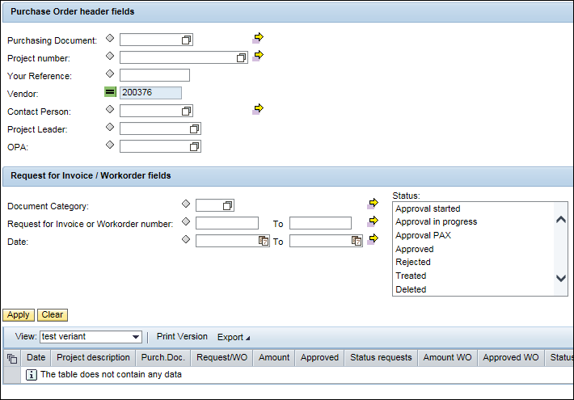
4. Follow-up of Requests and WO’s
Fill one or several criteria for searching Requests or Workorders on one of several PO’s.
Without criteria you’ll receive all the PO’s which Requests or WO’s have been submitted for in REFIN.
Choose one of several status (Ctrl-key) to limit the list of Requests (Document category = R) and/or WO’s (Document category = W). (Meaning of statuses : see next slide)
Without selected status you’ll receive all the Requests and/or WO’s that comply with the criteria, regardless of the status.
Click on “Apply”.
Click on “Clear” to erase the criteria and start a new selection.

Slide 38
4. Follow-up of Requests and WO’s
Approval started Request or WO in approval but not yet approved by the 1st Elia’s approver (project leader)
Approval in progress Request or WO not fully approved by Elia (approved by the 1st Elia’s approver but not by the last one)
Approval PAX WO in last approval step by Elia
Approved Request or WO fully approved
Rejected Request or WO rejected (and therefore to correct of delete)
Treated WO approved and regularized as a supplement to the PO (change order)
Deleted Request or WO deleted
NB : Statuses ‘Approval PAX’ and ‘Treated ’ are specific to WO’s and don’t exist for Requests for invoice.

Slide 39
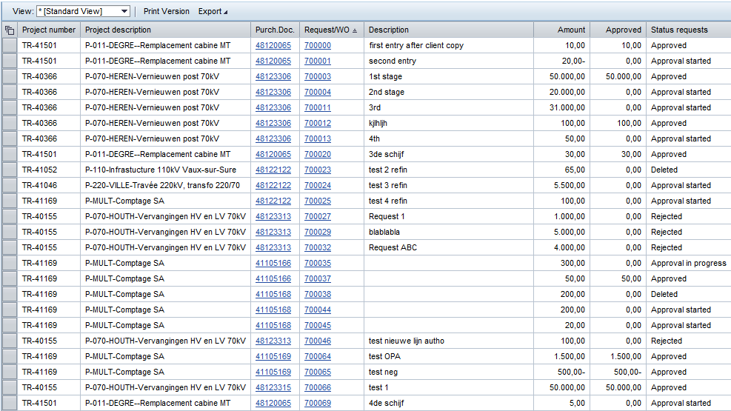
4. Follow-up of Requests and WO’s
Click on a Request / WO number, or on a PO number, in order to access the detail screen of this PO in REFIN.

Slide 40
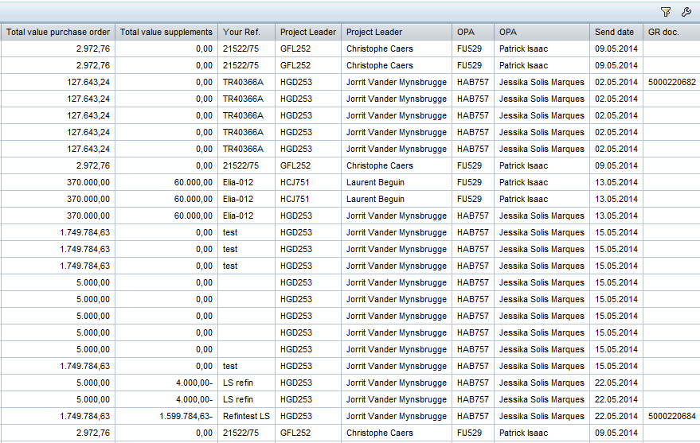
4. Creation of a display variant
You can change the lay-out of the list with the icon on the right side of the screen.

Slide 41
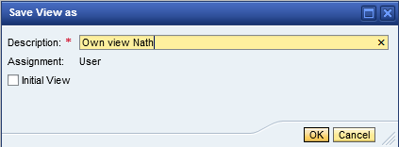
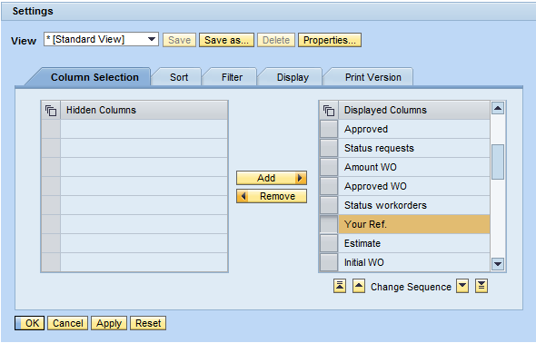
4. Creation of a display variant
2. Give a name to your variant and tick the box ‘Initial View’ to replace the ‘Standard View’.
1. Adapt the order of the columns, and, if necessary, hide some useless columns with the button ‘Remove’.
3. Click on “OK”.

Slide 42
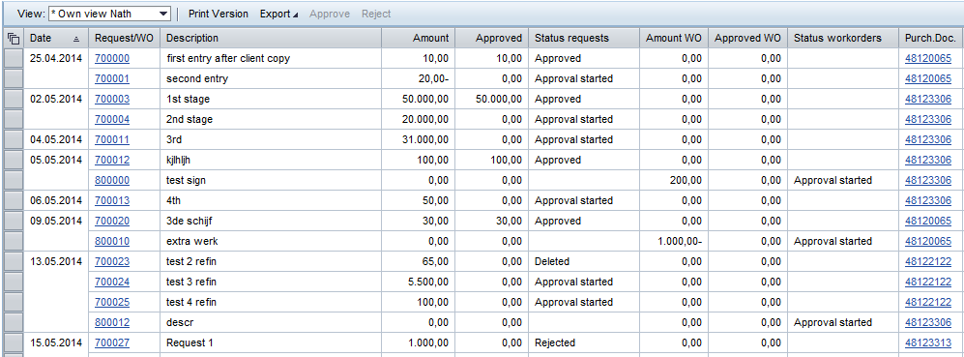
4. Creation of a display variant
Lay-out of the list is adapted in accordance with your variant.
Remark : Each one can create one or several variants depending of his needs.
Export to Excel

Slide 43
5. Requests and Workorders (WO’s) rejected

Slide 44
5. Requests and WO’s rejected
After reject by Elia, the Request or WO is sent back to the supplier.
A Request or a WO is not to be remaining with status « Rejected ». Reason is if you modify it by mistake and save the modification, it will be sent back again for approval to the Project Leader !
You have to correct or delete it.

Slide 45
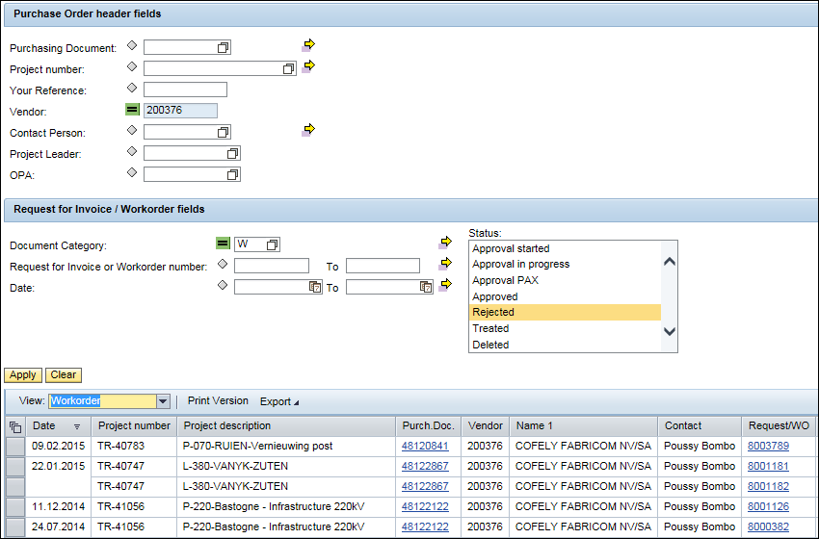
5. Requests and WO’s rejected
Choose if necessary the document category (R or W) with status “Rejected” and click on “Apply”.
Click then on the Request / WO-number in the list.

Slide 46
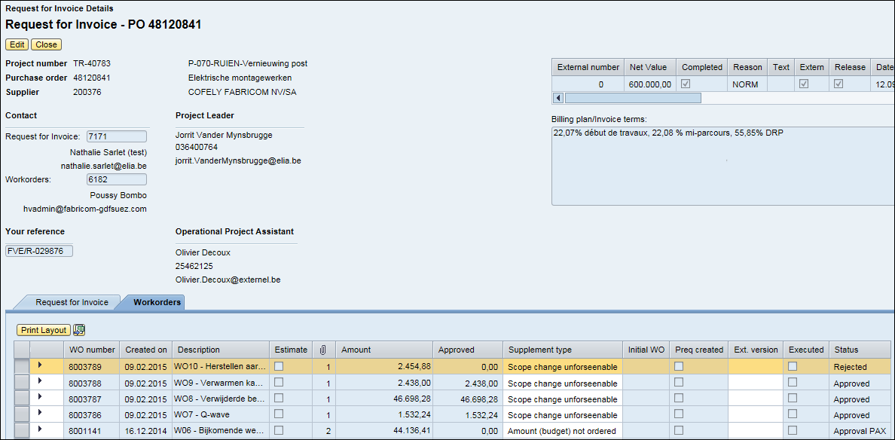
5. Requests and WO’s rejected
Click on “Edit” to adapt (or delete) a Request or a WO.
Click on the arrow to read the Project Leader’s comment.

Slide 47
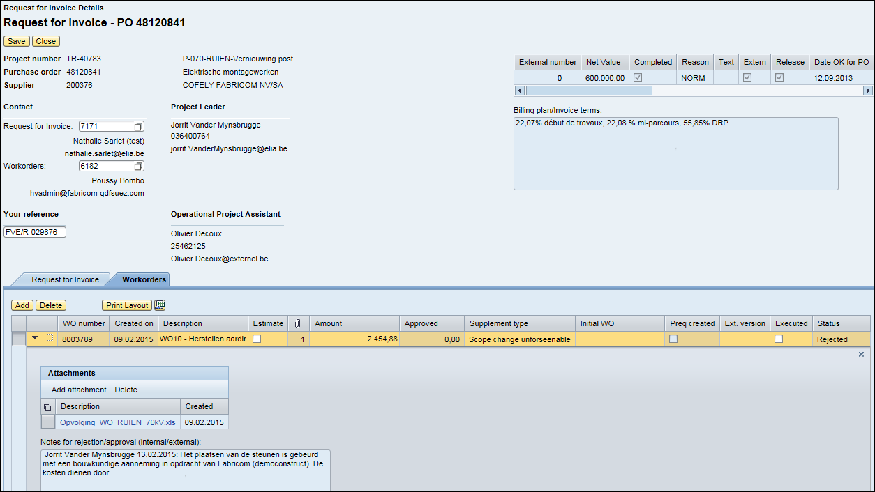
5. Requests and WO’s rejected
Adapt the Request/WO (value or description), add possibly the missing attachments and save, or delete the useless Request/WO.
After adapting and saving, the Request/WO is once again sent for approval to the Project Leader.
Rejection comment of the Project Leader or the OPA.

Slide 48
Need help ?
Purchasing Support
Nathalie Sarlet + 32 2 546 77 64 Purchasing Support

