Slide 1
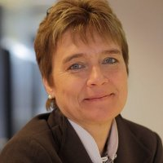
Saskia Van Uffelen
Saskia Van Uffelen (58)
Corporate Vice President
BeNeLux GFI
Belgian
ACADEMICS & CAREER
LANGUAGES
Hoger Pedagogisch Instituut Antwerpen, Belgium, Pedagogy
Hoger Instituut voor Lichamelijke Opvoeding, Belgium, Physical Education
2019-Present GFI
Corporate Vice President Benelux
2014-2019 Ericsson Belux
Chief Executive Officer
2008-2014 BULL BELUX
Chief Executive Officer
2005-2008 NORTHGATEARINSO
Vice President – Regional Executive Belgium
2001-2005 HEWLETT-PACKARD BELUX
2003-2005 Country Manager BeLux Customer Solutions Group
2001-2003 Country Manager BeLux
1991-2001 COMPAQ COMPUTER
1999-2001 Belux Sales Director Channel & Enterprise Accounts
1998 Channel Sales Manager (Integration of DIGITAL)
1991-1999 Commercial Sales Manager
1989-1991 XEROX
Sales and Management Training, Channel Management
Dutch: Native
French: Fluent
English: Fluent
BOARDS
Current boards
Independent board member & President of the board Media Invest Vlaanderen
Independent board member of board of University of Antwerp
Independant board member Elia
Independant board member Axa Insurance Belgium
Independant board member BPost
Dependant board member Future Technology Fund (representing Flemish Government)

