Slide 1
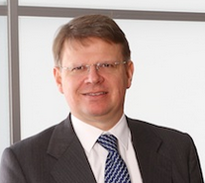
Frank Donck
Frank Donck (54)
Managing Director
3d investors NV
Belgian
Academics & Career
LANGUAGES
Vlerick Management School, Belgium, Master in Finance
University of Ghent, Belgium, Master in Law
Present 3d investors NV
CEO
Previous Investco Investment Manager
Chairman and board member in several listed and non-listed companies (i.a Telenet, Greenyard, Zenitel,, Telecolumbus, Centea, KBC Lease)
Dutch: Native
French: Fluent
English: Fluent
BOARDS
Chairman
Atenor Group NV
Desotec NV
Boardmember
Barco NV
KBC Group N.V.
KBC Verzekeringen N.V.

