Slide 1
Elia’s ARP-Day
Tuesday, 17th April 2018
Square Meeting Center, Brussels

Slide 2
Welcome!
Arbeitsstand
ARP-Day, 17/04/2018, Brussels

Slide 3
Morning Program
Nemo Link - Part I
- Introduction : allocation and nomination process on current borders
- Nemo Link : presentation of the project, timeline and technology
- Questions & answers
Nemo Link - Part II
- Nemo Link : trading framework, products, contractual and system framework
  - Integration of Nemo Link : impact on Elia systems
  - Changes in the ARP contract
  - Questions & answers

Slide 4
Introduction:
Allocation and Nominations processes on current borders (BE-NL and BE-FR )
Arbeitsstand
Jean-Michel Reghem – Product Manager EU Market
ARP-Day, 17/04/2018, Brussels

Slide 5
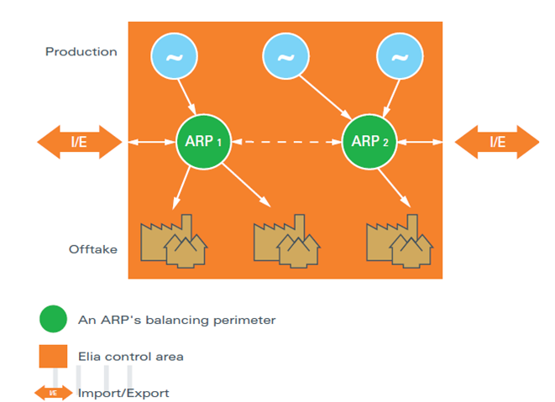
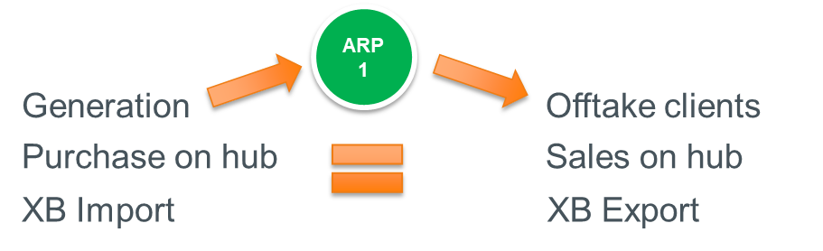
Reminder: Belgian Local Hub
BRP (ARP) Contract
→ Balance Responsible Party
→ BRP porfolio balanced in D-1
→ Balanced after RT measurement
(ex-post D+1)
All Injections = All Off-takes
Focus on allocation and nomination on existing BE borders

Slide 6

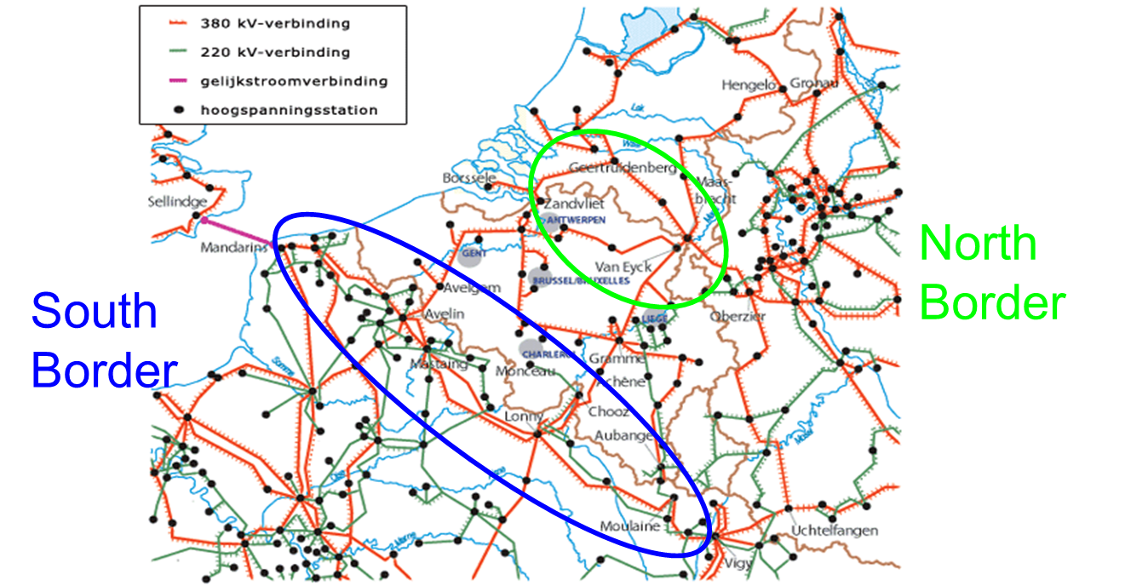
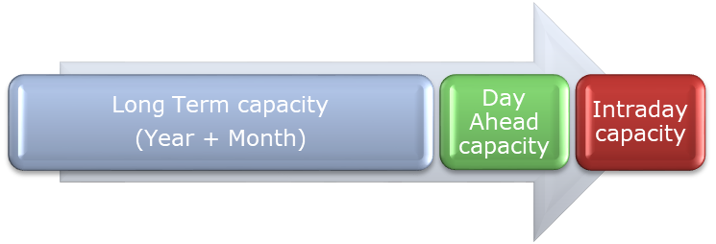
Allocations and Nominations on existing borders
Before Nemo
2 borders BE-FR & BE-NL
3 market time frames:
  Long term
  Day-ahead
  Intraday
BE-NL
BE-FR

Slide 7
Allocations and Nominations on existing borders
Long Term capacity
(Year + Month)
Day Ahead capacity
Intraday capacity
Current Products :
  Year: Explicit Auction
  Month: Explicit Auction
  Day: implicit allocation via DA market coupling (MRC): Day-ahead auction
  Intraday: implicit allocation via EPEX Platform: Continuous intraday trading market
Explicit auctions
• Auctioning of transport XB capacity
• Traders buy the energy separately on local markets
Implicit auctions
• (one step) Auctioning of Energy (at Power Exchange)
• No separate auctioning of capacity
• Capacity is made implicitly available to the market participants via an organized market/exchanges (together with the energy)
Implicit auctions
• (one step) Auctioning of Energy (at Power Exchange)
• No separate auctioning of capacity
• Capacity is made implicitly available to the market participants via an organized market/exchanges (together with the energy)

Slide 8
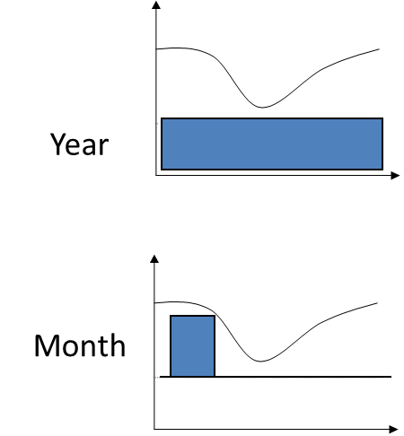
Long Term Allocation on BE-FR and BE-NL
Long Term capacity
(Year + Month)
Day Ahead capacity
Intraday capacity
NTC (Net Transfer Capacity) on each border divided in
Year Capacity
Day Capacity
Explicit Auction on JAO platform (→ SAP: Single Allocation Platform)
Harmonized Auction Rules (HARs) on EU level
Yearly capacity
Capacity that can be used for all hours of the year
Allocated in December for Year+1
Capacity on BE-NL border is allocated in two rounds
Monthly capacity
Capacity that can be used for all hours of the month
Allocated each month for Month+1
Nemo Link:
More LT Products

Slide 9
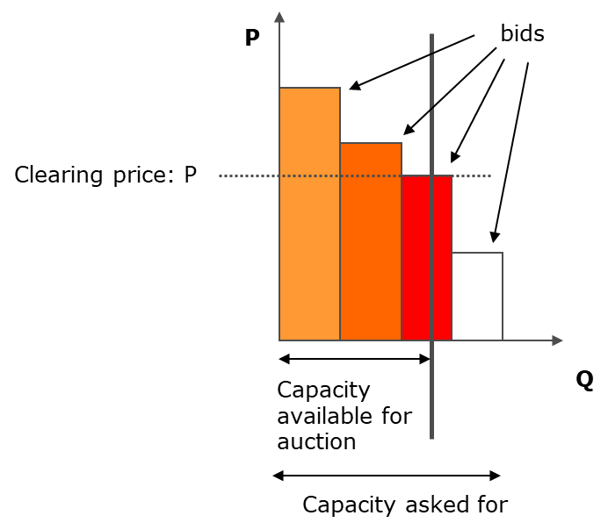
Long Term Allocation on BE-FR and BE-NL
Explicit Auction
Long Term capacity
(Year + Month)
Day Ahead capacity
Intraday capacity
1/ TSOs calculates the capacity available on each border (NTC)
2/ Market Participants submits bids on JAO Auction Platform for each border for each auction (Y or M)
3/ JAO allocates the capacity
Bids ordered from highest price to lowest price
Single round – “paid as cleared”
Year
Month
→ Long Term “Right” allocated to Market Participants

Slide 10
Long Term Allocation on BE-FR and BE-NL
Long Term capacity
(Year + Month)
Day Ahead capacity
Intraday capacity
4/ Market Participant nominates LT Rights
Before 1/1/2016: LT Rights = PTRs With UIOI(Physical Transmission Rights)
  PTR = “right” to nominate on the border (no obligation)
  UIOSI = Use It or Sell It
    Use It:
      Nomination of a part of allocated PTRs (8am D-1) on
        Elia and RTE nominations platforms for BE-FR
        Elia and Tennet nominations platforms for BE-NL
        → Nominated XB energy added to ARP DA balance perimeter
    Sell It:
      Non nominated PTRs are paid at DA price Market Spread between BE-FR or BE-NL if Market Spread > 0
      Non nominated PTRs’ capacity reused in DA allocation
      → No XB energy added to ARP DA balance perimeter for non-nominated PTRs
From 1/1/2016: LT Rights = FTRs Options (Financial Transmission Rights)
  Equivalent to PTRs where there is no more nominations
  No need to nominate on Elia, RTE and Tennet nomination platforms
  → No XB energy added to ARP DA balance perimeter for FTRs
  100% of FTRs are paid at DA price Market Spread between BE-FR or BE-NL if Market Spread > 0
Nemo Link:
PTRs
Single Side Nomination on RNP

Slide 11
Day-ahead allocation on BE-FR and BE-NL
Long Term capacity
(Year + Month)
Day Ahead capacity
Intraday capacity
Implicit allocation of daily capacity through Market Coupling:
Explicit auctions
• Auctioning of transport XB capacity
• Traders buy the energy separately on local markets
Implicit auctions
• (one step) Auctioning of Energy (at Power Exchange)
• No separate auctioning of capacity
• Capacity is made implicitly available to the market participants via an organized market/exchanges (together with the energy)

Slide 12
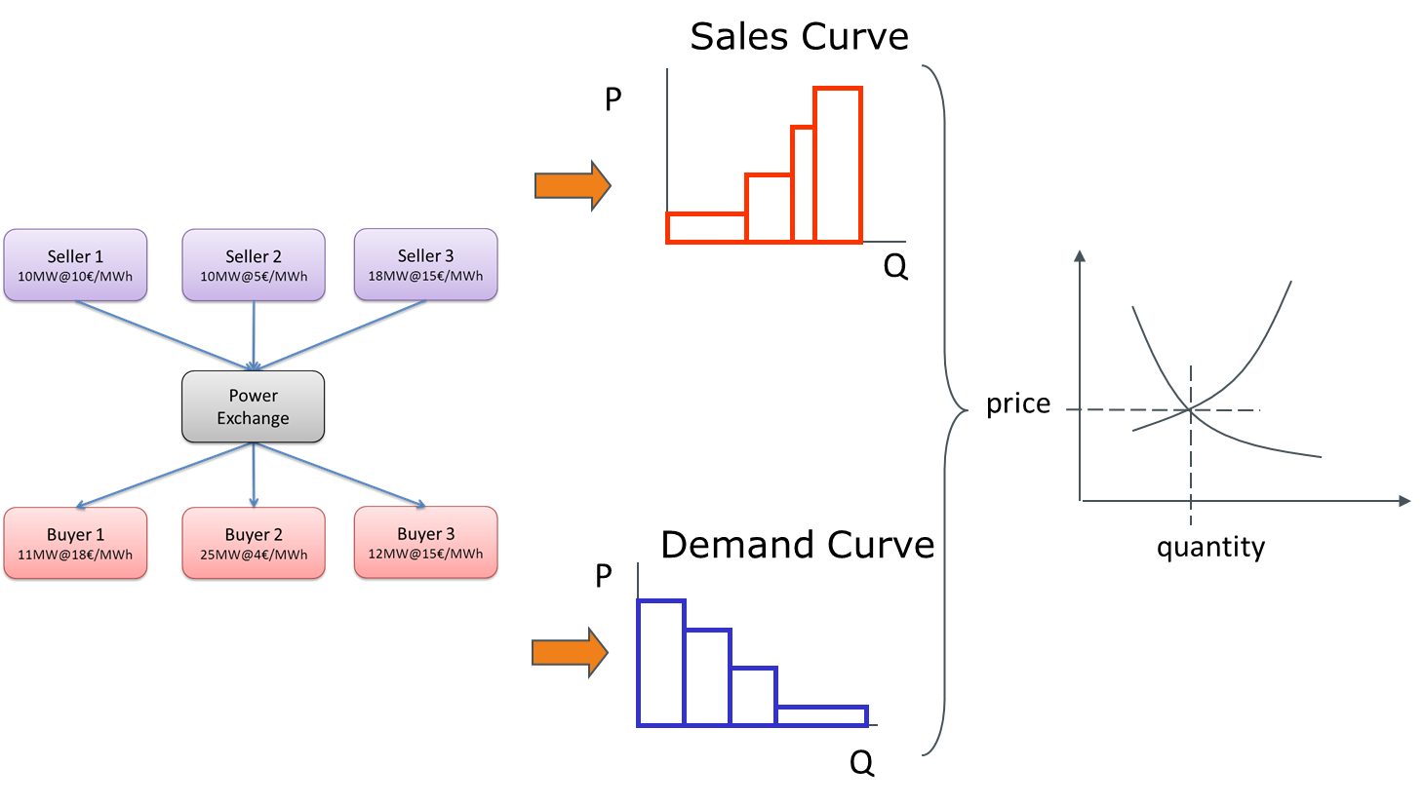
Day-ahead allocation on BE-FR and BE-NL
Long Term capacity
(Year + Month)
Day Ahead capacity
Intraday capacity
1/ ARP submits sell or buy bids on Power Exchange Trading Platform
(Epex Spot Belgium – Ex Belpex DAM)
2/ Day-ahead Allocation Auction (Market Coupling)
  → Belgian Bidding Zone price
3/ ARP nominates sold or bought energy on local Hub to PX (Elia e-nomination) before D-1 14h
2018: “Multiple NEMO”
(= Nominated Electricity Market Operator)
→ Nord Pool active also in Belgium along with Epex Spot Belgium

Slide 13
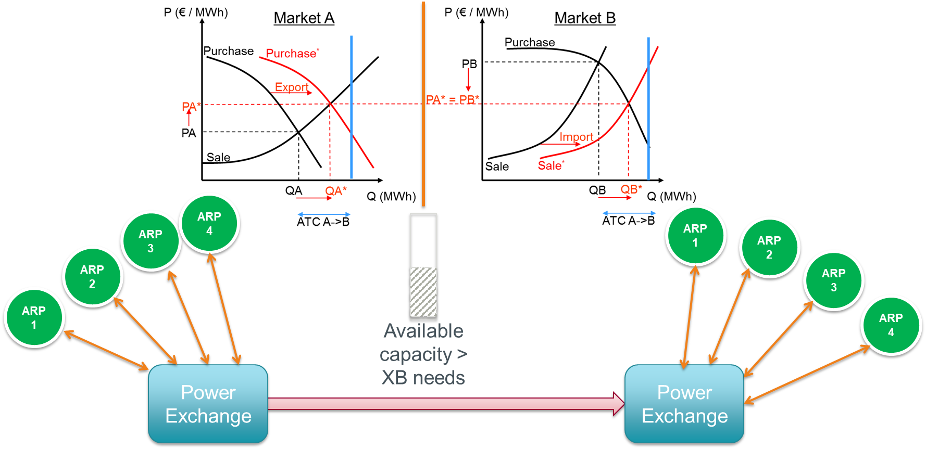
Day-ahead allocation on BE-FR and BE-NL
Long Term capacity
(Year + Month)
Day Ahead capacity
Intraday capacity
Cross-border nomination between PXs performed by the shipper
SHIPPING AGENT

Slide 14
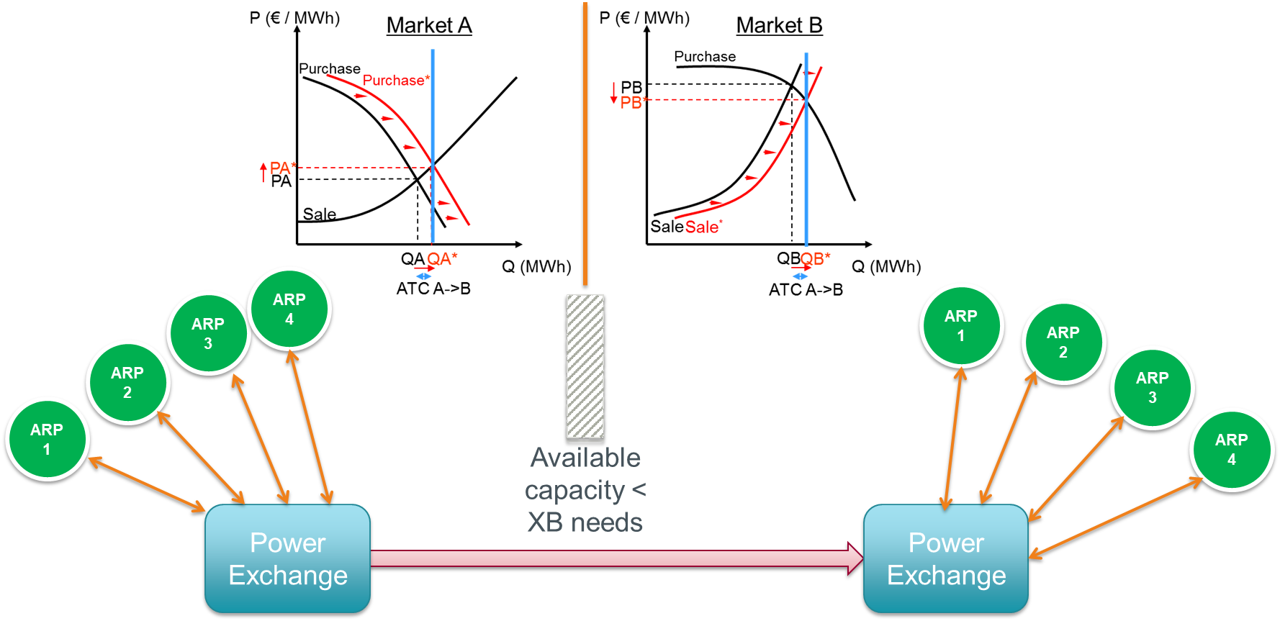
Day-ahead allocation on BE-FR and BE-NL
Long Term capacity
(Year + Month)
Day Ahead capacity
Intraday capacity
if XB capacity > XB needs to achieve price convergence
→ Identical price in 2 bidding zones
SHIPPING AGENT

Slide 15
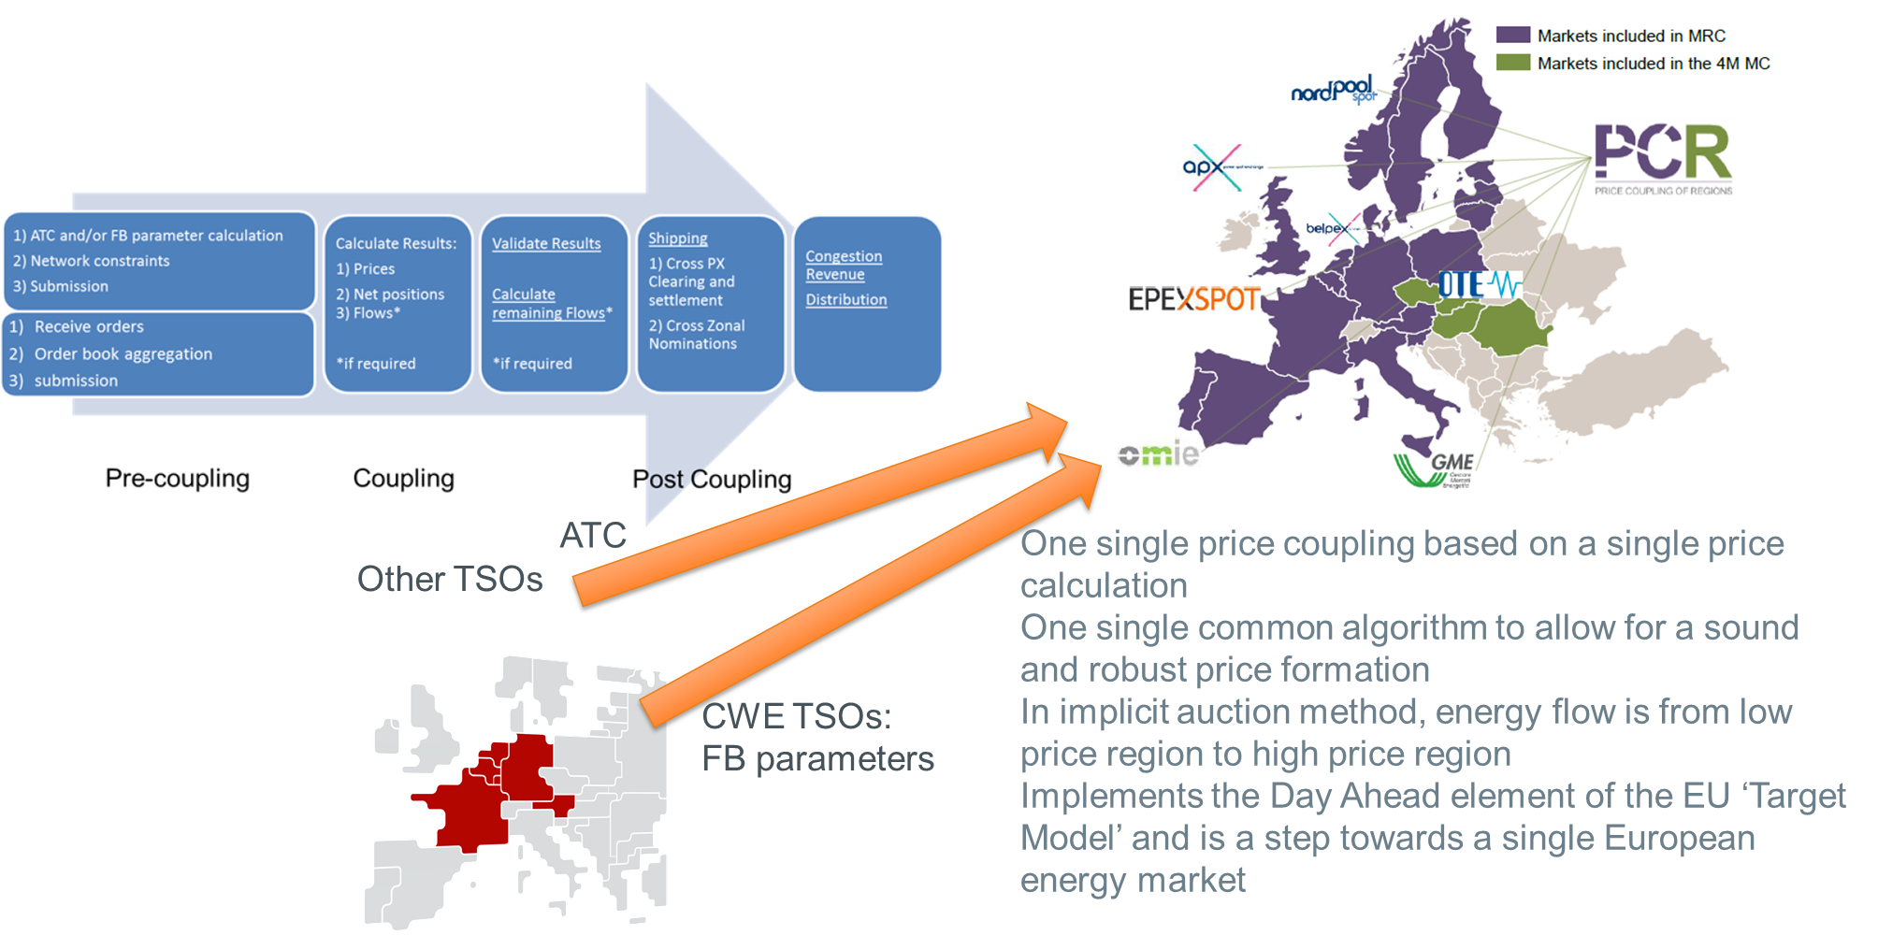
Day-ahead allocation on BE-FR and BE-NL
Long Term capacity
(Year + Month)
Day Ahead capacity
Intraday capacity
2018: “Multiple NEMO”
(= Nominated Electricity Market Operator)
→ Nord Pool active also in Belgium along with Epex Spot Belgium
Nemo Link: ATC-based

Slide 16
Day-ahead allocation: Shadow auctions
Long Term capacity
(Year + Month)
Day Ahead capacity
Intraday capacity
Multi-Regional Coupling: Try to maintain coupled as many bidding areas/ interconnectors as possible.
Partial Decoupling: situation where one or more bidding areas and/or interconnectors are temporary not participating in the MRC while the remaining bidding areas/interconnectors still participate in the MRC.
The Cross-Zonal Capacities for the decoupled borders/interconnectors are allocated via the available fallback allocation solutions.
On BE-FR and BE-NL: Shadow Explicit Allocation
Similar to LT PTR:
1/ ARP acquires DA Shadow Auction PTR on JAO Auction Platform
2/ JAO runs the DA Shadow Auction and allocates PTRs
3/ ARP nominates explicitely in Elia eNomination tool (+ RTE/Tennet NL nomination system)

Slide 17
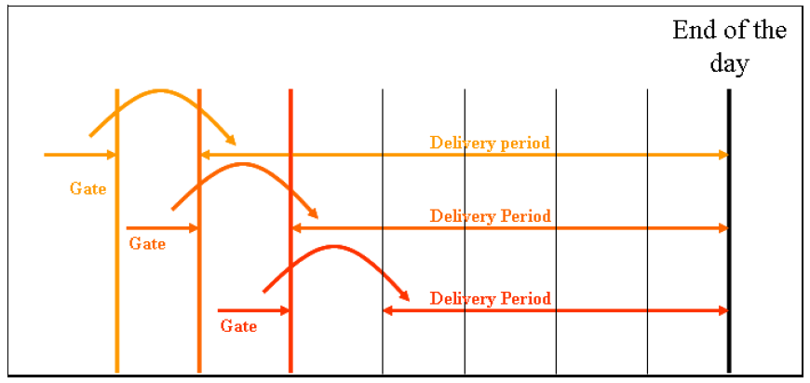
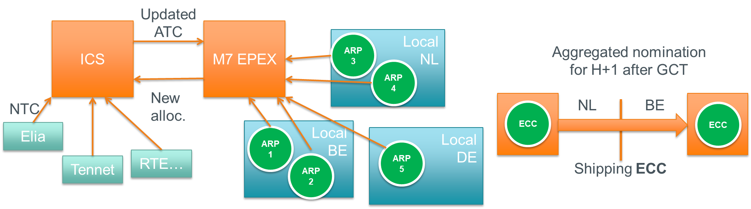
Intraday allocation on BE-FR and BE-NL
Long Term capacity
(Year + Month)
Day Ahead capacity
Intraday capacity
Continuous trading (!= DA auction)
24 gates (1 hour XB product)
BE, FR, NL, DE, SW, AT ID markets implicitly coupled
Trading M7 platform of EPEX Spot
Cross border capacity managed by TSO on ICS

Slide 18

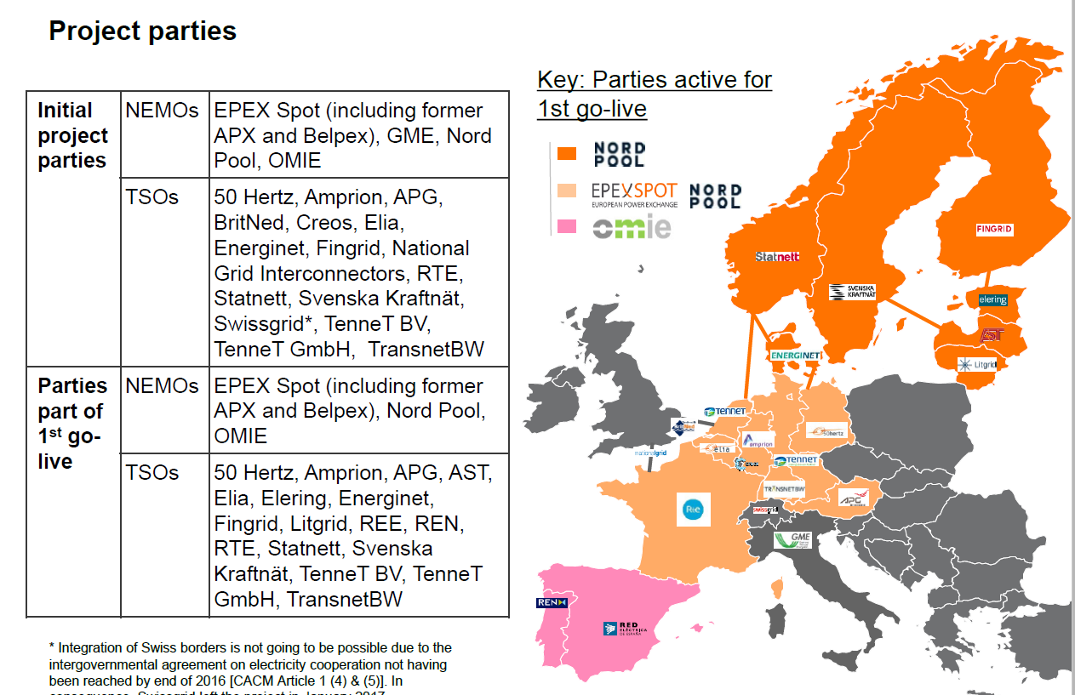
Intraday allocation on BE-FR and BE-NL
Long Term capacity
(Year + Month)
Day Ahead capacity
Intraday capacity
Juin 2018: XBID
Continuous trading (!= DA auction)
24 gates (1 hour XB product)
CWE + Nordics + baltics + Spain/Portugal
markets implicitly coupled
Trading Nord Pool, Epex Spot, OMIE
platforms
Cross border capacity managed by TSO

Slide 19
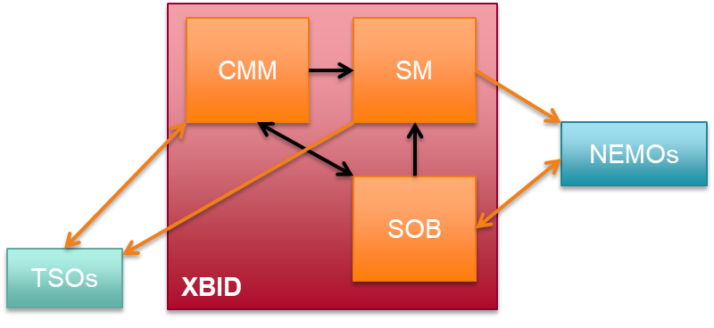
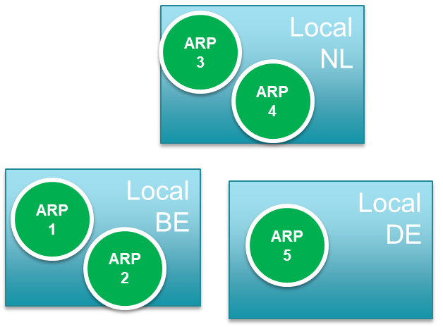
Intraday allocation on BE-FR and BE-NL
Long Term capacity
(Year + Month)
Day Ahead capacity
Intraday capacity
1/ ARP add sell or buy bids on Power Exchange Trading Platform
(Epex Spot Belgium – Nord Pool)
2/ Continuous Implicit Allocation Process
  Shared Order Book at XBID Level
  Shipping module: routing algorithm at
  trade level for order matching
  (using XB capacity info from
  Capacity Management Module)
3/ ARP nominates sold or
bought energy on local Hub
to NEMOs (Elia e-nomination)
before D+1 14h

Slide 20
Questions?

Slide 21
Nemo Link presentation
Arbeitsstand
ARP-Day, 17/04/2018, Brussels

Slide 22

Project Overview
Nick Pittarello
Client Relationship Manager

Slide 23





General Overview:
Nemo Link interconnector
High-voltage submarine interconnection between Belgium and the UK;
Potential to deliver 1,000MW of power;
Currently in construction; commercial go-live Q1 2019.
Notes:
Nemo Link® is the name of a project to lay high voltage electricity cables under the sea, improving the link between UK and European electricity generation with consumers in the UK and across the continent. It is a joint project between National Grid Interconnector Limited, a subsidiary company of the UK’s National Grid Plc, and the Belgian Elia group. The project will give both countries improved reliability and access to electricity and sustainable generation.
Nemo Link® will consist of subsea and underground cables connected to a converter station and an electricity substation in each country, which will allow electricity to flow in either direction between the two countries. The site for the converter station and electricity substation in the UK is an 8 hectare site, formerly occupied by the Richborough Power Station, which now forms part of the Richborough Energy Park proposals. A similar converter station and substation will be built in the industry zone Herdersbrug in Bruges, Belgium.

Slide 24
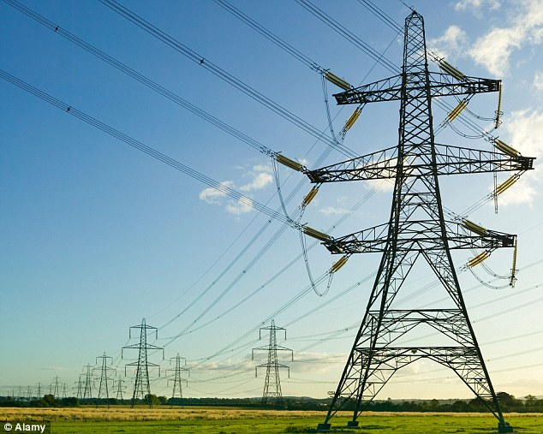


Benefits
Energy security
Increase security;
Diversify both countries’ electricity supply.
Electricity prices
Integrated European energy market;
Increased social welfare
Supporting renewables:
Renewable and climate change targets to meet;
Manage fluctuations in supply and demand of wind and solar energy.
Notes:
Energy security: Interconnectors play a crucial role in the European Union’s strategy to achieve a competitive and integrated European energy market. By allowing the UK and Belgium to trade power, the Nemo Link® interconnector will increase security and diversify both countries’ electricity supply.
Electricity prices: Greater opportunities for the UK to trade with wider European energy markets will contribute to downward pressure on wholesale electricity prices.
Supporting renewables: To meet international and domestic renewable and climate change targets, the UK and Belgium will generate more power from renewable sources, including offshore wind. By its nature, wind generation is intermittent and interconnectors provide an effective way to manage these fluctuations in supply and demand.
Why Belgium and the UK?
Belgium’s electricity transmission system is very well connected to Central Europe. The Nemo Link® interconnector between Belgium and the UK offers a new and robust connection to the European electricity grid.
The Nemo Link® interconnector will improve security of supply in both countries. The technology used will also ensure that normal operation is restored faster in the event of any disturbance on the grid.
The Nemo Link® interconnector will give Belgium and the UK access to a broader energy mix, providing the countries with new opportunities to expand into other electricity markets. The market forces of supply and demand will result in lower prices in peak-consumption periods, while the time difference of an hour between the two countries will also have a positive influence.
The intermittent nature of wind generation, which is currently being developed on a large scale in Europe, is creating a need for new interconnectors between the UK and the European continent. If too much renewable energy is generated in one region, the energy that is surplus to requirements can easily be transmitted through the interconnectors to a region where the level of demand is higher. This will also has a beneficial impact on market prices.
The distance between the UK and Belgium is relatively short, which minimises the length of the subsea cables.

Slide 25




Project Partners
Belgium’s high-voltage transmission system operator;
Key player at European level.
Owns and manages gas and electricity infrastructure;
UK and North Eastern US.
Elia
50%
National Grid
50%
Incorporated Joint Venture
Notes:
NLL is an incorporated joint venture (IJV) between the National Grid group, and Elia System Operator NV/SA (‘Elia’). National Grid plc, through its subsidiaries, owns and operates gas and electricity infrastructure in the UK. Elia is the national electricity transmission operator in Belgium. National Grid plc’s subsidiary, National Grid Interconnector Holdings Limited, and Elia System Operator each own 50% of the shares in NLL.
NLL will design, construct, own, maintain and operate the interconnector in conjunction with Elia System Operator.

Slide 26
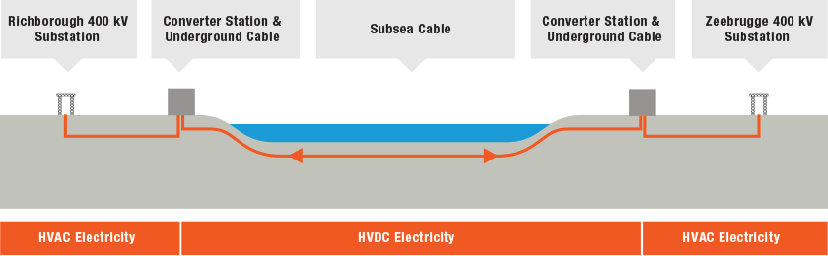
Concept
Converts electricity between Alternating Current (AC) and Direct Current (DC).
Point of connection to an electricity network and transforms the voltage of electricity to make that connection.
Notes:
What is an interconnector?
An interconnector is a connection between the electricity transmission systems of different countries, in this case via subsea cables. An interconnector provides the opportunity to trade electricity with other countries, thus helping to ensure a safe, secure and affordable energy supply for the UK and Belgium.
Converter stations and substations
What is a converter station?
A converter station converts electricity between Alternating Current (AC) and Direct Current (DC). AC is used in each country’s transmission systems, while DC is used for sending electricity along the subsea cable.
What is a substation?
A substation is a point of connection to an electricity network and transforms the voltage of electricity to make that connection. A new substation will be needed at each end of the Nemo Link ® interconnector to connect it to the transmission systems in the UK and Belgium.
Why DC?
Using subsea cables Nemo Link® will connect two High Voltage AC electricity systems separated by the North Sea. The Nemo Link® interconnector will utilise High Voltage Direct Current (HVDC) technology, which avoids the need to synchronise the two interconnected AC networks.
HVDC allows efficient transportation of electricity over large distances and in particular for subsea applications. It is also highly controllable and brings operational benefits to both transmission systems.

Slide 27

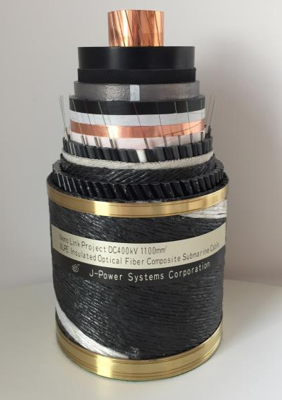
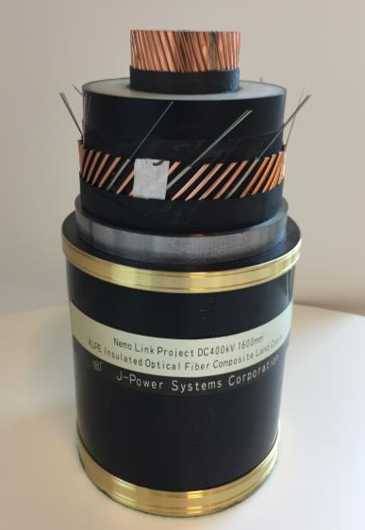
Technology: Cable
  XLPE (cross-linked polyethylene) cable
  First time use at 400 kV worldwide
  Conductor temperature 90°C
Submarine cable
4 lots (2x59 km – 2x71 km)
1100 mm² Cu
135 mm outer diameter
44 kg/m
Land cable
40 lots (40x600m)
1600 mm² Cu
121 mm outer diameter
38 kg/m

Slide 28
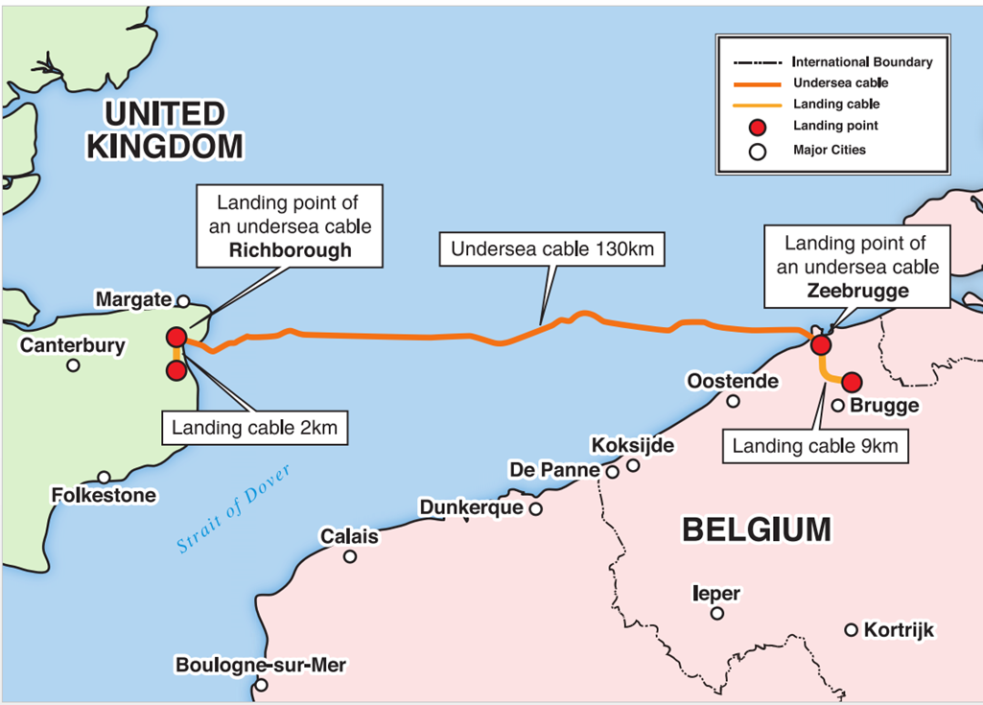
Cable Route
Notes:
The cable route
In addition to considering the land options available for the location of the converter station, factors affecting the routeing of the subsea cables have also been considered, including
Physical environment: Where possible, areas of rock, boulder clay and sand waves will be avoided as these can create difficulties in burying the cable.
Biological environment: The shortest cable route across designated conservation areas will be taken to minimise disturbance to the marine biological environment.
Human environment: Careful consideration of the route has been given to avoid all anchorage areas, dredging areas, existing marine disposal areas, wrecks, oil and gas infrastructure and offshore wind farms.
As part of the site selection process, options were identified for the landfall of the subsea cables and the route of the onshore underground cables considering:
Subsea cables landing technique
Coastal geology
Coastal processes
Beach gradient
Environmental sensitivity (such as nature conservation)
Rivers and watercourses
Existing infrastructure
Access
Land in the vicinity of the service station at Pegwell Bay, close to where the Thanet Offshore Wind Farm cables come ashore, was identified as the preferred option for the landfall. Once onshore, the underground cables will be routed through the Pegwell Bay Country Park and beneath the road from BayPoint Sports Complex (former Pfizer sports ground) to the Richborough site.
In Belgium, the preferred landfall was identified to be west of the existing landfalls of the Belwind and Northwind wind farms and the UK-Belgium Gas Interconnector. The landfalls of the future wind farms have also been taken into account.
Marine impact
A desk-top cable routing study and detailed offshore survey was undertaken to determine an optimum route through English, French and Belgium waters. The environmental impacts of this route have been assessed and an Environmental Report has been prepared.
A seabed survey was carried out using non-intrusive methods (geophysical) and intrusive methods (geotechnical) to provide information on the seabed type, for both engineering and environmental purposes.
The cables will be buried into the seabed either by a plough or trenching machine deployed by the main laying vessel directly or by a support vessel following behind.

Slide 29
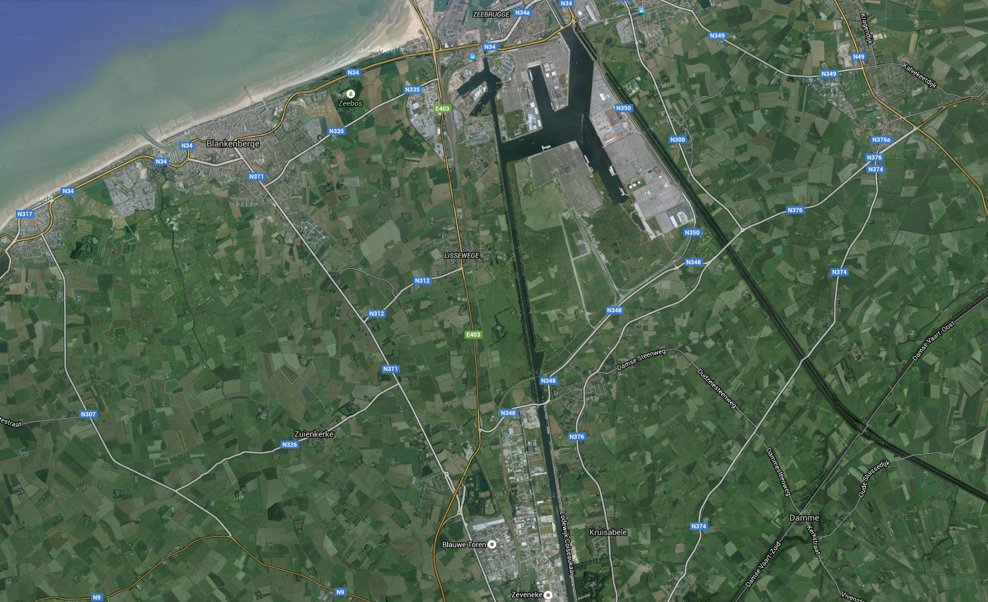
Geographical overview in Belgium
Offshore
Stevin substation
Nemo onshore HVDC cable (approx 9 km)
Stevin OHL
Herdersbrug Converter station
Stevin tunnel
Gezelle substation
Stevin cable

Slide 30
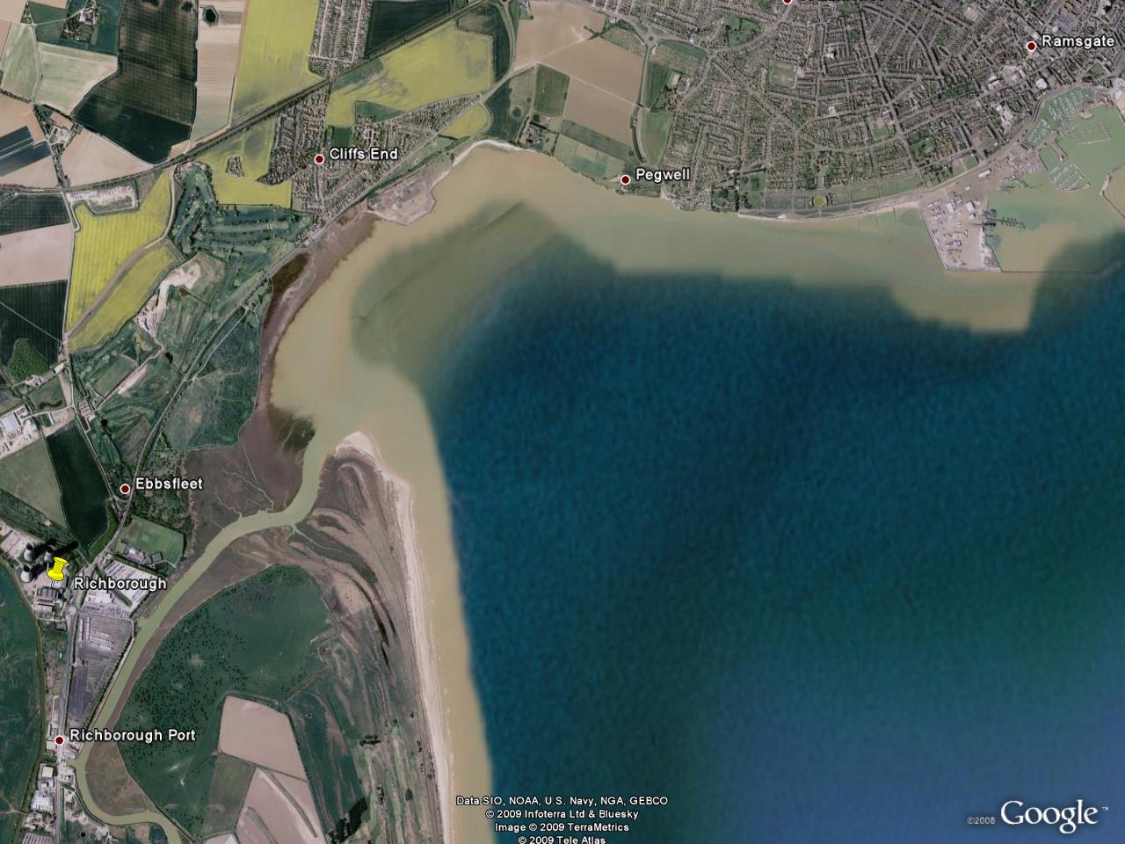
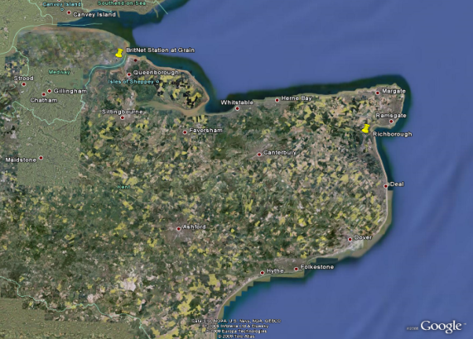
Geographical overview in UK
Nemo onshore cable route
(approx 2km)
Pegwell Bay (nature reserve)
Nemo offshore cable route
River Stour
Former Richborough
power station
30
30

Slide 31
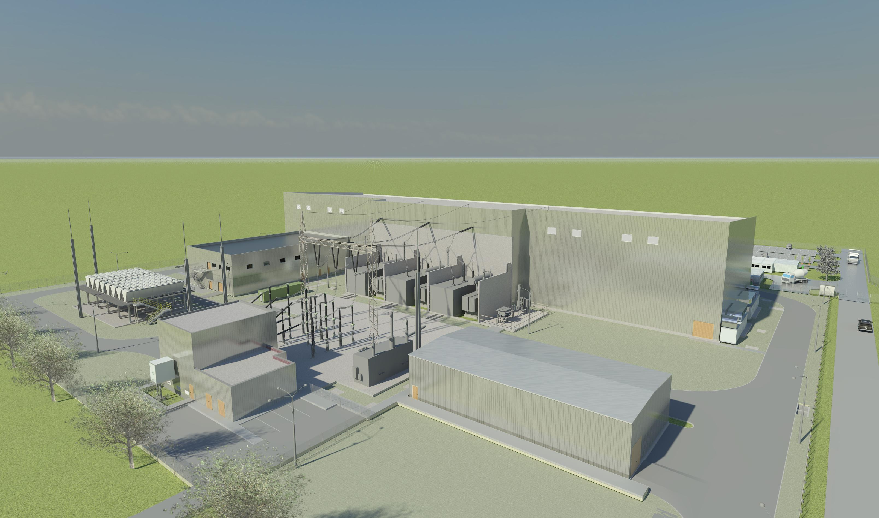
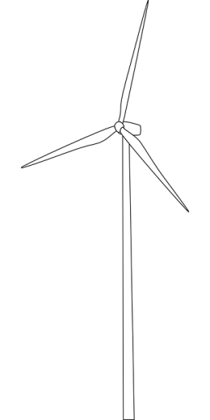
Converter Stations
Control Building
Transformers
Converter building
Cooling ventilator banks
GIS building (connection bay to Gezelle
in Belgium, and Richborough in GB)
Utilities Building
Spare Parts Building

Slide 32

Belgian converter station site: Herdersbrug
Nemo Converter station & laydown area

Slide 33
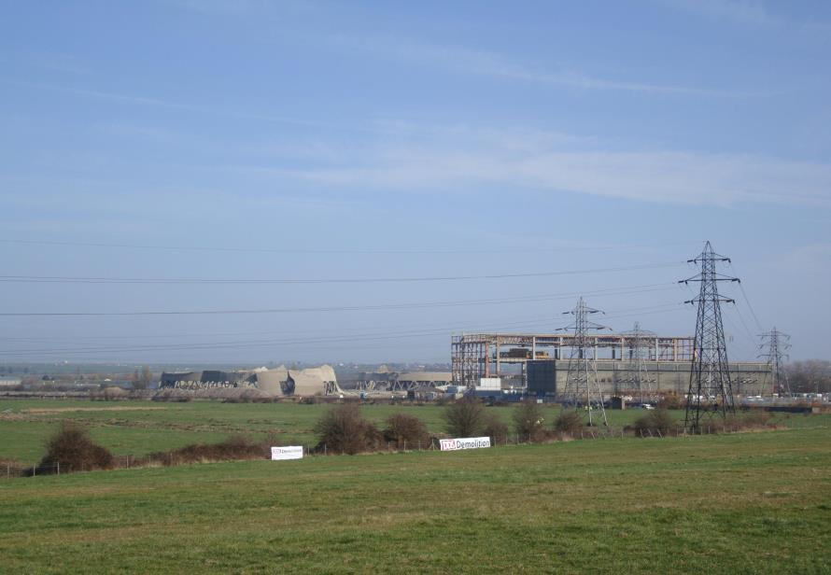
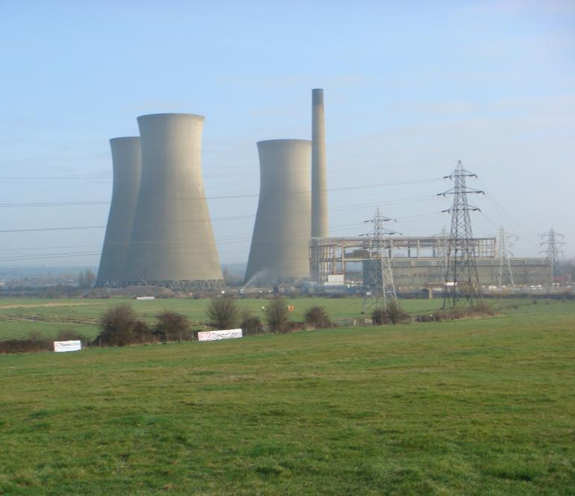
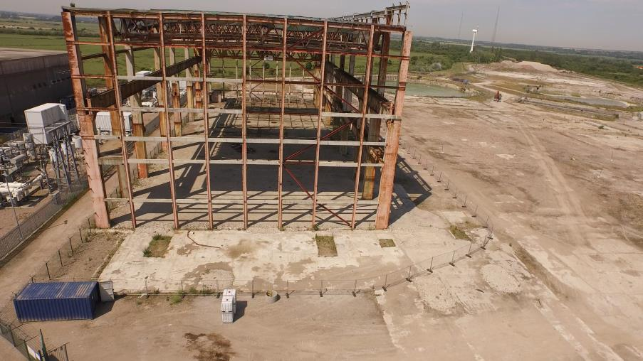
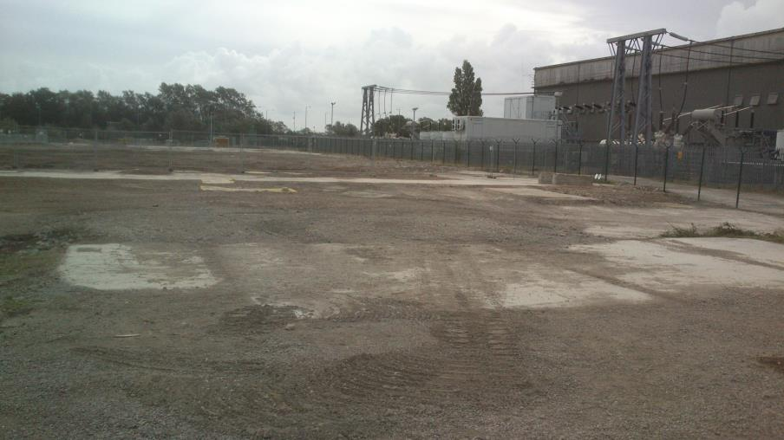
UK converter station site:
Richborough

Slide 34
Project Timeline
Go-Live

Slide 35
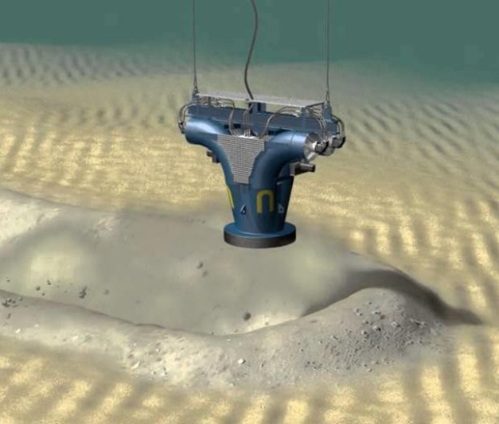


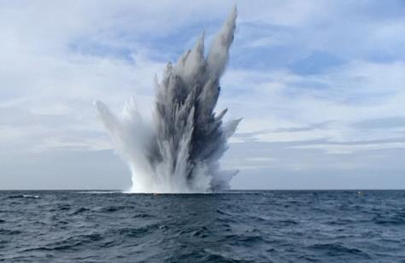

Some of the Construction Challenges
Seabed Conditions
The offshore weather challenge
Unexploded Ordnances (UXOs)
Permits/authorizations

Slide 36
End of part 1
Questions ?

Slide 37
Trading Framework
JAO will be selling Physical Long Term Transmission Rights (PTRs) in explicit auctions consistent with the FCA Guidelines
  The LTTR design has been consulted on and approved by regulators
PTRs give customers the right to nominate physical flow on the interconnector
Customers do not have to nominate capacity purchased in explicit auctions and can be remunerated at Loss Adjusted Day Ahead Market Spread under Use-it-or-sell-it (UIOSI) rules
Market parties may also benefit from capacity through cross border market coupling
JAO/ SAP
NEMO ( not Nemo Link)
Long Term
Capacity
Day Ahead
MRC
Intraday
XBID
Explicit Auction
(only capacity)
Implicit Auction
(capacity and energy)
Notes:
Customers ➔ Market parties in last bullet

Slide 38
  Treatment of Interconnector Losses
Capacity is defined at the mid-interconnector point
  When nominating, customers will have to provide a bit more on exporting and will receive a bit less on importing
    This is defined in the Long Term Nomination Rules
  If customers choose not to nominate they are compensated at the Loss Adjusted Day Ahead Market Spread
    This is defined in the GB-BE Border Specific Annex of the Harmonised Allocation Rules
The Nemo Link Loss Factor is expected to be ~2.6% and will be confirmed following commissioning
Notes:
Addition of “of the Harmonised Allocation Rules”

Slide 39
Current Auction Product Uncertainties
There are two areas currently in development through industry work-groups that will impact auctions:
  Market Splitting Rules
    Will determine the percentage of interconnector capacity reserved for different products (e.g. Annual/ Monthly/ Day Ahead)
    Another chance for market parties to input preferences on product suite during public consultation
  Long Term Capacity Calculation
    Will determine the amount of interconnector capacity available to be sold in long term timescales
Notes:
Deletion of “(LTTR design)” after “Market Splitting Rules”
Deletion of “Intraday” in “(e.g. Annual/ Monthly/ Day Ahead)”
Last bullet under Market Splitting Rules replaced by “Another chance for market parties to input preferences on product suite during public consultation”

Slide 40
Anticipated Initial Products*
*Subject to change
Q1 2019
Day Ahead
Only
Q2 2019
Rolling
Month Ahead
Q3 2019
Quarterly Product for Q4 2019
Q4 2019
Annual Product for 2020
2020
Intraday
(Wave 3 XBID)

Slide 41
Contractual Framework
Harmonised Allocation Rules (HAR)
Selling of capacity and billing
Harmonised Shadow Allocation Rules
Selling of capacity and billing where there is system failure or markets have de-coupled
Nemo
BSA
JAO Participation Agreement
Customer
JAO
For Customers
wishing to
Nominate
Channel LT Nomination Rules
Nomination of LT capacity
Nemo DA Nomination Rules
Nomination of DA capacity
Nemo
Annex
Customer
Nomination Participation Agreement
Nemo Link
Look out for the Consultation in May 2018

Slide 42
Nominating Capacity
In addition to the Nomination Participation Agreement, customers wishing to nominate capacity require additional agreements to be in place
GB | BE
Use of System Interconnector Agreement with National Grid Framework Agreement under the CUSC with National Grid Accession to the Framework Agreement under the BSC with Elexon Details of Production and Consumption Interconnector BMUs under the BSC. | ARP Contract

Slide 43

Systems Framework
    Forward Capacity Allocation (FCA)
    All TSOs must follow FCA guidelines for standardised allocation rules.
    Regional Nomination Platform (RNP)
    Channel Interconnector TSOs will provide a Platform to provide nomination and capacity management services
    Single Allocation Platform (SAP)
    European cross border capacity allocation, curtailment, settlement, invoicing and credit cover managed by SAP and operated by The Joint Allocation Office (JAO)
    Physical Transmission Rights
But SAP does not support nomination services and capacity management which are a vital component of the Physical Transmission Right.

Slide 44
Systems Framework (2)
SAP
Pan-European cross border trade
Operated by JAO
Single Allocation Platform
RNP
Manages nominations
Nemo Link/ Britned/ IFA
Operated by Unicorn
Regional Nomination Platform
NDS
Manages the interconnector
Operated by Nemo Link
Nemo Link Despatch System

Slide 45

Brexit Impacts
Brexit remains a big unknown
GB trying to remain within the Internal Energy Market and compliant with CACM and FCA
There may be political outcomes leading to GB no longer being part of the IEM
In this event, there may be a need to submit new allocation rules which will outline explicit auction processes

Slide 46
Historical Price Spreads (1)

Slide 47
Historical Price Spreads (2)

Slide 48
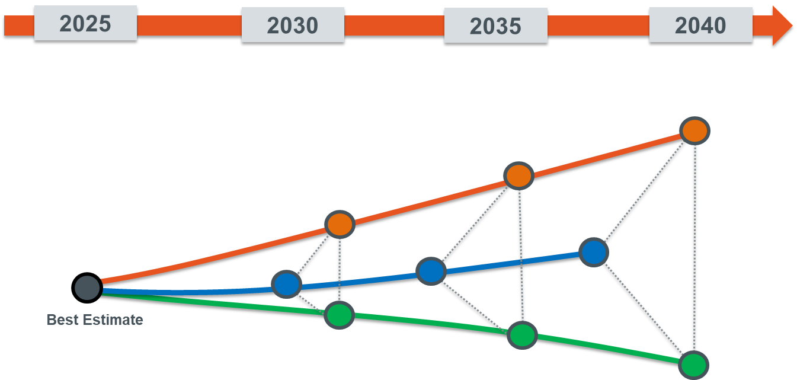
European Market Outlook
Future evolution of the European electricity system can be characterized using a set of scenarios based on European and national studies
=
Energy Transition lead by decentral RES development and driven by prosumers and high electrification
Decentral
=
Current trends & national policies reaching the 2030 RES targets
Base Case
Large Scale RES
=
Large Scale RES development path and driven by global climate policies and European cooperation
1 ’best-estimate’ scenario is considered for the European electricity system before 2025 with the latest forecasts from all TSOs
3 scenarios are considered for the European electricity system after 2025

Slide 49
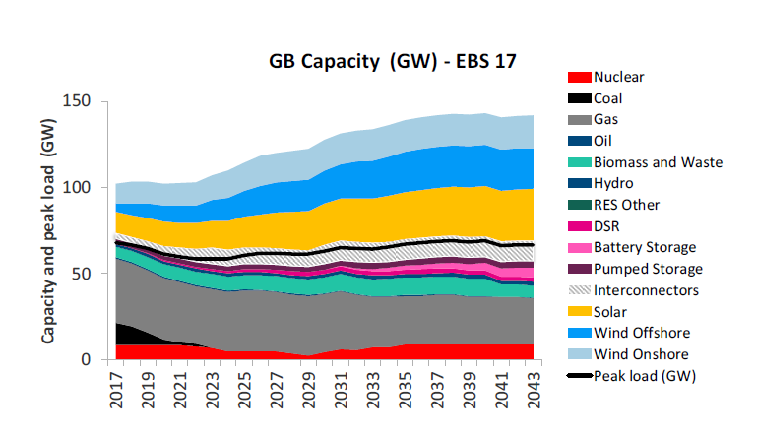


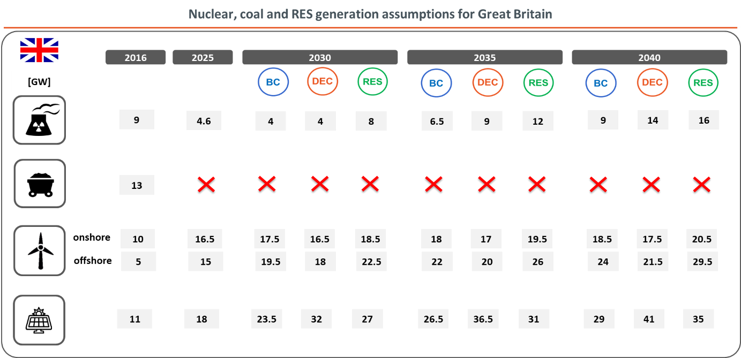
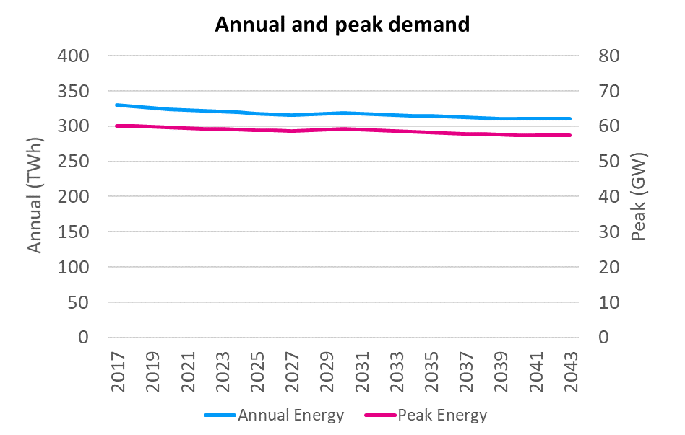

GB Market Outlook
Base Case
The assumption for GB market outlook are based on the latest ‘Future Energy Scenarios’ published each year by National Grid
Notes:
More RES than in previous TYNDP16 scenarios => upward push on need for ICs

Slide 50

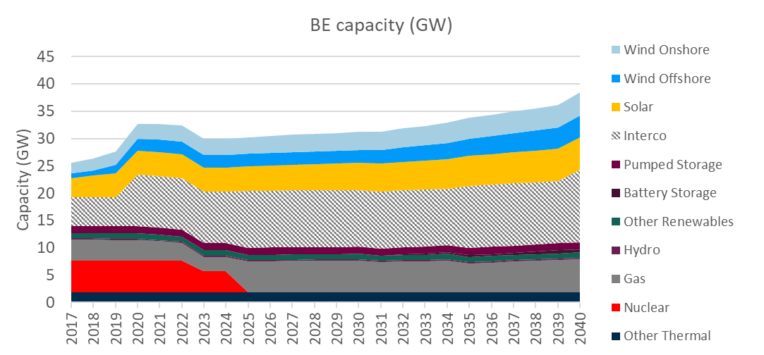

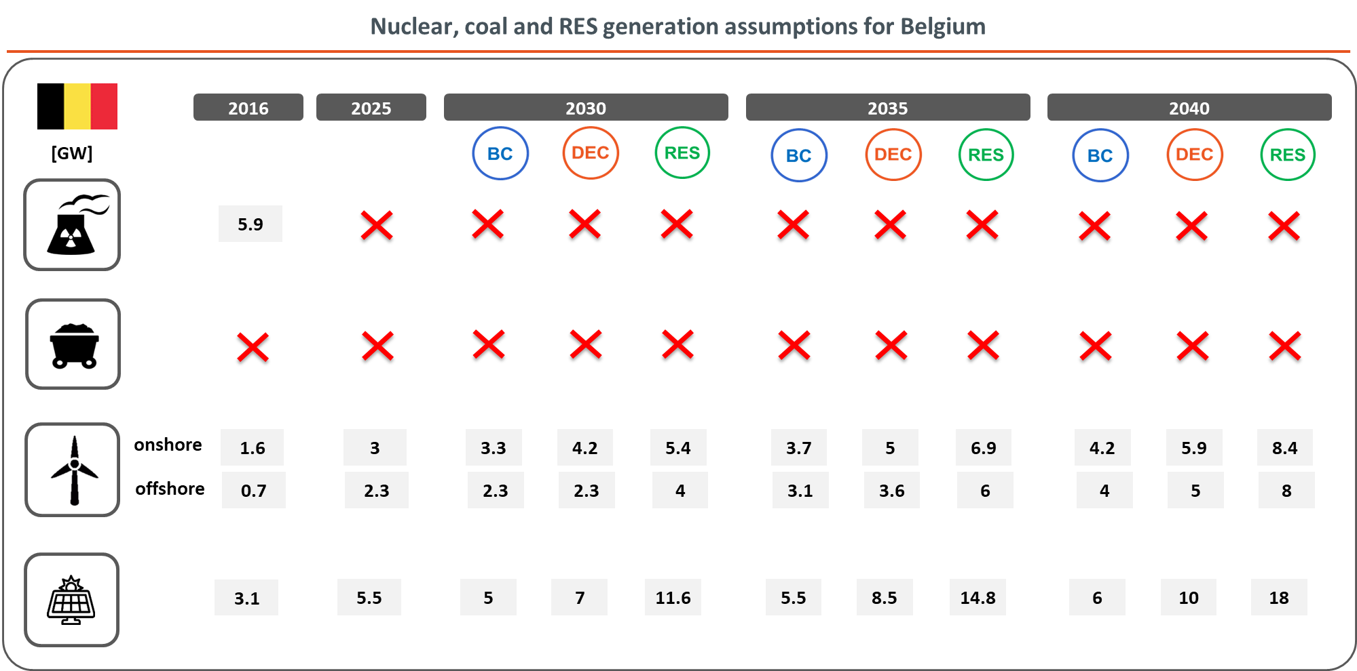
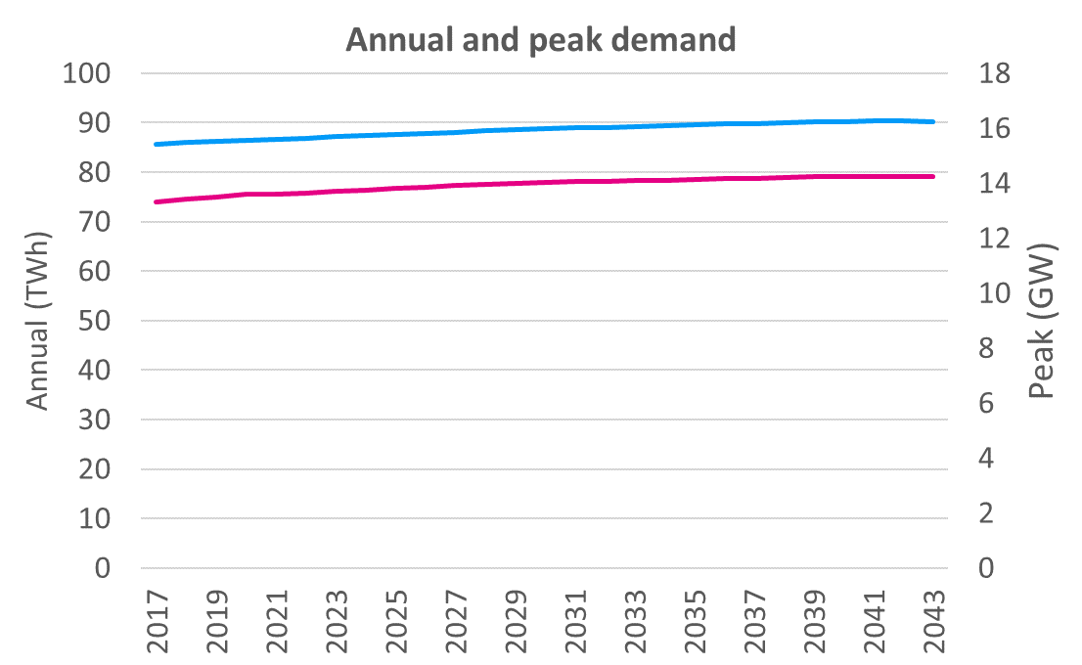
BE Market Outlook
Base Case
The assumption for BE market outlook are based on 3 main scenarios after 2025. See latest national study ‘Electricity Scenarios for Belgium Towards 2050’
Notes:
Gas/RES: increase in BE to compensate nuke/coal phase outs & towards EU-targets
More RES compared to TYNDP16 & MCM1 scenarios => increases SEW contribution in TYNDP18 for FRNB
RES scenario in line with national policy by applying last COP21 targets to Belgium

Slide 51
Wholesale prices GB + BE (Baringa)
Both Belgian and GB wholesale prices expected to rise in the near to medium term, driven by:
  Increasing commodity prices (gas, coal and carbon) and
  Increasing market tightness due to retirement of existing thermal and nuclear capacity
Prices in GB stay at a premium compared to Belgian prices mainly due to the existence of the Carbon Price Support
  SRMC of GB gas plant high relative to SRMC of continental thermal
  Last Budget statement indicated CPS would end when coal plant retire

Slide 52
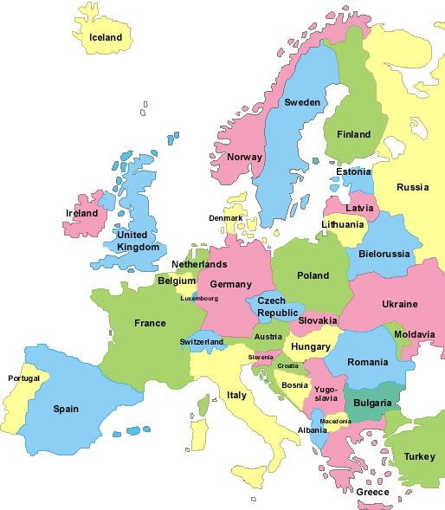
Belgium: Cross Border Traders’ Sweet Spot
Gas and Wind
Gas
Coal and Solar
Gas and Nuclear
Nuclear and Wind

Slide 53
Next Steps
Further communications to follow
  Register for the newsletter
Public consultation in May on*:
  HAR Border Specific Annex BE-GB
  DA Nomination Rules
  Nominations Participation Agreement
If you are interested in trading Nemo Link
  Contact us and/or your Key Account Manager to arrange a meeting
Systems testing in the summer/autumn
  Please contact Nemo Link if you wish to be involved
* In accordance with its GB Interconnector License Nemo Link Ltd shall consult in May on its entire Access Rules that include these 3 documents as well as documents already approved or consulted on (i.e. DA Fallback Allocation Rules, JAO Participation Agreement, LT Nomination Rules)
Notes:
Change to the reference to “Contractual framework consultation” by listing the documents to be consulted on and footnote clarifying the Access Rules consultation process.
Autumn added for systems testing

Slide 54

Contact us
For more information and general enquiries please email:
info@nemolink.co.uk
Write to us at:
Nemo Link Limited
Rue Joseph Stevens 7
1000 Brussels, Belgium
Or call us on:
0800 083 3149 9am – 5pm, Monday to Friday
Find out more at:
www.nemo-link.com
Nick Pittarello
Client Relationship Manager
Nick.Pittarello@nemolink.co.uk

Slide 55
Questions ?

Slide 56
Integration of Nemo: Impact on Elia Systems
Arbeitsstand
Jean-Michel Reghem – Product Manager EU Market
ARP-Day, 17/04/2018, Brussels

Slide 57

Long Term on Nemo Link
Elia
SAP
RNP
Rights info/MP for D
DB
PTRs for MP
(new, update, …)
All products
Notification of LT XB Nominated Capacity per MP for day D
Nomination window
for Day D
D-2 16:30 CET
D-1 9:30
DAFD
D
D-1 11:00
1/ ARP acquires PTRs on JAO Single Allocation Platform for LT Products
2/ ARP nominates (no obligation) in RNP (Mid-sea nomination)
→ Single Side Nomination: No need to nominate also in Elia systems
3/ Elia is updated by RNP with ARP nominations (Losses applied – Belgian side)
→ Nominated XB energy (BE value) added automatically to ARP DA balance perimeter
101,3 MW
100 MW
98,7 MW
Losses ~2,6%
GB
BE
Mid-interconnector

Slide 58
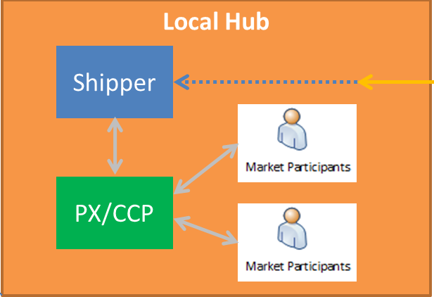
Day-ahead on Nemo Link
ARP: Sell/Buy bids on NP/Epex platfoms
Market Coupling DA allocation: Single Side Nomination on RNP for Shipper
As for BE-FR and BE-NL, ARP nominates sold or bought energy on local Hub to PX (Elia e-nomination) before D-1 14h

Slide 59
Day-ahead shadow auction on Nemo Link
In case of issue (decoupling …) with the DA Market Coupling, explicit fallback allocation will take place
Shadow auction: explicit allocation of Nemo Link Day-ahead capacity on JAO Single Allocation Platform
1/ ARP acquires DA PTRs on JAO Single Allocation Platform for DA products
2/ ARP nominates these DA PTRs on RNP (Single Side nomination)
→ Unlike DA Shadow Auctions on BE-FR and BE-NL, no nominations in Elia e-nominations
→ Mid-interconnector nominations: Losses to be applied
3/ RNP notifies DA explicit nominations to Elia Systems
→ Nominated XB energy (BE value) added automatically to ARP DA balance perimeter

Slide 60
Changes in ARP contract
Arbeitsstand
Thomas Van Den Broucke – Product Manager EU Market
ARP-Day, 17/04/2018, Brussels

Slide 61
Changes in the ARP contract:
Implementation of Nemo Link requires changes in the ARP contract
  New border BE-GB with its own specificities
  A specific ARP status related to an Offshore Interconnector
ARP-Day / Brussels, 17.04.2017

Slide 62
High level overview of the required changes in the ARP contract for Nemo Link
New GB-BE border
“ARP Offshore Interconnector”
Balancing for NLL as ARP_{OI}
Nom. procedures & losses on
BE-GB border
Import/Export on the BE-GB
Nemo Link will become an ARP Offshore Interconnector (ARP_{OI})
A new ARP status for which specific provisions related to an Offshore Interconnector will be included in the ARP Contract
Nemo Link as ARP_{OI}
Import/Export nominations on the BE-GB border
Nominations for PTRs with UIOSI* on Nemo Link ➔ by the ARPs on the Regional Nomination Platform (RNP)
The RNP is a nomination tool shared in Channel Region by Nemo Link, BritNed and IFA
ARPs must perform LT nominations directly in the RNP (not in the Elia system)
The nominated values in the RNP will directly be transferred by Elia into the balance perimeter of the ARP in Belgium
Nemo Link, as ARPOI, has to ensure the balance between:
Measured flow on the Offshore Interconnector on BE side
Programmed Import/Export flow as result of the market exchanges (on BE side)
Nemo Link will, as every other ARP
be able to access the local hub or market to restore its unbalanced position
be charged with regulated imbalance tariff
Nomination procedures for PTRs:
LT nomination rules for Nemo Link were consulted on and now under approval by the regulator
The value introduced in the balance perimeter of the ARP will be adjusted for the losses on the interconnector (described in LT nom rules)
* PTR: Physical Transmission Right, obtained via auctioning on JAO (Joint Allocation Office)
* UIOSI: use it or sell it
ARP-Day / Brussels, 17.04.2017

Slide 63
Timing and next steps on the changes in the ARP contract
Information was presented at WG Balancing of 30/09
Start of public consultation of the ARP contract on Friday 20th of April
Submission for regulatory approval mid June
ARP-Day / Brussels, 17.04.2017

Slide 64
Questions?

Slide 65
Thank you !
Lunch time

Slide 66
Afternoon Program
New file format B2B nomination between ARP and Elia
From ARP to BRP: future changes in roles and responsibilities services
Terms & Conditions BRP and BSP
Real Time Imbalance Volume Calculation

Slide 67
From Elia propietary to CIM standard
The evolution of E-Nomination
Arbeitsstand
François Jacquemin
ARP-Day, 17/04/2018, Brussels

Slide 68
E-Nomination
The electricity market imposes data that must be exchanged between the grid operator and the market players. For planning purposes, schedules for access to the Elia-grid have to be submitted in advance by market players. This could be achieved:
on Long Term or Day ahead Market (at least one day before execution);
on Intraday Market (on day itself, before execution).
These schedules allow the grid operator to plan the net security of the grid and to check the balance between injection and off-take.

Slide 69
E-Nomination
Elia has developed a scheduling system based on the XML messages. This system allows
Direct connection with Elia's servers for submitting schedules
Consultation of the status of previously submitted schedules
Safeguarding confidentiality.
Schedules can be generated in two different ways:
a "Business to Customer" interface (B2C) using a web browser interface (password required);
a "Business to Business" interface (B2B) using XML message transfer.

Slide 70
E-Nomination – B2B XML transfer
The XML that is currently being used supports a ELIA proprietary format.
In a time of Standardization for increased efficiency in IT services, Elia has decided to switch to :
The ENTSO-E CIM XML format. IEC 61970-552
Common Information Model (CIM) for Grid Models Exchange
The CIM for grid model exchange enables exchanges for the data necessary for regional or pan-European grid development studies, and for future processes related to network codes.
Specific ENTSO-E CIM standards have been defined to ensure the suitability of the CIM for ENTSO-E and to reflect the complexity of TSO data exchanges.

Slide 71
E-Nomination – IT agenda
During the months of September and October 2108, Each company that has a BRP contract with Elia
Each will receive a service package including :
A full documentation explaining in details the new format, and how it differs from the Current one
IT support when answers are needed.
The possibility to mutually agree on a testing period
A choice in production date
Elia will let BRP’s choose from several dates to switch to the new format between March 2019 and March 2020. The current format will be decommissioned on March 30th 2020.

Slide 72
Questions?

Slide 73
3) From ARP to BRP: future changes in roles and responsibilities services
Arbeitsstand
Sofie Van den Waeyenberg
ARP-Day, 17/04/2018, Brussels

Slide 74
Introduction
Current framework
Changing context
Future framework
Impact on the ARP/BRP

Slide 75
Current framework

Slide 76
Current framework: Roles & responsibilities
Grid User
Access Holder
Access Responsible party (& BRP_{source)}
Balance
CIPU signatory
AS provision
Mvar
Black Start
BSP
AS provision
Non-CIPU:
FCR/R1
Balancing Service Provider
BRP_{BSP}*
aFRR/R2
mFRR/R3
AS provision
FCR/R1
aFRR/R2 (pilot)
mFRR/R3

Slide 77
Current framework: ARP responsibilities in more detail (1)
1. Overview of ARP’s tasks and responsibilities
Balancing responsibility: ARP must foresee and deploy all means to be balanced on a qh basis
      In real time ARP may deviate of its balance in order to help the zone @ some conditions described in ARP contract.
      TSO may request BRP to prove the means he foresees to put in place
Nominations: Daily program must be balanced in DA
Obligation for ARP for units ≥ 25 MW to sign CIPU contract and to bid remaining margin
      If no CIPU contract, access to the grid may be refused
Varia:
      If there is no ARP on an access point, the access to the grid may be refused
      Grid losses are compensated by ARPs
      ARP must be active/reachable 24h/24, prove a financial guarantee and technical capability
      Pooling possible between two ARPs & Possibilities for multiple ARPs per access point described
Nominations @ physical injection/offtake to the grid:
- per access point to Elia grid *
- per DSO grid
- per CDSO grid
- separate nomination per CIPU unit*
be best estimate for offtake
Binding* for injection (return to schedule possible through CIPU procedures)
ID Updates only for CIPU units
Elia has the right to refuse/reject or adapt nominations if incoherencies and/or if risk for the grid security
Nominations of commercial exchanges
- exchanges on Belgian hub
- Imports & exports
ID updates possible
Must be coherent with nominations of counterparty
Sum of all nominations must be= 0 in DA

Slide 78
Current framework: ARP responsibilities in more detail (2)
2. ARP nominations – link with CIPU contract
The ARP is aware of all the large assets that may affect his portfolio balance and for which Elia receives schedules (via the CIPU contract signed by the ARP).
Both CIPU schedules and nominations on access point are used to verify the ARP’s portfolio balance
Example: 1 client site with local production units
ARP nominations
Demand facility
consumes
100 MW
Non-CIPU unit
generates
4,5 MW
Level: Access Point
95 MW
Non-CIPU unit
generates
0,5 MW
CIPU unit
generates
27 MW
CIPU unit
- 27 MW
Net offtake
=
68 MW

Slide 79
Use of flexibility and impact on BRPs perimeter
Anna: To keep as Back up slide
Any activation of flexibility on a flexibility unit results in a correction of the perimeter of the BRP having this unit in his portfolio. Several modalities exist today:
No correction at all for some exceptions: R3 non CIPU (till end 2018) and FCR
BRPs perimeter is corrected with the Requested Energy ➔ applicable when BRP and BSP are the same entity
    In practice for CIPU units
    Applicable for all kind of activations (balancing, congestion…)
BRPs perimeter is neutralised (corrected with Energy Delivered) ➔ only when TOE modalities are applicable
    Only for cases eligible for ToE
      mFRR only for the moment (in future extended to balancing* , DA/ID and SDR )
      Only netto offtake delivery point
BRPs is not corrected, but the Perimeter of the BRP associated to the BSP is corrected with the Requested Energy ➔ only when “opt out” modalities are applicable
    For all cases not foreseen in points 1→ 3
Activation of CIPU units (BRP and BSP are the same entity)
      BRP’s perimeter is corrected with Requested Energy (this is an incentive to correctly provide the requested volume)
      Valid as well for balancing as for congestion activations
For non CIPU units
    If unit eligible for TOE ➔ either ToE modalities either opt out modalities
    If not eligible for toE ➔ only opt out modalities

Slide 80
Changing context

Slide 81
A changing context: Drivers
Increasing needs for flexibility (volumes & volatility) to keep the system balance
Balancing Market opening to all technologies, players, voltage levels (TSO / DSO connected Grid Users)
new EU Network Codes
NOW
FUTURE
Central role for ARP as provider for Ancillary Services
EU Guidelines
Decentralization of roles and responsibilities
New Federal Grid Code
Regulated Terms & Conditions
Changing Energy Landscape
Opening of Markets

Slide 82
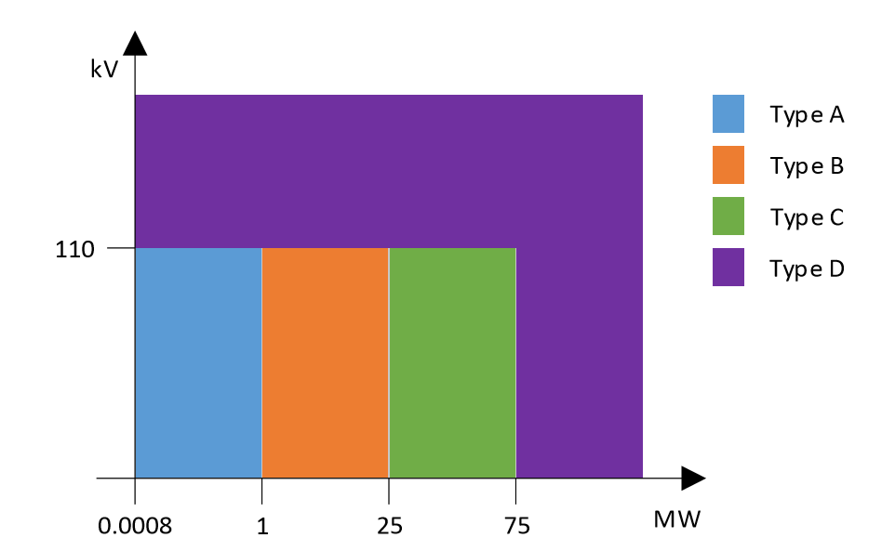
A changing context: PGM classification
Note that derogations are possible for implementation of connection code but not of operational/market codes

Slide 83
Future framework

Slide 84
Future roles & responsibilities
Grid User
Access Holder
Balance Responsible Party_{source}
Nominations
T&C BRP
T&C BSP
Currently in public consultation
Coordinating
Role
Balance Service Provider
Balance Responsible Party_{BSP}
FCR/R1
Reserved & non-reserved
aFRR/R2
mFRR/R3
Scheduling Agent
DA/ID Schedules
iCAROS project (ongoing)
Bidding for redispatching
Outage Planning Agent
Outage plans
Restoration Service Provider
Black Start Service
Projects in 2018
Defence Service Provider
‘Voltage Service Provider’
Mvar Service

Slide 85
Future roles & responsibilities – Obligations per asset type
Blue: demand
Purple: PGM & storage
Grid User
Access Holder
Balance Responsible Party_{source}
Nominations
Mandatory
Balance Service Provider
Balance Responsible Party_{BSP}
Voluntary
Mandatory type C/D
Voluntary type B
FCR/R1
Reserved & non-reserved
aFRR/R2
mFRR/R3
Scheduling Agent
DA/ID Schedules
If redispatching
Mandatory type B/C/D
Bidding for redispatching
Voluntary
Mandatory type B/C/D
Outage Planning Agent
Outage plans
Mandatory
Mandatory type B/C/D
Restoration Service Provider
Black Start Service
Defence Service Provider
‘Voltage Service Provider’
Mvar Service

Slide 86
From CIPU to iCAROS - From ARP to OP-Agent/S-Agent/BSP
ARP
Present
(CIPU)
CIPU
Large
Generation
(TSO-connected)
Availability plans
Scheduling
Redispatching flexibility
Free balancing bids
Red Zones Mechanism
Roles introduced by GL SO
Role introduced by
GL EB
Generation Load
Storage
Future
(iCAROS project)
Outage Planning Agent
Scheduling Agent
BSP
Availability plans
Scheduling
Redispatching flexibility
Free balancing bids
Congestion Risk Indicator (CRI)

Slide 87
Data Coherence & Grid User Coordination
Grid User can decide to appoint 1 entity for all roles or distribute the roles across different entities.
ELIA should receive coherent data as input for the different processes and will act as facilitator.
The Grid User plays a key role in coordinating the different parties that deliver this information to ELIA.
What? Who?
Outage Plans
Outage Planning Agent
Level: Asset
Generation / Consumption
Schedules
Scheduling Agent
Level: Asset
Generation / Consumption
Nominations
BRP
Level: Access Point
Net offtake / Net injection
Redispatching bids
Scheduling Agent
Level: Asset or Delivery Point
Generation / Consumption
Balancing bids
BSP
Level: Delivery Point
Generation / Consumption
Coherence needed
Coordination by Grid User

Slide 88
Timeline from Current to Future framework
CIPU
iCAROS implementation
Current Federal Grid Code
ARP central role in the provision of ancillary services to ELIA
Transition period
Party with BRP responsibility takes on role as Scheduling Agent and Outage Planning Agent (Proposal new Federal Grid Code art. 271)
Other ancillary services appointed via Terms & Conditions of the concerned service
Focus of this presentation
Future framework
Full implementation of new roles and responsibilities in the provision of ancillary services to ELIA

Slide 89
Impact on the ARP/BRP

Slide 90
Impact on the ARP/BRP: an overview
Responsibilities of the BRP
BRP vis-à-vis Scheduling Agent:
    BRP nominations vs Schedules
    Schedule firmness & Use of flexibility

Slide 91
Future framework: BRP responsibilities in more detail
1. Overview of BRP’s new tasks and responsibilities
Balancing responsibility: BRP must foresee and deploy all means to be balanced on a qh basis
      In real time ARP may deviate of its balance in order to help the zone @ some conditions described in BRP contract.
      TSO may request BRP to prove the means he foresees to put in place
      New : TSO may challenge him and impose means
Nominations: Daily balancing program must be balanced in DA
Obligation for ARP for units ≥ 25 MW to sign CIPU contract and to bid remaining margin
      If no CIPU contract, access to the grid may be refused
Varia:
      If there is no BRP on an acces point, the acces to the grid may be refused
      Grid losses are compensated by BRPs
      BRP must be active/reachable 24h/24, prove a financial guarantee and technical capability
      Pooling possible between two BRPs & Possibilities for multiple BRPs per access point described
NEW
NEW
Nominations @ physical injection/offtake to the grid:
- per access point to Elia grid *
- per DSO grid
- per CDSO grid
- separate nomination per CIPU unit*
be best estimate for offtake
Binding* for injection (return to schedule possible through CIPU procedures)
Nominations for physical injection/offtake become technology neutral.
Responsibilities relative to PGMs scheduling moved towards SA
ID Updates only for CIPU units
NEW
Elia has the right to refuse/reject or adapt nominations if incoherencies and/or if risk for the grid security
Nominations of commercial exchanges
- exchanges on Belgian hub
- Imports & exports
ID updates possible
Must be coherent with nominations of counterparty
Also if incoherencies with schedules and Outage planning
NEW
Sum of all nominations must be= 0 in DA
Obligation for BSP for units ≥ 25 MW & for Scheduling Agent of PGMs B,C,D to bid remaining margin
      Obligation for GU to designate them
      If no BSP and SA contracts, access to the grid may be refused
      In case of activation, BRP is informed of the activated energy in his portfolio
NEW

Slide 92
BRP – Scheduling Agent: BRP nominations vs Schedules
2. BRP nominations – link with schedules of the Scheduling Agent
The BRP is no longer by default aware of all the large assets that may affect his portfolio balance and for which Elia receives schedules (unless if the same party that is BRP also takes on the role of Scheduling Agent).
    Split between schedules on asset level and BRP nominations on access point level
NEW
Example: 1 client site with local production units
Scheduling Agent’s schedules
Demand facility
consumes
100 MW
PGM (type B)
4,5 MW
PGM (type B)
generates
4,5 MW
PGM (type C)
27 MW
PGM (type A)
generates
0,5 MW
BRP’s Nominations
PGM (type C)
generates
27 MW
Level: Access Point
68 MW
Net offtake
=
68 MW

Slide 93
BRP – Scheduling Agent: Schedule firmness & Use of flexibility
The scheduled use of active power must be informed to ELIA by the Scheduling Agent via Day-ahead and Intraday Scheduling:
  Schedules are binding and redispatching bids are firm. Both can be updated until the scheduling deadline *
  ELIA updates the schedule when ELIA activates flexibility for redispatching or balancing
    ELIA corrects the BRP perimeter accordingly when activating flexibility for redispatching or balancing
    ELIA informs the BRP at the level of its portfolio
  Real-time firmness: schedule deviations that can create or aggravate congestion risk are not allowed
    Return-to-schedule demanded by ELIA: no correction of BRP perimeter
    No use of flexibility by the BRP in (near) real-time in congestion sensitive areas (as is the case today)
* Condition explained in scheduling design note on coordination of assets

Slide 94
Summary

Slide 95
Summary
… in the future “CIPU” will be a term of the past
… the CIPU contract will be replaced by multiple contracts (incl. Terms & Conditions)
(~ similar to evolutions with respect to BSP/BRP)
… the EU guidelines have given us some new roles and responsibilities
… these new roles can must be appointed by the Grid User, to either one entity or to multiple entities
(taking into account the rules for appointment of roles)
… in the future the ARP/BRP will no longer by definition play the central role in the provision of ancillary services
… the role and responsibilities of the ARP will be divided among a new set of roles (incl. Outage Planning Agent, Scheduling Agent, …)
The future changes in roles and responsibilities will affect the ARP towards a focus on BRP responsibilities:
… with a difference between BRP nominations and Scheduling Agent’s schedules
… with other roles responsible for bidding flexibility for redispatching (Scheduling Agent) and for balancing (BSP)
… with the BRP informed of flexibility activations on the level of its portfolio
… with interdependencies between the different data flows and thereby a necessary coordination by the Grid User between the roles
95

Slide 96
Questions?

Slide 97
4) Terms & Conditions BRP and BSP
Arbeitsstand
Anna Tsiokanos & Amandine Leroux
ARP-Day, 17/04/2018, Brussels

Slide 98
Context and Introduction

Slide 99
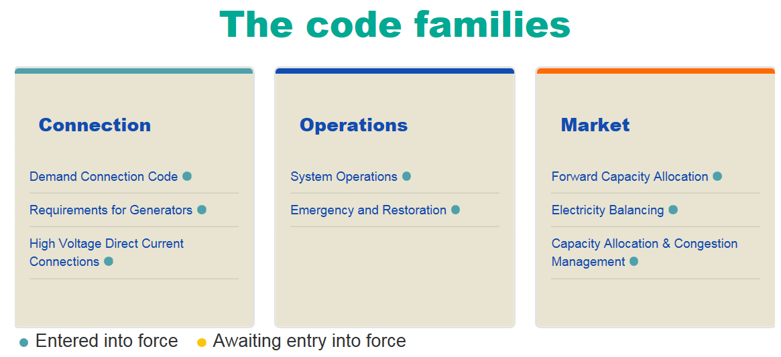
European Context
Electricty Balancing Guideline (EBGL): each TSO shall submit the national regulator (CREG ) two draft proposals by 6 months after EIF:
Terms and Conditions for Balancing Responsible Party
Terms and Conditions for Balancing Service Provider
Deadline 18 June 2018
Emergency and Restoration Guideline (E&R): each TSO shall submit rules for market suspension and restoration 1 year after EIF:
addendum in T&C for Balancing Responsible Party
addendum in T&C for Balancing Service Provider
Deadline 18 Decembrer 2018

Slide 100
Future framework - 3 regulated documents
EB GL
Federal Grid Code
Art 18.6
Art 18.5
BRP contract
TSO
BSP contracts
General conditions
General conditions
Balancing Rules
All means ( IGCC, inter-TSO )
Exact merit order
Transparency
Monitoring
T&C BRP
Based on: Art 18.6 of EBGL
T&C BSP
Based on: Art 18,5 of EBGL
Annexes
Annexes
Bal. Rules: (chap 6→ end)
Market rules for TSO
Chap 1-5 of Balancing rules are not anymore relevant as redundant with regulated T&C BSP
Basis of BRP contract = current regulated ARP contract
Basis =
Current non regulated GFAs for T&C
General Terms & Conditions for Ancillary Services for the rest

Slide 101
2018
Mar
Today
May
Jul
Sep
Nov
2019
Mar
2019
BRP Contract
Submission V1.1
Submission V 1.2
Expected EIF T&C BRP
In // with FGC
15/3 – 15/5
20/09 – 15/11
Public cons. T&C BRP V1.1
18/6
Public cons. T&C BRP V1.2
12/18
Q1 2019
No content changes compared to version last of ARP contract
Terminology alignment with EBGL
Reorganization of chapters
Imposed by E&R: related to Market suspension/restoration
END of ARP Contract
Q1/2019
BSP Contract
Expected EIF T&C BSP
In // with FGC
Sumbission V1.2 to CREG
Submission V1.1 to CREG
12/18/2018
15/3 – 15/5
18/6
20/9 - 15/11
12/18/2018
Q1/2019
Public Cons. T&C BSP V1.1
Public Cons. T&C BSP V1.2
Submission Bal Rules to CREG
Q1/2019
No content change (design mFRR 1/4/2018)
Imposed by E&R
EIF Bal Rules
Adapted in order to be compliant with T&C BSP
Q1/2019
End of current GFAs
Rem: Dates are indicative and could be subject to further adaptations

Slide 102
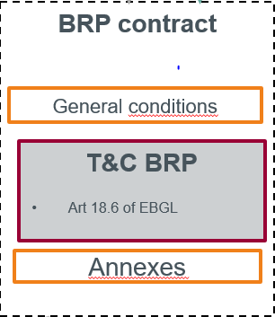
BRP Contract

Slide 103
T&C BRP – Approach
Align terminology with EBGL terminology:
  Ex: BRP instead of ARP, terms such as “position”, “schedule” “allocation” … have a specific signification in EBGL
  Impact on chapter “nominations” (art 12,13 + annexes 1&5)
  Impact on cahpters “calculation of imbalance” (= allocations + position + adjustment) (art 10 + annex 3)
  Regroup in a same section all articles relative to mandatory topic art 18,6 of EBGL.
  ex. “Requirements to become BRP in T&C “ will contain “Financial Solvency” (Art 4 of ARP contract ) & “Payment guarantee” (Art 17 of BRP contract)
Separate general conditions and Terms and Conditions (core obligations of BRP)
  Contractual articles of ARP contract ( “administrative procedure in case of disputes”, “contact information”) in General Conditions.
  “Core” annexes in T&C BRP ( annex 1,3,5 on imbalance calculation and on nominations moved in T&C)
  Ex: “financial guarantee”: principles in T&C BRP & administrative procedure/bank number in Annex
evolution of the ARP contract towards a more logical and more conform to EBGL structure.
the content of each existing Article of current ARP contract remains quasi unchanged
A mapping is provided to facilitate stakeholder reception.

Slide 104

BRP Contract
…Compliancy with EBGL…
BRP Contract
EBGL art 18,6 | Section of T&C BRP
a. Definition Balancing responsibility | X.
b. Requirements to become BRP | XI.
c. BRP imbalance financial responsibility requirement | XI.
d. BRP data and information requirements | XII.
e. Rules for schedule change linked to IDGCT | XII.
f. BRP settlement rules | XIV.
g. imbalance price area delineation | IX.
h. BRP settlement finalisation duration rules | XIV.
i. T&C BRP non-compliance consequences | XI.
j. Obligation for submission of balance position modifications | XIII.
k. BRP settlement rules (bis) | XIV.
l. HVDC ramping restriction | N.A.
General Conditions
Definitions and scope of the BRP contract
Invoicing and payment
Liabilities
Emergency situation or force majeure
Confidentiality
Termination or suspension
Miscellaneous conditions
Settlement of disputes
Terms and Conditions BRP
Imbalance area
Balancing responsibilities
Requirements for becoming a BRP
Imbalance calculation
Daily Balancing Program
Imbalance settlement
Appendices

Slide 105
Link between ARP contract and BRP contract
Existing titles and subtitles of ARP contract are kept
Art. | Title ARP contract | New Art. BRP | Title in BRP Contract
1 | Definitions | 1 | Definitions
2 | Additional rules of interpretation | 4 | Additional rules of interpretation
3 | Scope of the Contract | 2 | Scope of the Contract
4 | Proof of the financial solvency of [ARP] | 16 | Proof of the financial solvency of [BRP]
5 | Invoicing and payment terms | 5 | Invoicing and payment terms
6 | Notification to third parties of confidential or commercial sensitive information | 8 | Notification to third parties of confidential or commercial sensitive information
7 | Settlement of disputes | 11 | Settlement of disputes
8 | Measures in case of an emergency situation or force majeure | 7 | Measures in case of an emergency situation or force majeure
9 | Termination or suspension of the Contract | 9 | Termination or suspension of the BRP Contract
10 | Balancing obligations of [ARP] | 15 | Balancing obligations of [BRP]
11 | Allocation to the Balancing Perimeter | 14 | The Balancing Perimeter of BRP
 |  | 19 | Attribution to the Balancing Perimeter
12 | Nominations | 23 | Daily Balancing Program
13 | Complete or partial refusal of Nominations on Day D-1 and complete or partial suspension of Nominations on Day D | 26 | Complete or partial refusal of the Daily Balancing Program on Day D-1 and complete or partial suspension of the Daily Balancing Program on Day D
14 | Suspensive conditions affecting the execution of this Contract | 18 | Suspensive conditions affecting the execution of this BRP Contract
15 | Duration of this Contract | 3 | Duration of this Contract
16 | Tariffs | 28 | Tariffs
17 | Payment guarantee | 17 | Payment guarantee
18 | Data exchange | 21 | Data exchange
19 | Pooling Agreement | 22 | Pooling Agreement
20 | Liability | 6 | Liability
21 | Miscellaneous conditions | 10 | Miscellaneous conditions

Slide 106
Link between ARP contract and BRP contract: Appendices
Existing titles and subtitles of ARP contract are kept
Art. | Title ARP contract | New Art. BRP | Title in BRP Contract
Ap. 1 | Transmission Rights for Import and Export | 27 | Transmission Rights for Import and Export
Ap. 3 | Imbalance | 20 | Imbalance
Ap. 4 | Amount of the required financial guarantee | 17.4 | Amount of the required financial guarantee
 | Standard Bank Guarantee form related to the Contract | Appendix 1 | Standard Bank Guarantee form related to the BRP Contract
Ap. 5 | Procedure for Nominations | 24 | Procedure for the submission of the Daily Balancing Program
 | Nomination system | 25 | System with regards to the submission of the Daily Balancing Program
Ap. 6 | Contact Information | Appendix 2 | Contact Information
Ap. 7 | Pooling Agreement | Appendix 3 | Pooling Agreement
Ap. 8 | Tariff Structure and Invoicing Process | 29 | Tariff Structure and Invoicing Process

Slide 107
T&C BRP – Terminology
The definitions of the current ARP contract are aligned to a maximum extent with terminology of the European guideline on electricity balancing:
Replacement of the term "position" with "allocation“ throughout the BRP contract
Replacement of the term “Access Responsible Party” or “ARP” by the term “Balancing Responsible Party” or “BRP” in the entire BRP Contract
Replacement of the terms
  “rescue code” by “system defence plan ”
  “restoration code” by “restoration plan ”
Elia aligns the BRP Contract with the terminology of the European network code EBGL and introduces following new definitions:
  “External commercial trade schedules”
  “Internal commercial trade schedules”

Slide 108
T&C BRP – new Terminology
The Balancing perimeter of BRP consists of: | The Daily Balanced Program of BRP consists of:
The Allocations: Access points to the Elia Grid; and/or Distribution Offtake-Allocation(s) (ex. Position) Offtake and/or Injection Allocations CDS Grid losses | The Nominations (taking into account the losses ) Nominations on Access Point to Elia grid Nominations for the overall offtake/or injection on a distribution network; and / or Nominations for the overall offtake and/or injection on one or more Closed Distribution Grids
Commercial Trades External commercial trade (=Import/export ) (=last update of schedule) Internal commercial trade (=last update of schedule) | The Commercial Trade schedules External commercial trade schedules (import and/or export) and/or; Internal commercial trade schedules
The imbalance adjustment The correction of the Balancing perimeter in case of activation (ex. For balancing services)

Slide 109
2018
Mar
Today
May
Jul
Sep
Nov
2019
Mar
2019
BRP Contract
Submission V1.1
Submission V 1.2
Expected EIF T&C BRP
In // with FGC
3/15/2018 - 5/15/2018
20/09 – 15/11
Public cons. T&C BRP V1.1
6/18
Public cons. T&C BRP V1.2
12/18
Q1 2019
No content changes compared to version last of ARP contract
Terminology alignment with EBGL
Reorganization of chapters
Imposed by E&R: related to Market suspension/restoration
Inclusion of TC NLL, ToE mFRR , SDR
Offshore modalities
last Submission to CREG
Submission to CREG
ARP Contract
Public Cons. ARP Contract
END of ARP Contract
3/19
4/20- 5/18
6/15
Q1/2019
Offshore interconnector
ToE - reserved mFRR - non CIPU
SDR baseline
Rem: Dates are indicative and could be subject to further adaptations

Slide 110
BSP Contracts

Slide 111

Content of T&C for Balancing Service Provider
EBGL art 18.5
a. BSP qualification process rules
b. Balancing capacity procurement and transfer rules
c. Rules to become BSP
d. BSP data and information requirements
e. Rules on BSP-BRP relation
f. BSP data and information requirements for evaluating provisions
g. Location definitions
h. Rules for determining settlement volumes
i. Settlement rules for balancing capacity and balancing energy
j. BSP settlement finalization duration rules
k. T&C BSP Non-compliance consequences
The content of the Terms & Conditions should fulfil specifications of Art. 18 §5
Current General Framework Agreements for ancillary services, as published on ELIA website, are fully compliant with those content requirements
ELIA Draft proposals for T&C BSP is mainly an update of current GFAs to comply with new legal framework and lead to Regulated Terms & Conditions

Slide 112
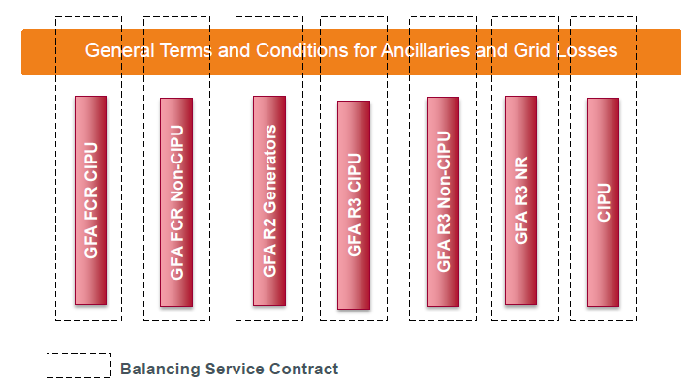
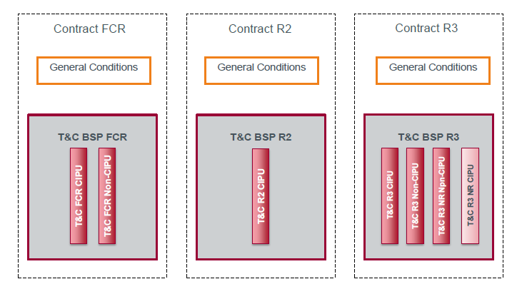

Current GFA structure vs T&C organization
Non-regulated GFAs
New structure aims to
Facilitate reading for BSP
Comply with EBGL requisites
Provide flexibility for future consultations
Align terminology (BSP, Capacity/Energy Bids,… )
Regulated contracts for balancing services
KEY Principles
Ensure a one-to-one correspondance between current GFA and T&C
Maitain a “per type of provider” structure (generation / demand response)
Ensure coherence by grouping T&C per type of Balancing Service : FCR, R2 and R3
  Allow flexibility for consultation

Slide 113
BSP Contracts – New structure proposal
FCR
aFRR
mFRR
General Terms and Conditions for Ancillaries and Grid Losses
“New” T&C R3 NR CIPU
Required by EBGL
Scope is limited to “free bids” CIPU for intraday balancing purposes
Design wise : only translation of current CIPU contract, nothing new
No impact on CIPU contract
Current GFAs FCR (CIPU & non-CIPU), R2 (CIPU), R3 (CIPU & non-CIPU) and R3 NR (non-CIPU)

Slide 114
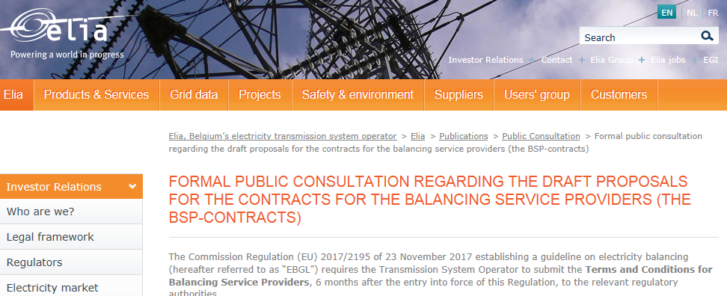

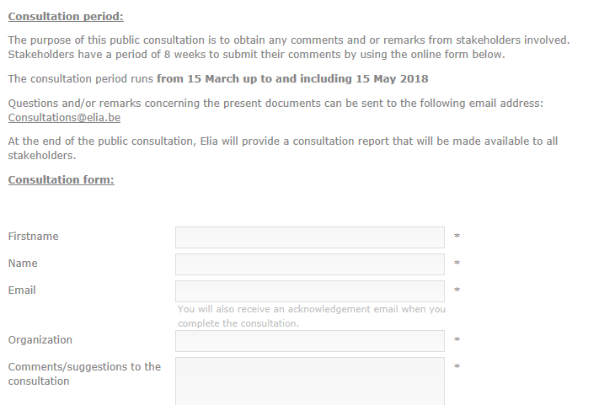
Additional Information
Ongoing consultation on ELIA proposal
Detailed information in explanatory document
Deadline to submit your feedback via online web form : 15 May 2018
BRP: http://www.elia.be/en/about-elia/publications/Public-Consultation/Formal-consultation-on-the-draft-proposal-for-the-Balancing-Responsible-party-contract-brp
BSP: http://www.elia.be/en/about-elia/publications/Public-Consultation/Formal-public-consultation-regarding-the-draft-proposals-for-the-contracts-bsp

Slide 115
2018
Mar
May
Jul
Sep
Nov
2019
Mar
2019
BSP Contract
Expected EIF T&C BSP
In // with FGC
3/15/2018 - 5/15/2018
Submission V1.2 to CREG
9/20 - 12/15
Sumbission V1.2 to CREG
6/18/2018
12/18/2018
Q1/2019
Public Cons. T&C BSP V1.1
Public Cons. T&C BSP V1.2
12/18/2018
Q1/2019
No content change (design mFRR 1/4/2018)
Imposed by E&R
Submission Bal Rules to CREG
EIF Bal Rules
Refresh last design:
  R3 ToE +CMO
  Bal price cap
  R1 daily sourcing
Adapted in order to be with T&C BSP
6/20/2018
Mid Sept
Dec/2018
Submission Bal Rules to CREG
expected approval
EIF - ToE reserved mFRR non CIPU + CMO
R3 2018 (ToE + CMO)
bal price cap
Daily regional auctions for FCR
GFA cons. + signature
Also linked to approval of ToE Rules V2
Rem: Dates are indicative and could be subject to further adaptations

Slide 116
Questions?

Slide 117
5) Real Time Imbalance Volume Calculation
Arbeitsstand
David Zenner
ARP-Day, 17/04/2018, Brussels

Slide 118
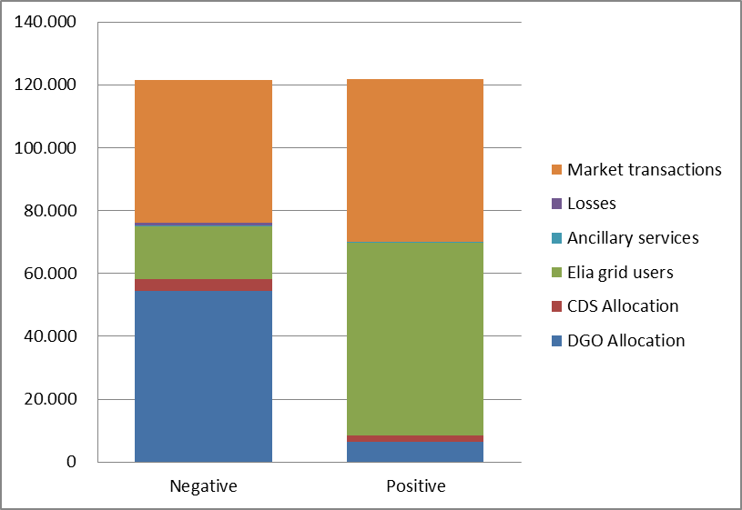
Imbalance position of a BRP
Allocation DSO
Allocation CDS
Grid Users Elia
Activation AS
Market Transacties

Slide 119
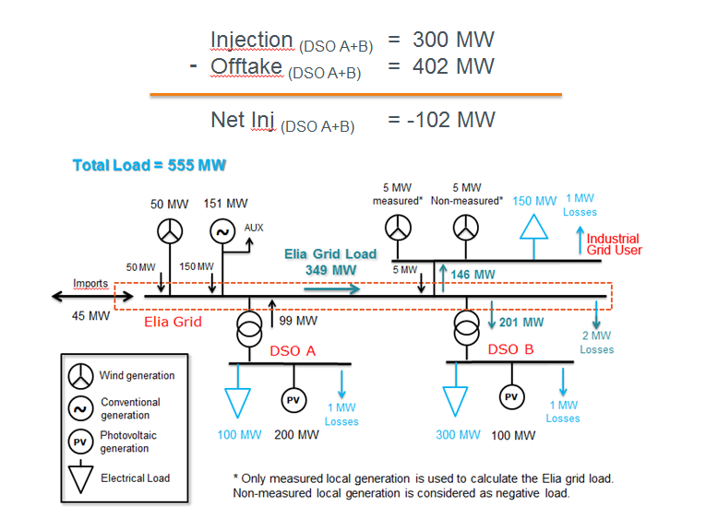
Allocation DSO
Allocation DSO
Allocation CDS
Grid Users Elia
Activation AS
Market Transactions
Concertation with Synergrid:
DSOs do not dispose of RT measurement of their customers (AMR-info on D+1)
Big part of the DSO-customers are not quarter-hour measured (SLP-customers)
Elia started an internal analyses based on:
RT infeed as published on our website
Historical allocation data (available M+1)
Comparison of the result with the average
imbalance of each BRP

Slide 120
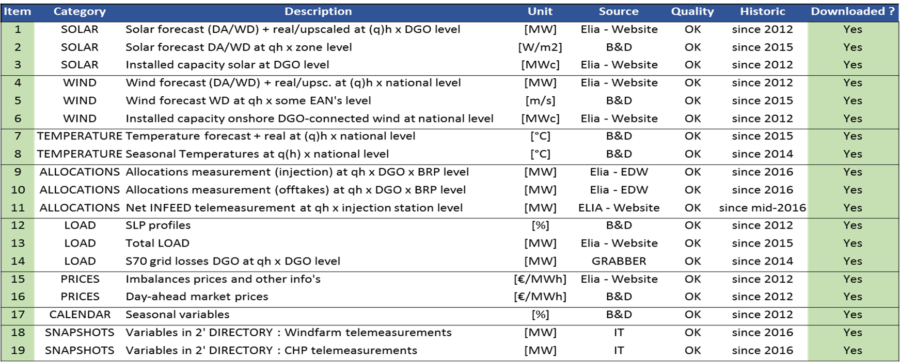
Allocation DSO: input data
Allocation DSO
Allocation CDS
Grid Users Elia
Activation AS
Market Transactions

Slide 121

Allocation DSO: data visualisation
Allocation DSO
Allocation CDS
Grid Users Elia
Activation AS
Market Transactions
Key point : Depending on DGO and/or BRP - BRP portfolio sensitivity wrt to a specific variable (wind, solar, …) can be very different => these disparities should be captured by a model

Slide 122

Allocation DSO: data visualisation
Allocation DSO
Allocation CDS
Grid Users Elia
Activation AS
Market Transactions
Key point : Depending on DGO and/or BRP - BRP portfolio sensitivity wrt to a specific variable (wind, solar, …) can be very different => these disparities should be captured by a model

Slide 123

Allocation DSO: data visualisation
Allocation DSO
Allocation CDS
Grid Users Elia
Activation AS
Market Transactions
Some trends are also depending on the DSO

Slide 124

Allocation DSO: sunday 30/04/17
Allocation DSO
Allocation CDS
Grid Users Elia
Activation AS
Market Transactions

Slide 125

Allocation DSO: sunday 30/04/17
Allocation DSO
Allocation CDS
Grid Users Elia
Activation AS
Market Transactions

Slide 126

Allocation DSO: injection BRP – friday 31/03/17
Allocation DSO
Allocation CDS
Grid Users Elia
Activation AS
Market Transactions

Slide 127

Allocation DSO: high DA-price
Allocation DSO
Allocation CDS
Grid Users Elia
Activation AS
Market Transactions

Slide 128

Allocation DSO: results ‘large’ BRP
Allocation DSO
Allocation CDS
Grid Users Elia
Activation AS
Market Transactions

Slide 129

Allocation DSO: results ‘medium large’ BRP
Allocation DSO
Allocation CDS
Grid Users Elia
Activation AS
Market Transactions

Slide 130

Allocation DSO: results ‘small’ BRPs
Allocation DSO
Allocation CDS
Grid Users Elia
Activation AS
Market Transactions

Slide 131

Allocation DSO: results per month
Allocation DSO
Allocation CDS
Grid Users Elia
Activation AS
Market Transactions

Slide 132

Allocation DSO: extra analysis & findings
Allocation DSO
Allocation CDS
Grid Users Elia
Activation AS
Market Transactions
Results are independent of the imbalance of the zone: same results are obtained if we focus on quarters where the zone imbalance was bigger than 200 MW
Results are independent of the imbalance of the BRP: no correlation between the error and the imbalance of the BRP
RT injection measurement of the DSO doesn’t give substantial improvement to the model
Model has still problems with the allocation of January wrt the switches between BRPs (till half of February when the new allocation is ready)

Slide 133


Grid Users Elia
Allocatie DNB
Allocatie CDS
Netgebruikers Elia
Activaties AS
Markttransacties
Mix of 2 solutions:
Telemetering (where available and of good quality)
  Niet elke netgebruiker heeft telemetingen op zijn toegangspunt
  Bepaalde telemetingen geven stroom, maar niet vermogen (+ richting)
  Nauwkeurigheid van telemetingen?
  Up-to-date houden van register en formules?
Measurements every 15min
  Base for the invoice
  Precision OK
  Register and formulas are existing, just adaptations needed for continuous communication
  Adaptation of the meter (APN-network or IP)

Slide 134
Allocation CDS connected to the Elia grid
Allocation DSO
Allocation CDS
Grid Users Elia
Activation AS
Market Transactions
CDS who are executing themselves the allocation: model DSO will be applied
In case Elia is performing the allocation for the CD: same approach as for Elia Grid Users

Slide 135
Activation AS
Allocation DSO
Allocation CDS
Grid Users Elia
Activation AS
Market Transactions
Correction of the perimeter for activations of:
R2: available and aggregated within the EMS of Elia
R3 & free bids: available in the tool Probid
Impact of ToE Elia Grid Users → correction of the perimeter of the ARP_{source} based on the notification of the BSP in geval
Impact of ToE DSO Grid Users → relevance of taking this in account to be analyzed (dependent on the precision of the used model)

Slide 136
Market Transactions
Allocation DSO
Allocation CDS
Grid Users Elia
Activation AS
Market Transactions
All transactions are available in our tool NXPRO,
As long as they were nominated by the BRP (time till D+1 14h)
Day ahead nominations
Intra-day nominations OTC (as long as communicated by the BRP)
Day ahead XB
Intra-day XB

Slide 137

Implementation
IT developments necessary
Allocation DSO
Allocation CDS
Grid Users Elia
Activation AS
Market Transactions
Adaptations to existing installations necessary

Slide 138
Questions?

Slide 139
Brussels, 17/04/2018

